Slide 1
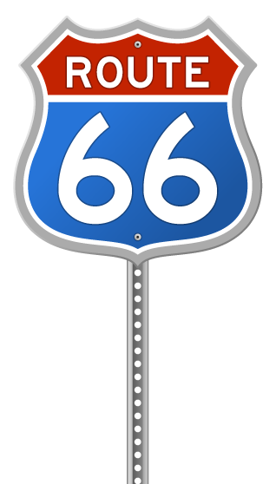
RIBBONS ACROSS THE LAND THE STORY OF THE INTERSTATE HIGHWAY SYSTEM
Authored by JEFF MOORE, AICP Presented by Jennifer McCleve

Slide 2
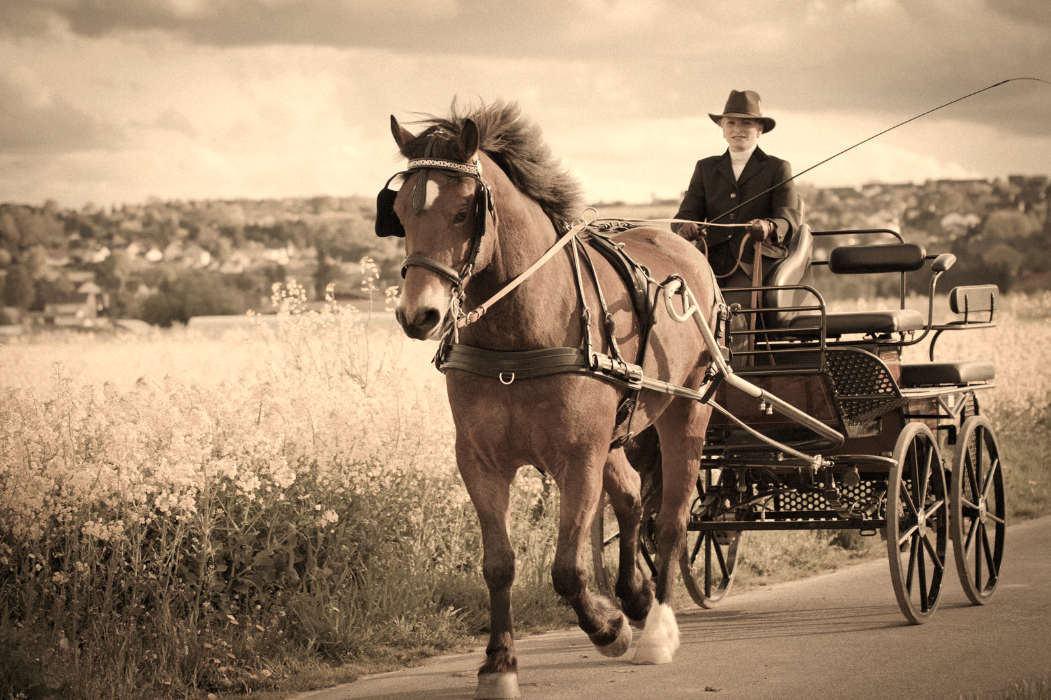
Transportation in 19th Century America
Notes:
Paintings: Manifest Destiny by John Gast & Boone Leading the Settlers by George Caleb Bingham.
At the end of the 18th Century, America was a new nation with immigrants arriving daily from around the world.
The expansion and settlement of this new nation took a long time because everything had to be constructed by hand and horse power.
With the excitement of exploration and the desire for new lands, people looked for the easiest and fastest routes for getting to the country’s ever-changing frontier.

Slide 3
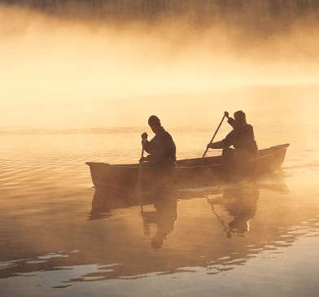
Ribbons of Water Rivers as Reliable Transportation
Notes:
Flatboat paintings by George Caleb Bingham.
In the early years of America, roads were primitive, and railroads didn’t exist yet, so settlers turned to the rivers, first “ribbons of the new nation” for transportation, tying together early American communities.
Canoes were used for getting themselves and goods from one place to another.
As the desire for transporting more goods increased, flatboats and then keelboats became commonplace. Boats moved easiest down the river with the current, so the majority of shipping was one-way.

Slide 4
Steamboat Invented in 1787
Notes:
In 1787, a new invention, the steamboat, made shipping on the rivers a dream for the future and even a more profitable enterprise.
For the first time, shipping along rivers could be done both up and down the river with ease.
Using steam for power and paddlewheels for propulsion, the steam packet boat became the method used all over the country—anywhere a river flowed—for moving people and goods.
For nearly a century, packet boats were the force behind the development of the nation, and there were thousands of these vessels navigating the waterways.

Slide 5
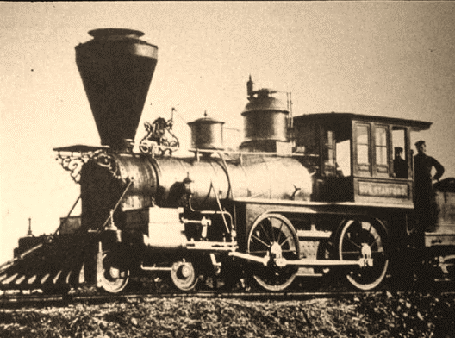
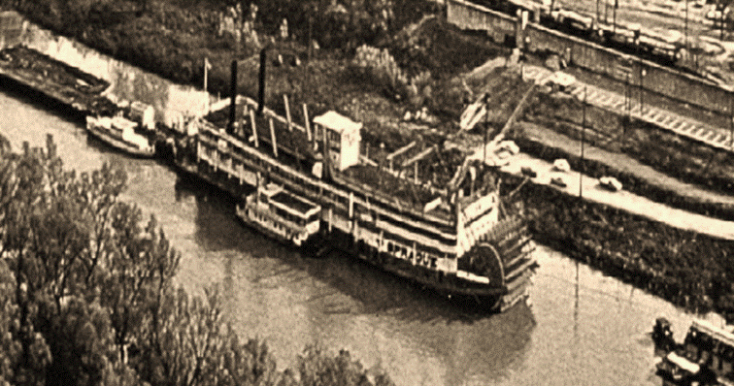
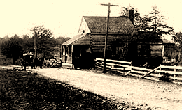
Transportation Network Expands: Towboats, Trains, & Turnpikes
Notes:
As the railroad came into its own, and better roads (called turnpikes) were being built, the demand for river transportation changed.
By the late 1920s, towboats were rapidly taking over the major heavy-load shipping contracts.

Slide 6
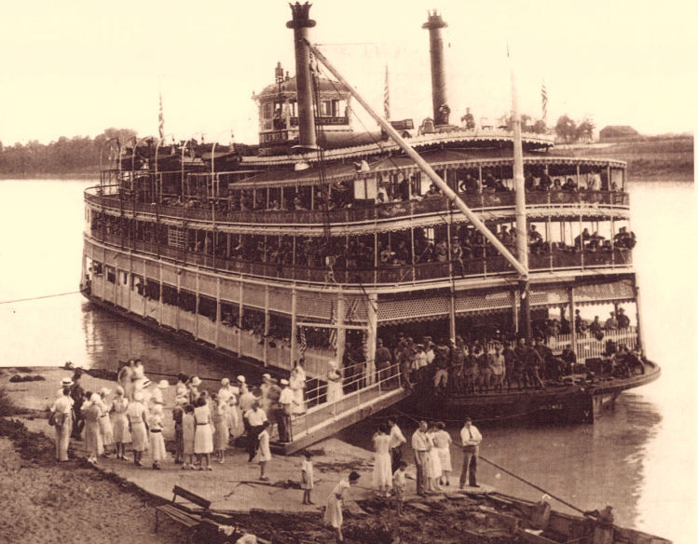
From Freight to Excursions: The Decline of the Packet Boats
Notes:
And with the building of better roadways, as the trucking industry began to flourish the packet industry declined.
Within a few decades, most of the steam packet trade was gone, and remaining boats were converted to excursion work.

Slide 7
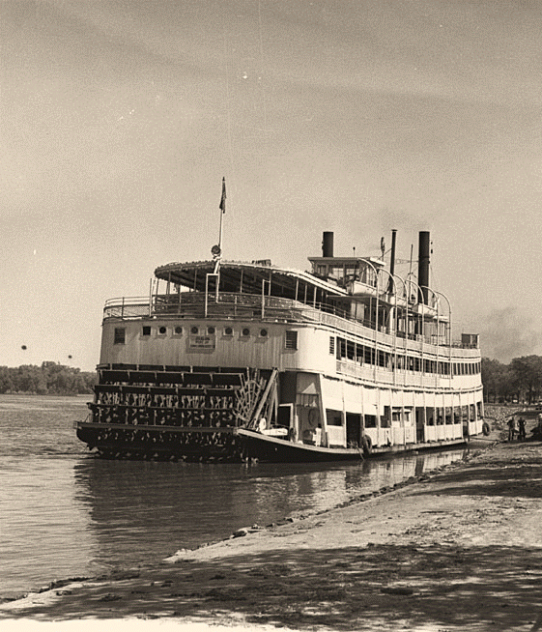
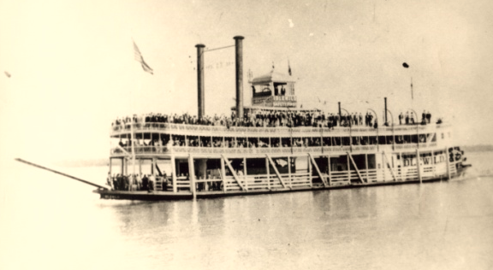
Belle of Louisville 1914
Notes:
The Belle of Louisville, built in 1914, is one of those boats. In fact, today she is the last river steamboat operating in the US that was built as a packet boat.
Christened the Idlewild, she served first as a ferry and day packet, and was outfitted for later excursion work. It insured her future, since she was built near the end of the steamboat era.
By the early 1930s, the Idlewild had become an excursion vessel. For the next three decades she continually changed to accommodate a “tramp’s” life.
In 1948, her name was changed to the Avalon, and in the next 13 years she became the most widely-traveled river steamer for her size in US history.

Slide 8
Belle of Louisville Today
Notes:
Over 100 years of operation – an unequaled feat in our country’s river steamboat history – she is truly a legendary lady and a Louisville icon.
The Belle is a constant reminder of the time when rivers were the highways of America.

Slide 9
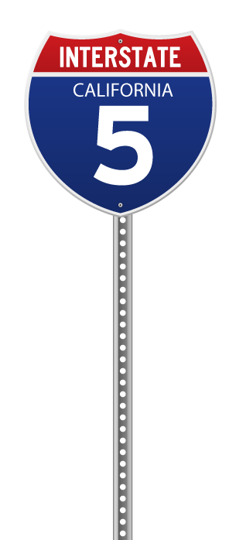
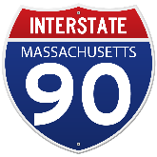
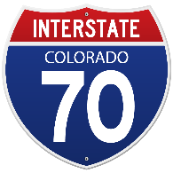
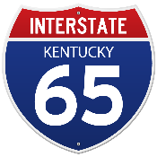
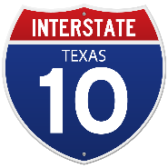
Ribbons of Concrete Interstate Highway System
Notes:
Then came the advent of vehicular travel. Goods were needed to be easily transported across the country overland. People wanted to be able to travel from state to state more efficiently. These needs fostered the ribbons of concrete: Our interstate highway system.

Slide 10
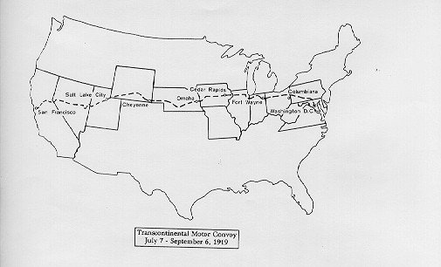
1919: A new adventure
Dwight D. Eisenhower volunteered to travel with the first Transcontinental Motor Convoy from Washington, D. C. to San Francisco, California.
Notes:
After World War I, a young army officer by the name of Dwight D. Eisenhower was looking for his next big assignment. Partly to learn, but mostly for the adventure, Eisenhower volunteered to travel with the first Transcontinental Motor Convoy from Washington, D. C. to San Francisco, California.

Slide 11
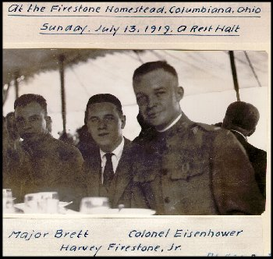
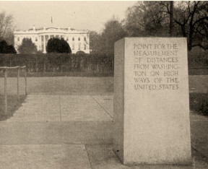
1919: A new adventure
Notes:
On July 7, 1919, The convoy set out from the Zero Milestone, which was located on the Ellipse in front of the White House.

Slide 12
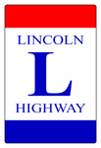
Created in 1913, the Lincoln Highway Association promoted the road using private and corporate donations.
"The Lincoln Highway is something more than a road, it will be a road with personality, a distinctive work of which the America of future generations can point to with pride-an economic, but also artistic triumph."
- Carl Fisher
Notes:
Carl Fisher proposed an improved, hard-surfaced road that would stretch almost 3400 miles from New York to San Francisco, over the shortest practical route. The Lincoln Highway Association was created in 1913 to promote the road using private and corporate donations.

Slide 13
“Nothing of the sort had ever been attempted”
Eisenhower excitedly proclaimed as the convoy headed west.
The convoy would travel 3251 miles.
Notes:
“Nothing of the sort had ever been attempted” excitedly proclaimed Eisenhower as the convoy headed west.
The convoy would travel 3251 miles. Half that distance was over dirt roads, wagon trails, desert sand, and mountain passes.

Slide 14
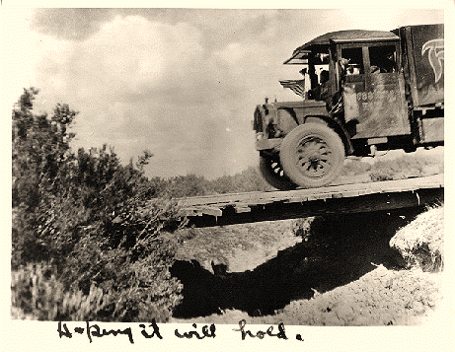
For 62 days, the convoy experienced heat, mud, breakdowns and accidents, and bridgeless river crossings.
Notes:
For 62 days, the convoy experienced heat, mud, breakdowns and accidents, and bridgeless river crossings. Where bridges did exist, the heavy military vehicles often broke through the bridge decks.

Slide 15
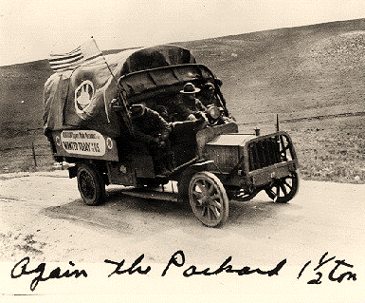
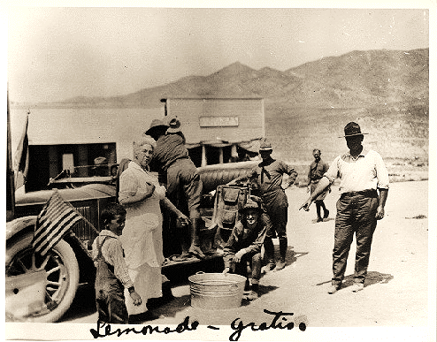
The convoy passed through 350 communities in 11 states
Excerpt from a speech marking the arrival of the Transcontinental Motor Convoy:
Much like those early explorers in this journey of yours across plain, desert, and mountain trail, you have blazed new trails—the trails of commerce, highways, mechanical achievement, and the protection of the flag. Surely no achievement could be more worthy of recognition and well earned praise.
Notes:
As the convoy passed through 350 communities in 11 states, they were greeted with dances, picnics, and more speeches. At several stops, the convoy’s film crew would show a movie of their travels so far. People across the nation followed the progress of the convoy and a strong interest grew for better roads.

Slide 16
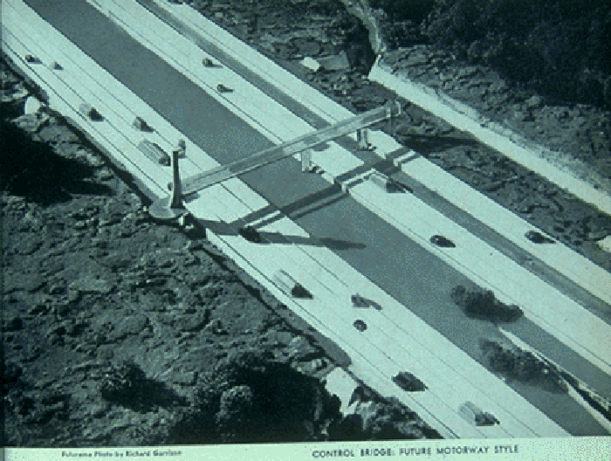
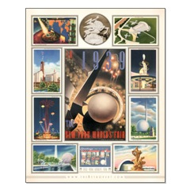
New York World's Fair
unveiled “Futurama”
1939
Notes:
In 1939, the General Motors Pavilion at the New York World's Fair unveiled "Futurama,". Designed by Norman Bel Geddes, Futurama depicted the vision of American transportation in 1960. Futurama consisted of a scale-model America, including a "City of Tomorrow" and a network of interconnecting fourteen-lane superhighways. Thousands of model cars traveled ceaselessly around this streamlined system.

Slide 17
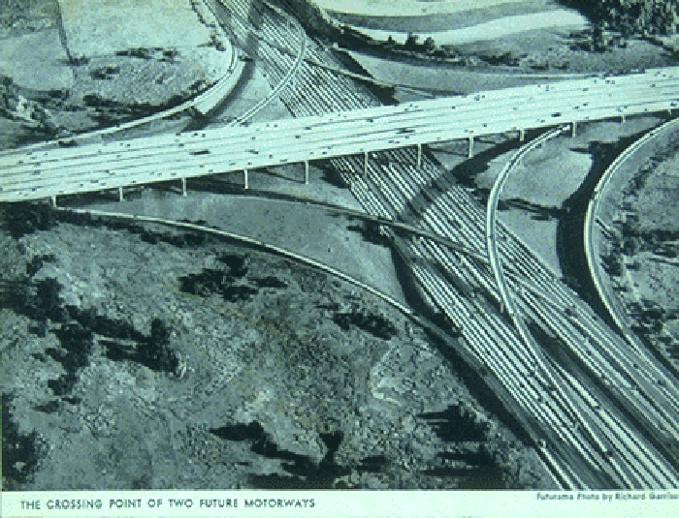
New York World's Fair
“Futurama”
"We are too much inclined to believe, because things have long been done a certain way that is the best way to do them. Following old grooves of thought is one method of playing safe. But it deprives one of initiative and takes too long. It sacrifices the value of the element of surprise. At times, the only thing to do is to cut loose and do the unexpected! It takes more even than imagination to be progressive. It takes vision and courage. "
- Norman Bel Geddes
"Futurama"
Notes:
Norman Bel Geddes said:
"We are too much inclined to believe, because things have long been done a certain way that is the best way to do them. Following old grooves of thought is one method of playing safe. But it deprives one of initiative and takes too long. It sacrifices the value of the element of surprise. At times, the only thing to do is to cut loose and do the unexpected! It takes more even than imagination to be progressive. It takes vision and courage. "

Slide 18
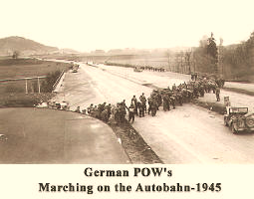
In the 1940’s, United States found itself involved in World War II.
Eisenhower had become a general.
Notes:
In the 1940’s, the United States found itself involved in World War II. Eisenhower had become a general and led the invasion of Nazi Germany. His opinion of better roads for our country was reinforced by his experience along the German highways called Autobahns.

Slide 19
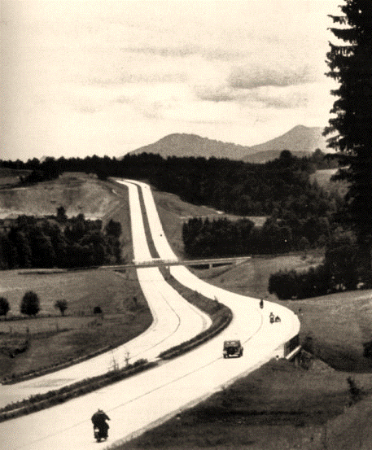
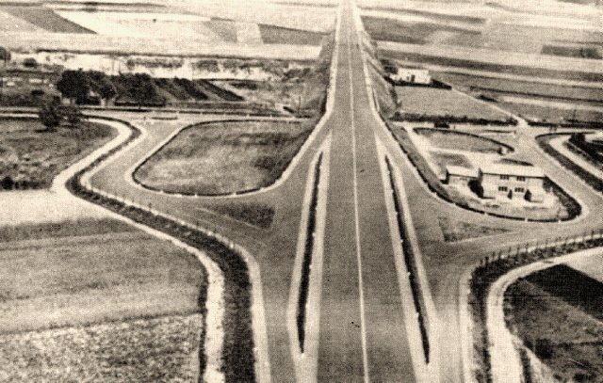
Built in the 1930’s,
the Autobahn’s highway system of four lanes.
“That old convoy had started me thinking about good, two-lane highways, but Germany had made me see the wisdom of broader ribbons across the land.”
- General Dwight D. Eisenhower
Notes:
Built in the 1930’s, the Autobahns were a system of four lane highways with no intersections, so traffic could run without stopping. With lightning speed, American troops sped along the Autobahns deep into Germany, putting the German army on the run.
General Dwight D. Eisenhower said:
“That old convoy had started me thinking about good, two-lane highways, but Germany had made me see the wisdom of broader ribbons across the land.”

Slide 20
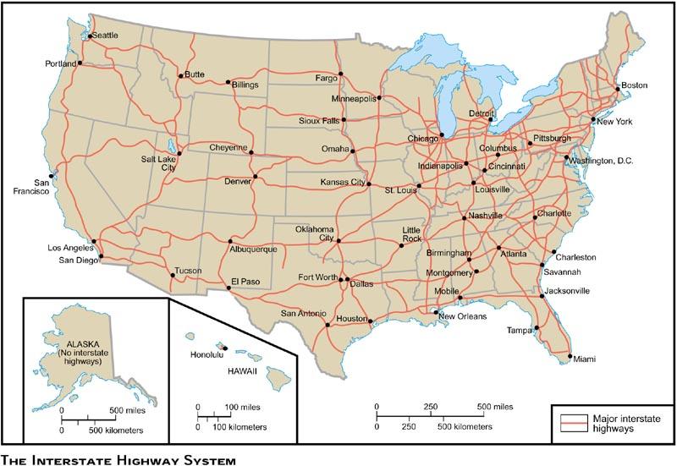
On June 29, 1956, President Eisenhower signed the Federal Aid Highway Act that created the National System of Interstate and Defense Highways.
Notes:
On June 29, 1956, President Eisenhower signed the Federal Aid Highway Act that created the National System of Interstate and Defense Highways.
These roadways would have at least two 12 ft wide lanes in each direction and be designed to handle traffic speeds from 50 mph to 70 mph. The system would have no intersections, traffic signals, or rail crossings. Motorists would enter and exit the highways on ramps at interchanges. The money to pay for these new highways would come from fuel taxes and fees for motor vehicles.

Slide 21
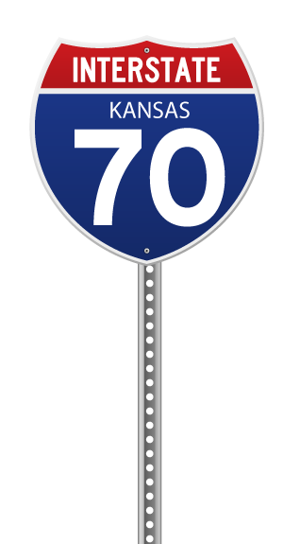
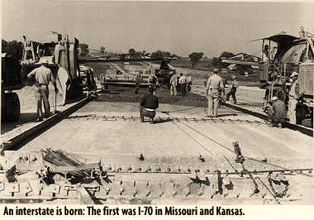
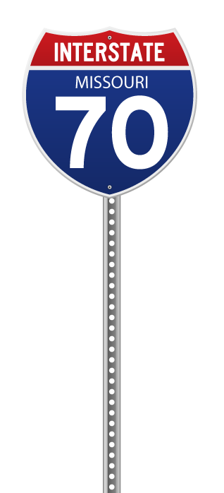
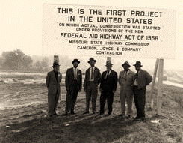
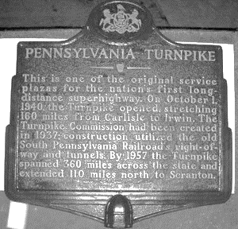
WHO IS FIRST?
The Pennsylvania Turnpike, sections of Interstates 44 & 70 in Missouri, and a section of Interstate 70 in Kansas all lay claim to being the first.
Notes:
The Pennsylvania Turnpike, sections of Interstates 44 and 70 in Missouri, and a section of Interstate 70 in Kansas all lay claim to being the first.

Slide 22
Over 46,000 miles of interstate highways
across the United States
Notes:
Over 46,000 miles of interstate highways spread across the United States and includes over 55,000 bridges, and over 14,000 interchanges. The only state without the benefit of an interstate highway is Alaska. Currently, interstate highways represent 1% of the nation’s total road mileage, but carries 20% of the nation’s traffic.

Slide 23
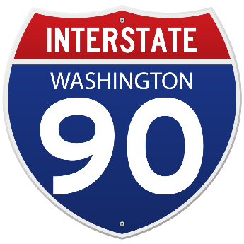
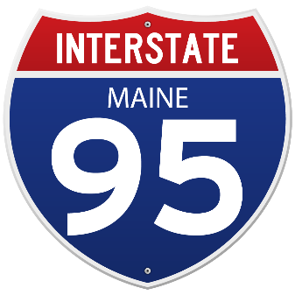
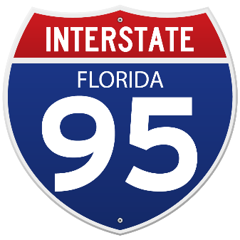
EAST-WEST INTERSTATE ROUTE NUMBERS END IN AN EVEN NUMBER. The longest Interstate is I-90, which runs from Boston to Seattle, a distance of 3,081 miles.
NORTH-SOUTH INTERSTATE ROUTE NUMBERS END IN AN ODD NUMBER. I-95, which runs from Miami, Florida, to Houlton, Maine, a distance of 1,919.74 miles, is the longest north-south route and passes through 16 states including Washington, D.C.
Notes:
East-west interstate route numbers end in an even number. The longest Interstate is I-90, which runs from Boston to Seattle, a distance of 3,081 miles.
North-south routes end in an odd number. I-95, which runs from Miami, Florida, to Houlton, Maine, a distance of 1,919.74 miles, is the longest north-south route and passes through 16 states including Washington, D.C.

Slide 24
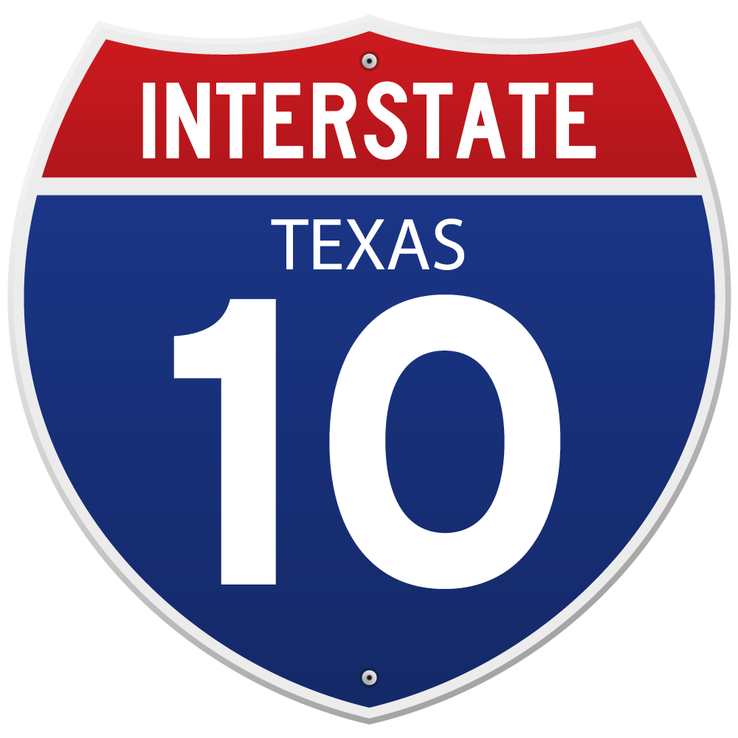
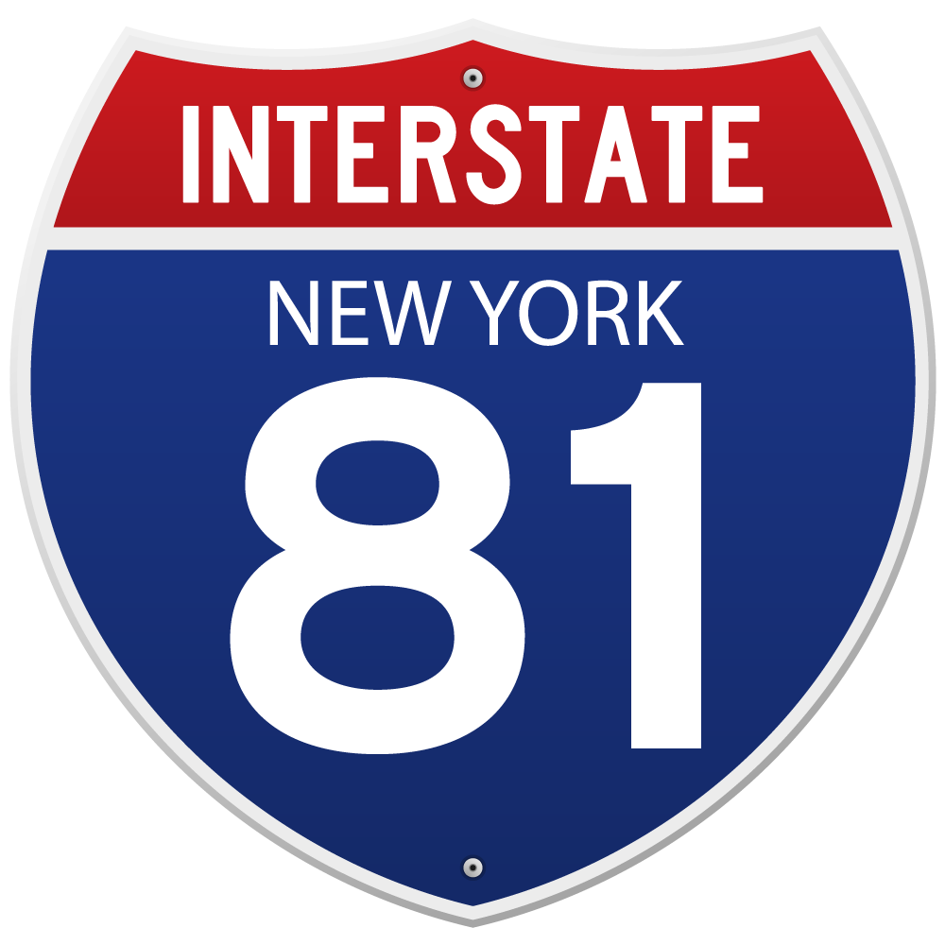
State with Most Interstate Miles: Texas 17 routes totaling 3,233.45 miles
State with Most Interstate routes: New York
1,674.73 miles
29 routes
Notes:
The State with Most Interstate Miles: Texas, 17 routes, totaling 3,233.45 miles
The State with Most Interstate Routes: New York, 1,674.73 miles, 29 routes

Slide 25
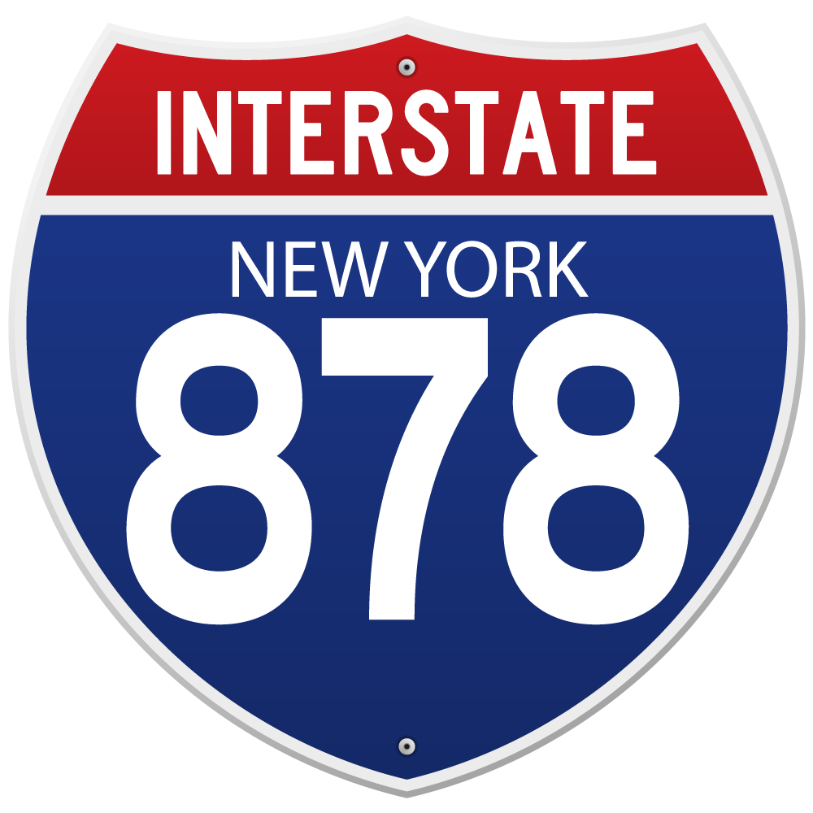
SHORTEST INTERSTATE ROUTE: New York City I-878 seven-tenths of a mile long totaling 3,696 feet
Notes:
The shortest interstate route is I-878 in New York City, which is just seven-tenths of a mile long. That's 3,696 feet.

Slide 26
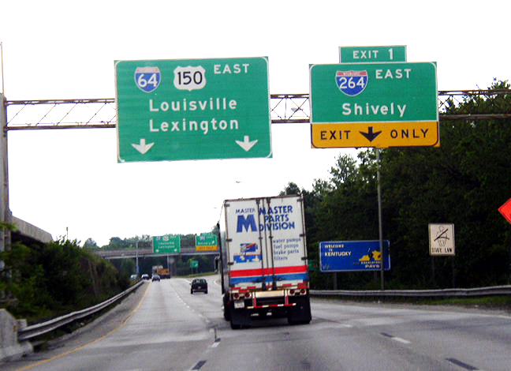
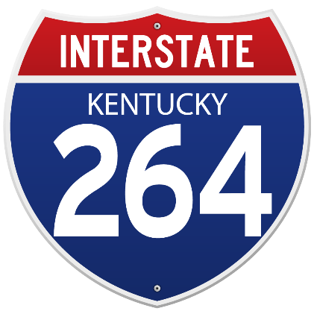
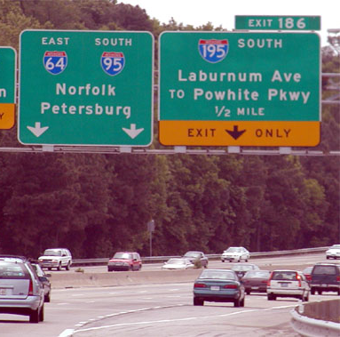
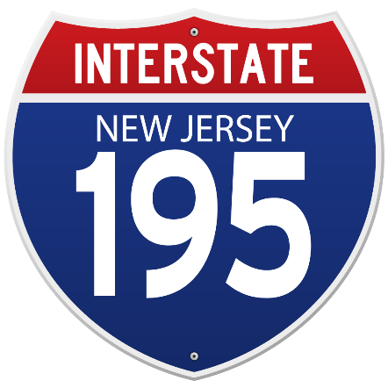
If the first digit of a three-digit interstate route number is
EVEN
the route goes around a city.
If the first digit of a three-digit interstate route number is
ODD
it is a spur into a city.
Notes:
If the first digit of a three-digit interstate route number is odd, it is a spur into a city. If it is even, the route goes around a city.

Slide 27
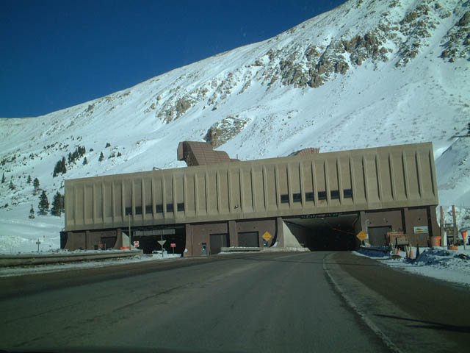
LONGEST TUNNEL AND HIGHEST ELEVATION:
Eisenhower Memorial Tunnel in Colorado on I-70
11,012 feet (east) & 11,158 feet (west) above sea level.
Notes:
On I-70, the Eisenhower Memorial Tunnel in Colorado is the longest tunnel built as part of the interstate highway system and at 11,012 feet (east) and 11,158 feet (west) above sea level is the highest elevation along the system.

Slide 28
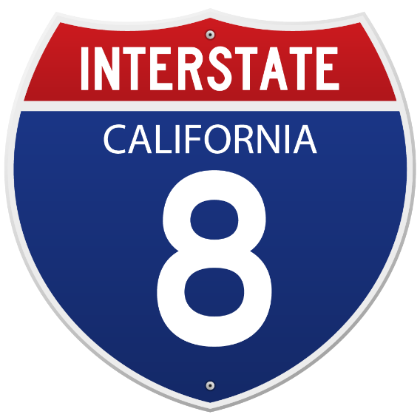
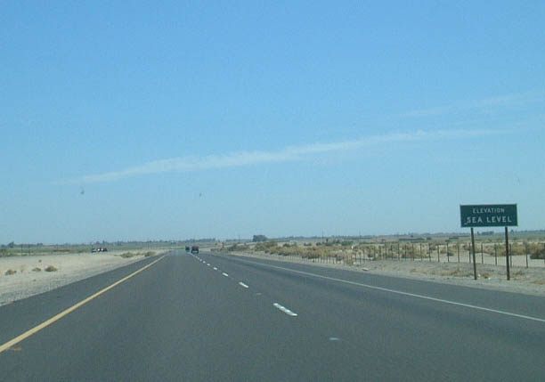
LOWEST ELEVATION OF INTERSTATE:
Interstate 8
in El Centro California
52 feet below sea level
Notes:
The interstate segment with lowest elevation is located on Interstate 8, El Centro, California, 52 feet below sea level.

Slide 29
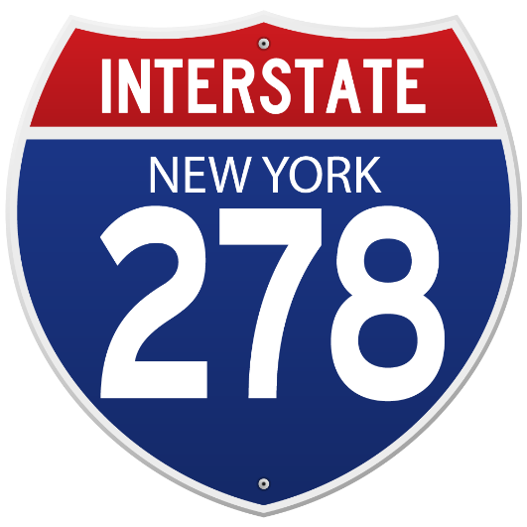
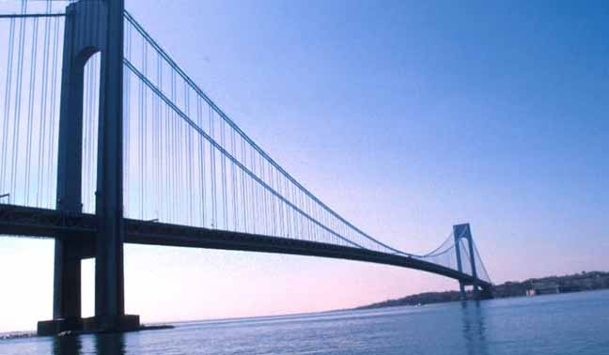
LONGEST
SUSPENSION BRIDGE:
Verrazano-Narrows Bridge
I-278 in New York City
Spans 4260 feet
Built in 1964
Notes:
The longest suspension bridge in the nation (the Verrazano-Narrows Bridge) is located on I-278 in New York City, a span of 4260 feet, built in 1964. The Mackinac Bridge on I-75 (3800 feet---built in 1957) and the George Washington Bridge on I-95 (3500 feet---built in 1931) are the 3rd and 4th longest suspension bridges in the nation.

Slide 30
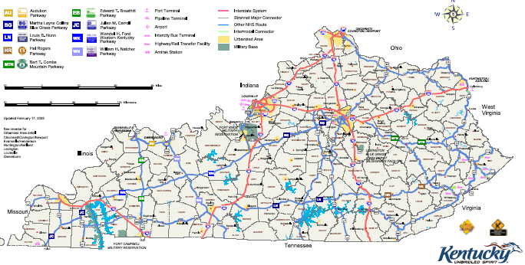
KENTUCKY
HIGHWAY FACTS
Total Interstate System Mileage: 772 miles
Notes:
Total System Mileage—772 miles
Routes: I-24, I-64, I-65, I-71, I-75, I-264, I-265, I-275, I-471
The Longest Route: I-75 (191.77 miles)
The Longest East/West Route: I-64 (191.50 miles)
The Shortest Route: I-471 (5.01 miles)
I-264 (Watterson Expwy) & I-65 (KY Turnpike) from Elizabethtown to Louisville are the oldest sections of Interstate; The Waterson was built in 1948. KY Turnpike started construction in 1955.
I-71 was the first completed route, in 1969. I-65 & I-75 were completed in 1970, then I-64 in the early 70’s. I-24 was completed in 1980.
The Longest Bridge: On I-24 over the Ohio River, 5634 feet long.
Highest Traffic Volume: I-65 near the Louisville Airport—over 200,000 vehicles per day

Slide 31
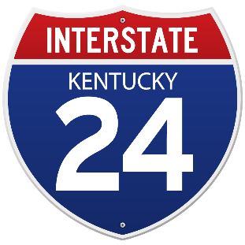
Interstate Routes:
I-24, I-64, I-65, I-71, I-75, I-264, I-265, I-275, I-471
Notes:
Total System Mileage—772 miles
Routes: I-24, I-64, I-65, I-71, I-75, I-264, I-265, I-275, I-471
The Longest Route: I-75 (191.77 miles)
The Longest East/West Route: I-64 (191.50 miles)
The Shortest Route: I-471 (5.01 miles)
I-264 (Watterson Expwy) & I-65 (KY Turnpike) from Elizabethtown to Louisville are the oldest sections of Interstate; The Waterson was built in 1948. KY Turnpike started construction in 1955.
I-71 was the first completed route, in 1969. I-65 & I-75 were completed in 1970, then I-64 in the early 70’s. I-24 was completed in 1980.
The Longest Bridge: On I-24 over the Ohio River, 5634 feet long.
Highest Traffic Volume: I-65 near the Louisville Airport—over 200,000 vehicles per day

Slide 32
KENTUCKY HIGHWAY FACTS
Longest Route:
I-75 at 191.77 miles long
Longest East/West Route:
I-64 at 191.50 miles long
Shortest Route:
I-471 at 5.01 miles long
Longest Bridge:
I-24 over the Ohio River at 5,634 feet long
Notes:
Total System Mileage—772 miles
Routes: I-24, I-64, I-65, I-71, I-75, I-264, I-265, I-275, I-471
The Longest Route: I-75 (191.77 miles)
The Longest East/West Route: I-64 (191.50 miles)
The Shortest Route: I-471 (5.01 miles)
I-264 (Watterson Expwy) & I-65 (KY Turnpike) from Elizabethtown to Louisville are the oldest sections of Interstate; The Waterson was built in 1948. KY Turnpike started construction in 1955.
I-71 was the first completed route, in 1969. I-65 & I-75 were completed in 1970, then I-64 in the early 70’s. I-24 was completed in 1980.
The Longest Bridge: On I-24 over the Ohio River, 5634 feet long.
Highest Traffic Volume: I-65 near the Louisville Airport—over 200,000 vehicles per day

Slide 33
KENTUCKY HIGHWAY FACTS
Oldest sections of Interstate:
I-264 (Watterson Expwy) & I-65 (KY Turnpike) from Elizabethtown to Louisville, built in 1948.
?????KY Turnpike started construction in 1955. Conflicts with above fact.
First completed Route:
I-71 was completed in 1969. I-65 & I-75 were completed in 1970, then I-64 in the early 70’s. I-24 was completed in 1980.
Highest Traffic Volume:
I-65 near the Louisville Airport—over 200,000 vehicles per day
Notes:
Total System Mileage—772 miles
Routes: I-24, I-64, I-65, I-71, I-75, I-264, I-265, I-275, I-471
The Longest Route: I-75 (191.77 miles)
The Longest East/West Route: I-64 (191.50 miles)
The Shortest Route: I-471 (5.01 miles)
I-264 (Watterson Expwy) & I-65 (KY Turnpike) from Elizabethtown to Louisville are the oldest sections of Interstate; The Waterson was built in 1948. KY Turnpike started construction in 1955.
I-71 was the first completed route, in 1969. I-65 & I-75 were completed in 1970, then I-64 in the early 70’s. I-24 was completed in 1980.
The Longest Bridge: On I-24 over the Ohio River, 5634 feet long.
Highest Traffic Volume: I-65 near the Louisville Airport—over 200,000 vehicles per day

Slide 34
“Together, the united forces of our communication and transportation systems are dynamic elements in the very name we bear - United States. Without them, we would be a mere alliance of many separate parts.“
– President Dwight D. Eisenhower
Notes:
We’ll wrap with a quote from the visionary of the ribbons across our land:
President Dwight D. Eisenhower said:
"Together, the united forces of our communication and transportation systems are dynamic elements in the very name we bear -- United States. Without them, we would be a mere alliance of many separate parts." –

