Slide 1
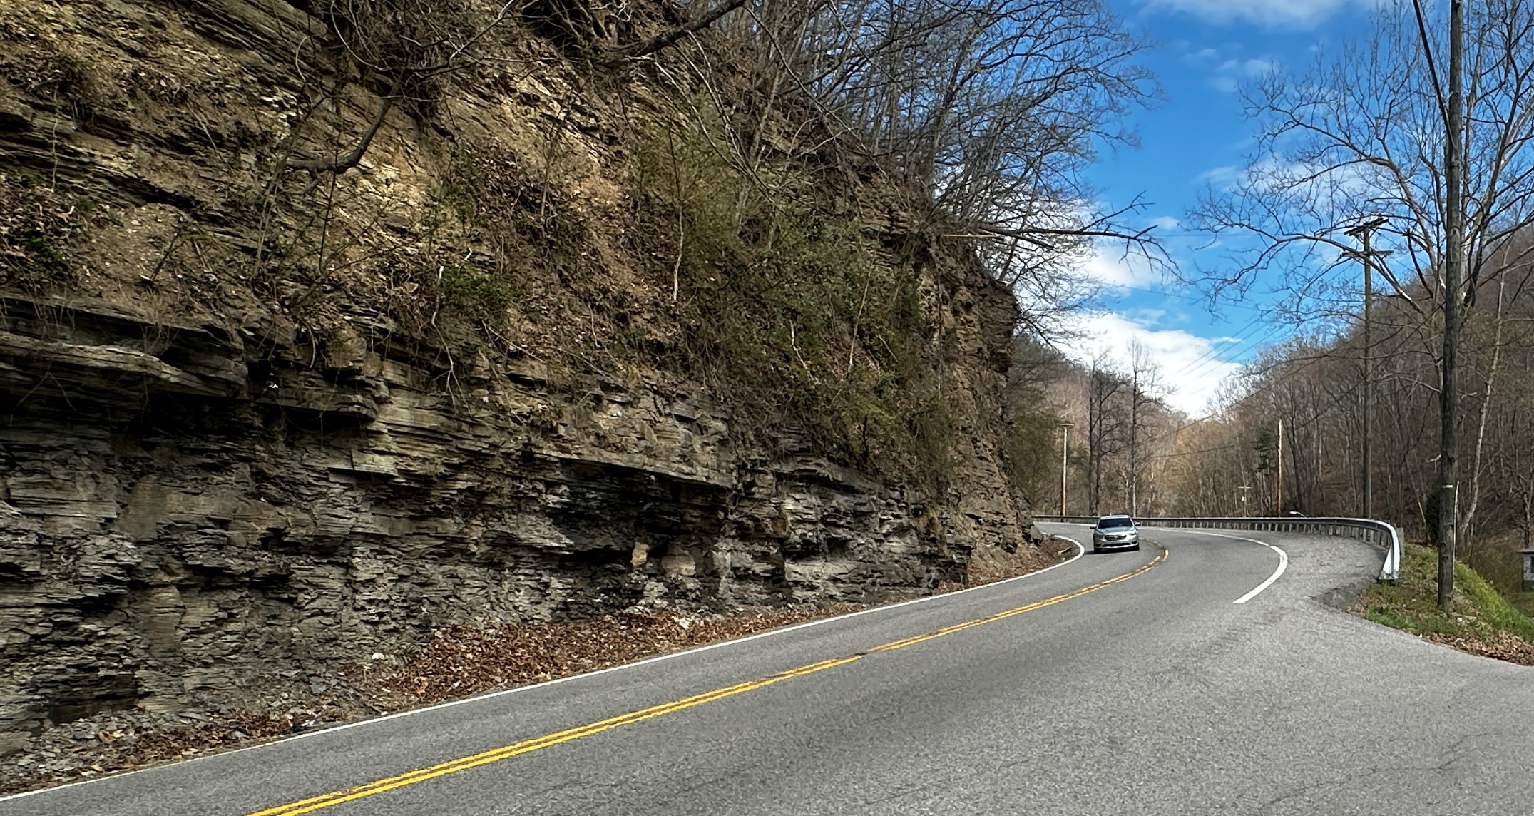




PUBLIC MEETING
KYTC invites you to view plans to improve Town Mountain Road north of Pikeville to US 119.
Stop by anytime to ask questions and share your thoughts!
Thursday, September 11th, 2025
Open-House 4:00-7:00 PM
The Troubadour “Log Cabin”
502 Town Mountain Road Pikeville, KY 41501

