Slide 1
Drilled Shafts: A Primer
Section Engineers Meeting
March 6, 2014
Lexington, KY

Slide 2
What is a Drilled Shaft?
A deep foundation that is constructed by placing fluid concrete in a drilled hole. Reinforcing steel is usually inserted in the excavation prior to placing the concrete.
Sizes can range from 2 to 30 feet in diameter and can be over 200 feet in length.
They are particularly advantageous where enormous loads are placed on the foundation or where other limitations such as scour, construction space, or vibrations may control.
One shaft can replace a cluster of piles.

Slide 3
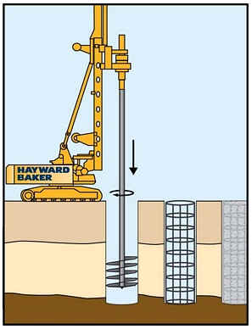
Drilled Shaft Installation

Slide 4
Drilled Shaft Installation
Can be installed in wet or dry conditions
Can be installed with a slurry to help keep excavation from collapsing
Typically installed with rock sockets on KYTC projects
Typically installed with permanent casing for KYTC projects
Concrete mix design to allow concrete to flow around reinforcement

Slide 5
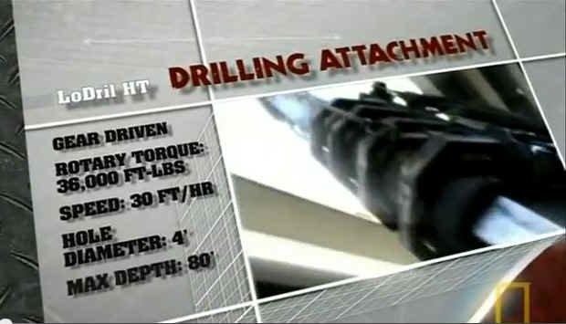
Video

Slide 6
Field and Integrity Testing
Additional drilling at each shaft location during construction to verify top of rock and rock socket lengths
Crosshole Sonic Logging (CSL) after shaft construction to check for defects
In special circumstances load testing of shaft to verify load carrying capacity

Slide 7
What to watch for
Core drilling before construction – takes time to drill and evaluate
Tying and lifting of rebar cage
Concrete mix and slump
Clean excavation prior to cage placement and concrete pour
Filling of CSL tubes with water
Presence of water in excavation – need for tremie pour

Slide 8
Resources for Field Personnel
Florida DOT Inspector Tutorial http://www.dot.state.fl.us/construction/training/drill%20shaft/Welcome.htm
KYTC Special Note for Drilled Shafts – See 2008 Standard Specifications Note 11C (in back of Spec Book)

Slide 9
Call Geotech for support
Contact Bart Asher, Daryl Greer, or Tony Beckham
502-564-2374
We will attend pre-construction meeting if you desire
We will make site visits to discuss plans, aid inspectors, with or assist with construction problems

Slide 10
Questions?
Daryl Greer
Geotechnical Branch
502-564-2374
daryl.greer@ky.gov

