Slide 1
COST PLUS

Slide 2
Reasons for Cost-Plus
Can’t agree on a price
Specialty work
Notice of Changed Conditions

Slide 3
FORCE ACCOUNT WORK TC63-11

Slide 4
FORCE ACCOUNT EXAMPLE

Slide 5
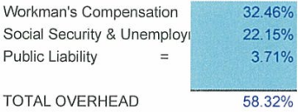
109.04.02 Force Account Work - Labor
109.04.02 Force Account Work
A) Labor. For all labor and for foremen in direct charge of the specific operations,
the Department will pay the Contractor:
1) the actual cost of wages paid, but at rates not to exceed those for comparable
labor currently employed on the project, as the Engineer determines;
2) an amount equal to the sum of the products of established labor burden
percentages and the actual cost of wages. The amounts determined by the
established labor burden percentages constitute full compensation for the
cost of workers’ compensation insurance, social security taxes,
unemployment compensation insurance, public liability insurance; and any
other taxes or insurance which are added to labor costs; and
3) an amount equal to 25 percent of the actual cost of wages and the other costs
identified above. This amount is full compensation for office overhead and
general superintendence.
Actual Cost = hourly rate plus + overhead

Slide 6
Equipment Rates
109.04.02 Force Account Work
C) Equipment and Tools. For any machinery or special equipment that the
Engineer has authorized for use and the Contractor has used, the Department
will pay the rental rate stated on the rental company invoice for the actual
agreed time and rate that such equipment is required on the work and will
add an amount equal to 15 percent of the rental sum as full compensation for
fuel, lubricants, and filters.
The Department will pay for equipment that the Contractor is already using
on the project, and which is not obtained specifically for the force account work
based on an hourly rate. The Department will determine the hourly rate by
taking the Blue Book monthly rental rate, adjusted for age and geographic
region, dividing it by 176 and adding the Blue Book estimated operational cost.
The Department will pay rental rates for equipment required to be on standby at
one half the normal rate, excluding operational cost, and pay for standby time for
a maximum of 8 hours per day and 40 hours per week.
The Engineer will measure the rental of equipment by time in hours of
actual working time and the necessary traveling time of the equipment
within the limits of the project, unless the Engineer has ordered special
equipment in connection with force account work, in which case the
Engineer will also include travel time and transportation to the project.
The Department will not pay rental rates or percentages for the use of small
tools and manual equipment.

Slide 7
Equipment Rental Rates
https://www.equipmentwatch.com/

Slide 8
Equipment Watch Login
Districts 1-4
Email: matt.looney@ky.gov
PW: kentuckyrain0515
Districts 5-8
Email: rachel.mills@ky.gov
PW: w34zvtwtj9
Districts 9-12
Email: beth.whitt@ky.gov
PW: racehorse0515
https://www.equipmentwatch.com/

Slide 9
Atlas Copco SB 150

Slide 10
IHI 45NX

Slide 11
Gehl Skid Steer

Slide 12
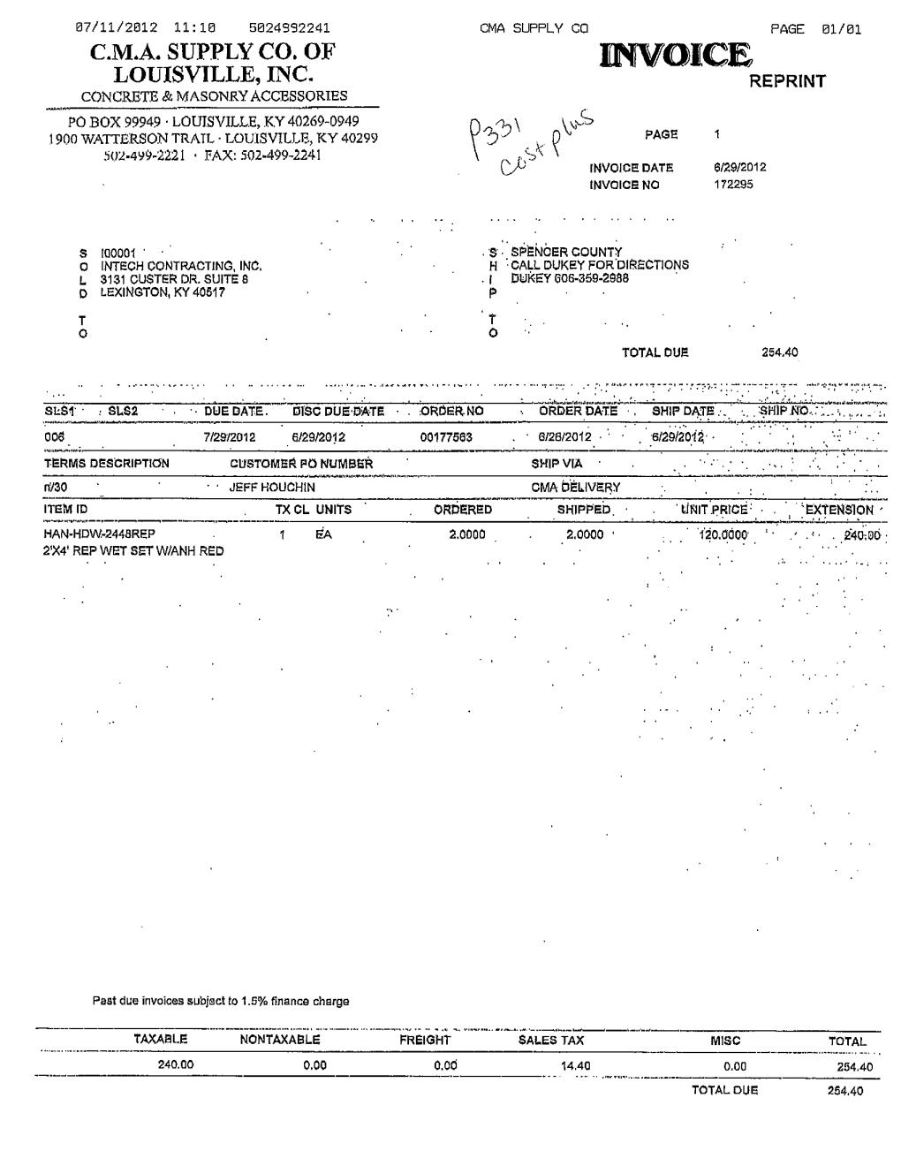
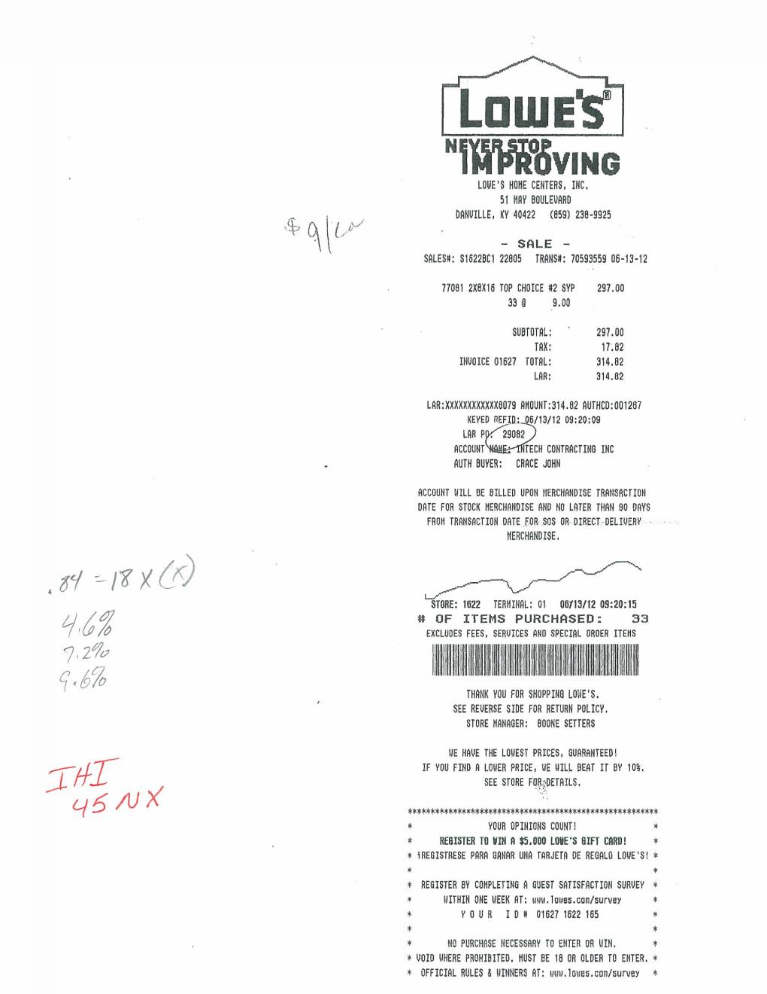
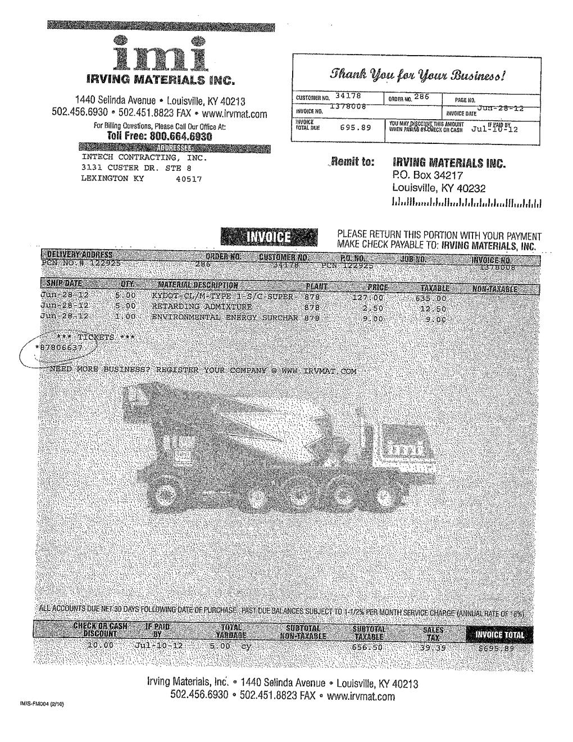
Materials
INVOICES/RECEIPTS

Slide 13
TC 63-10

