Slide 1


Contractor Performance Evaluations
Steps and Guidance
Kentucky Transportation Cabinet
Kentucky Transportation Center

Slide 2
Contractor Performance Evaluation
Purpose
Provide a feedback loop to a Contractor’s Prequalification rating
Positive performance is rewarded
Negative performance could reduce a Contractor’s Maximum Eligibility Amount
Kentucky Transportation Cabinet
Kentucky Transportation Center

Slide 3
Contractor Performance Evaluation
Background
A collaborative effort between the Kentucky Transportation Cabinet and the University of Kentucky Transportation Center
Initiated by SPR 00-212: Quality-Based Prequalification of Contractors
Modified under SPR 12-438: Contractor Evaluations in the Contractor Selection Process
Kentucky Transportation Cabinet
Kentucky Transportation Center

Slide 4
Contractor Performance Evaluation
Resource Location
Division of Construction Website
http://transportation.ky.gov/Construction/Pages/default.aspx
Specific Contractor Evaluation Website
http://transportation.ky.gov/Construction/Pages/Contractors-Performance-Evaluation-Report.aspx
Links to:
  New (2014) ~ Instructions & Guidelines
  New (2014) ~ Evaluation Spreadsheet
  Appeal Form
  Department of Highway’s Evaluation Website
  Training Video
Kentucky Transportation Cabinet
Kentucky Transportation Center

Slide 5
Contractor Performance Evaluation
Significant Changes (2014)
  Less subjectivity/specific guidance for ratings
  Fewer ratings (7 project complete/6 interim)
  Comments not required
  Evaluations not required for subcontractors who perform less than $50,000 in the evaluation period
  The average is a “3”
  The Chief District Engineer is not required to sign the evaluation
Kentucky Transportation Cabinet
Kentucky Transportation Center

Slide 6
Contractor Performance Evaluation
Who is evaluated?
  Every Prime Contractor
  Every Subcontractor performing more than $50,000 worth of work in the evaluation period.
    You can evaluate any subcontractor even if they do not meet the above threshold
    Subcontractors not meeting the above threshold also may request an evaluation
    There will be scenarios where a subcontractor does not warrant an interim evaluation but will require a project completion evaluation.
Kentucky Transportation Cabinet
Kentucky Transportation Center

Slide 7
Contractor Performance Evaluation
When are evaluations to be completed?
  Once per calendar year, for every project, for each contractor (prime & subcontractor)
  Two Scenarios
    The project is complete: evaluate the contractors on the project once all work, punch lists, and cleanup is complete.
    The project is will continue into the next calendar year: evaluate the contractors on the project BY December 31st.
Kentucky Transportation Cabinet
Kentucky Transportation Center

Slide 8
Contractor Performance Evaluation
What should you consider prior to completing an evaluation?
  Use the next two lists of questions as a checklist prior to starting evaluations
  One list is for interim evaluations and the other for project complete evaluations
  Attempt to consider the prime and subcontractors independently though there will be crossover; the prime is responsible for the entire project
Kentucky Transportation Cabinet
Kentucky Transportation Center

Slide 9
For Project Completion Evaluations Be Able to Answer…
What amount of work was removed/replaced and/or what amount of deductions were assessed?
Was a Section Engineer’s punch-list completed prior to final inspection?
What amount (qualitative-minor, average, major) of corrective work was needed?
Were there any material deficiencies?
When was the project complete compared to the scheduled completion date or working days?
When was corrective work completed compared to the issuance of the Comprehensive Final Inspection Report?
What level of engagement, scheduling, communication and cooperation was there with KYTC?
Did traffic control meet standards?
Was work completed only within allowed hours?
Were there any work zone incidents?
Were temporary (eg. flagger, double fine, etc.) signs changed to reflect project traffic control?
Was there active use of advanced warnings, consideration of Over-Size Over-Weight carriers, communication with media, and onsite traffic technician staff?
Were there any OSHA citations?
Were there any hazards noted by the section engineer?
Were there safety meetings regularly held? Were all project partners invited to safety meetings?
Were there any EPA fines?
Was seeding progressively managed according to permits?
Were any 5-day letters issued?
Did reseeding occur more than once?
When was seeding established compared to completion date?
Kentucky Transportation Cabinet
Kentucky Transportation Center

Slide 10
For Interim Evaluations Be Able to Answer…
What amount of work was removed/replaced and/or what amount of deductions were taken?
Were there any material deficiencies?
Were deficiencies addressed in a timely manner?
Does the project progress appear to indicate the project is behind, on, or ahead of schedule?
What level of engagement, scheduling, communication and cooperation was there with KYTC?
Did traffic control meet standards?
Was work completed only within allowed hours?
Were there any work zone incidents?
Were temporary (eg. flagger, double fine, etc.) signs changed to reflect project traffic control?
Was there active use of advanced warnings, consideration of Over-Size Over-Weight carriers, communication with media, and onsite traffic technician staff?
Were there any OSHA citations?
Were there any hazards noted by the section engineer?
Were there safety meetings regularly held? Were all project partners invited to safety meetings?
Were there any EPA fines?
Was seeding progressively managed according to permits?
Were any 5-day letters issued?
Kentucky Transportation Cabinet
Kentucky Transportation Center

Slide 11
Contractor Performance Evaluation
Start the evaluations…
  Each time you begin an evaluation(s), download the most recent TC 14-19 template from transportation.ky.gov/construction visiting the Contractor’s Performance Report link
    This will ensure you have the most up-to-date contractor list
  Start by opening the template…
Kentucky Transportation Cabinet
Kentucky Transportation Center

Slide 12
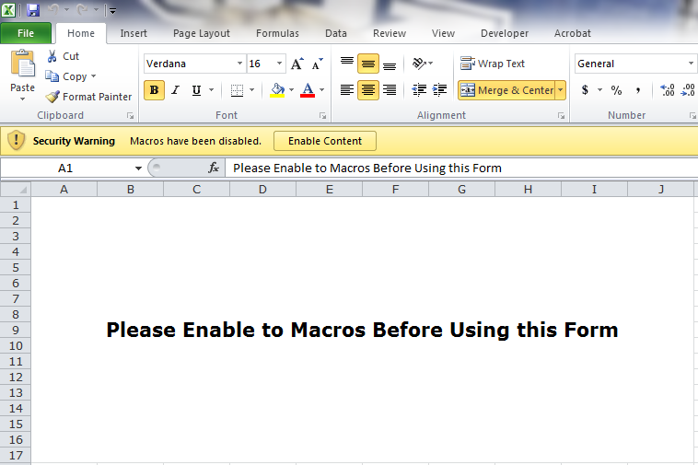
Contractor Performance Evaluation
If/when you get a “Security Warning” click “Enable Content.”
Click here
Kentucky Transportation Cabinet
Kentucky Transportation Center

Slide 13
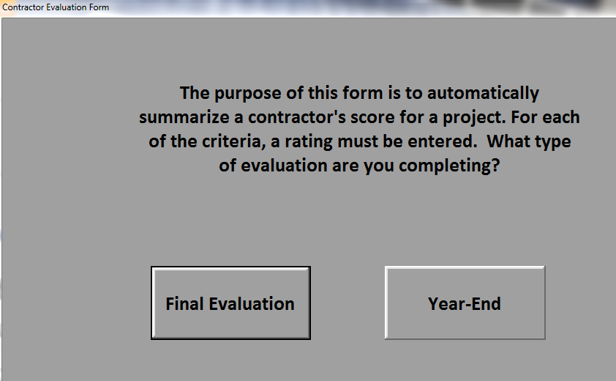
Contractor Performance Evaluation
Then follow the onscreen guidance…
Kentucky Transportation Cabinet
Kentucky Transportation Center

Slide 14
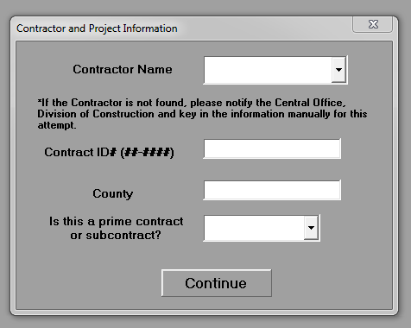
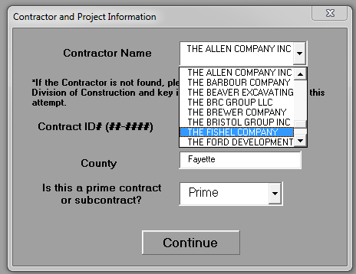
Contractor Performance Evaluation
Fill out the Contractor and Project Information with drop down menus for assistance…
Kentucky Transportation Cabinet
Kentucky Transportation Center

Slide 15
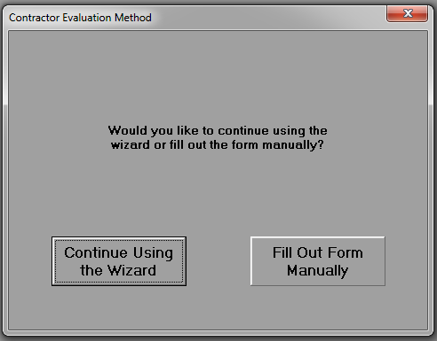
Contractor Performance Evaluation
Decide whether to continue using the easier user interface or manually enter ratings…
Kentucky Transportation Cabinet
Kentucky Transportation Center

Slide 16
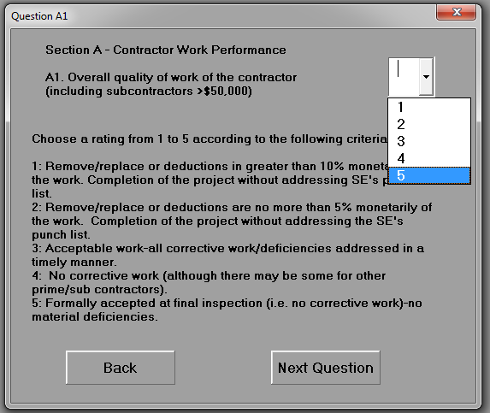
Contractor Performance Evaluation
When using the wizard, ratings are evaluated one at a time displaying applicable criteria…
Kentucky Transportation Cabinet
Kentucky Transportation Center

Slide 17
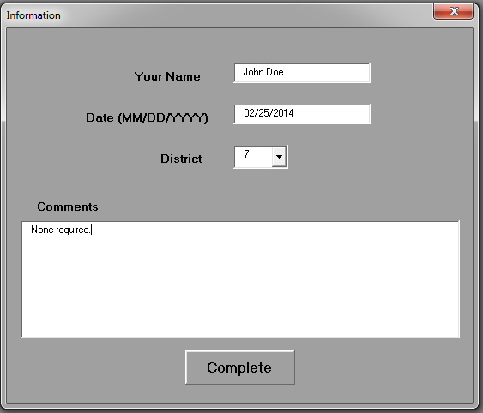
Contractor Performance Evaluation
Enter the evaluator's information…
Kentucky Transportation Cabinet
Kentucky Transportation Center

Slide 18
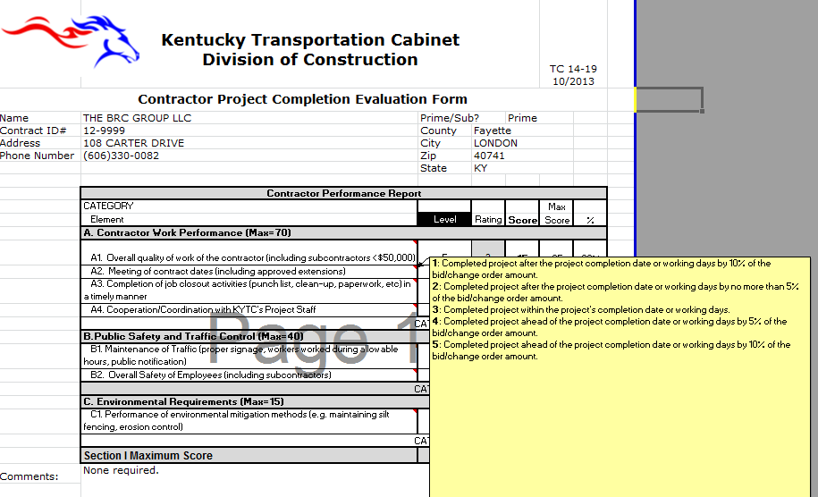
Contractor Performance Evaluation
Review the form and adjust ratings as necessary…
Kentucky Transportation Cabinet
Kentucky Transportation Center

Slide 19
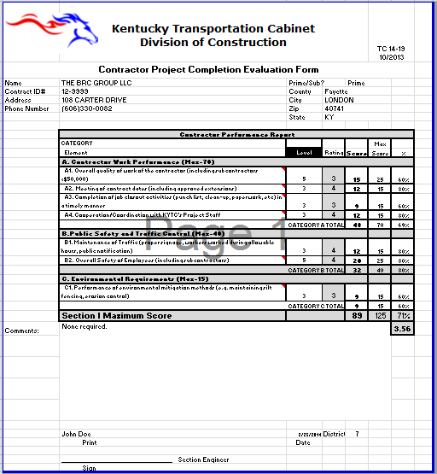
Kentucky Transportation Cabinet
Kentucky Transportation Center

Slide 20
Contractor Performance Evaluation
Remaining Steps…
  Save the file with a file name unique to the project, contractor, and evaluation period.
  Print and sign the form
  Submit a copy of the signed evaluation, with an Appeal Form (TC 14-20), to the Contractor
    Provide copies to the TEBM for Delivery & Preservation and the CDE
    Upon expiration of the appeal window (10 buisness days), ensure the TEBM submits the evaluation to the Division of Construction Procurement (Current contact: Cherie Shelton)
Kentucky Transportation Cabinet
Kentucky Transportation Center

Slide 21
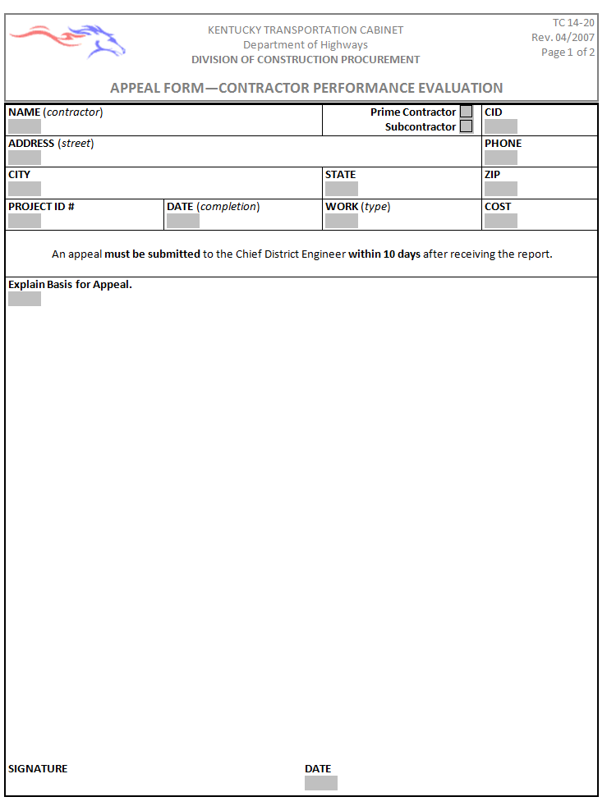
Contractor Performance Evaluation
The Contractor Appeal process…
  If the Contractor disagrees with their evaluation they may submit the Appeal Form TC 14-20
  It must be submitted within 10 business days of receiving the evaluation, to the CDE.
Kentucky Transportation Cabinet
Kentucky Transportation Center

Slide 22
Contractor Performance Evaluation
If you have questions, contact your Central Office, Division of Construction Liaison for assistance.
Kentucky Transportation Cabinet
Kentucky Transportation Center

