Slide 1
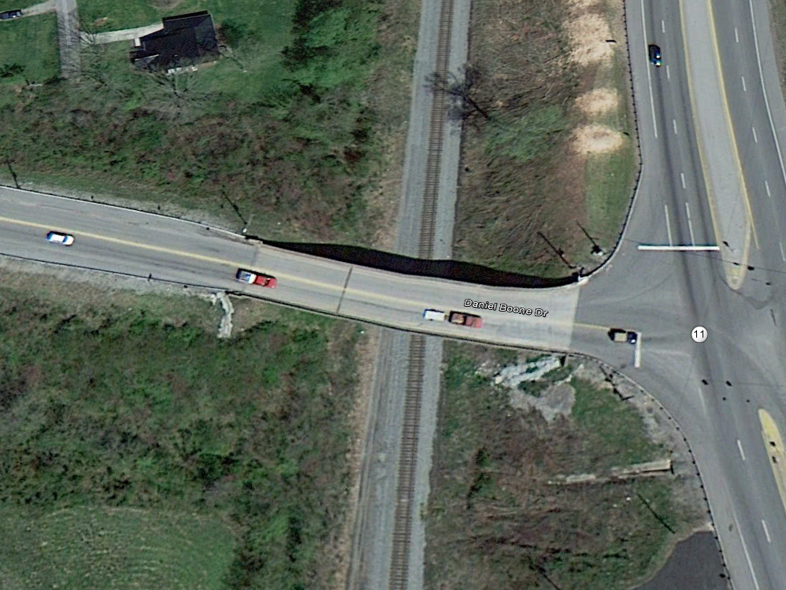
KY 11 Bridge Replacement Project
Scope of Project
Replace the Existing 2 lane Daniel Boone Drive Bridge with a 3 Lane Structure.
Objectives
Increase Bridge Radii to allow trucks better access to downtown Barbourville
Add additional lane to improved traffic flow out of Barbourville
Construct bride that will keep the Historic Heritage of Barbourville
Daniel Boone
Dr. Thomas Walker

Slide 2
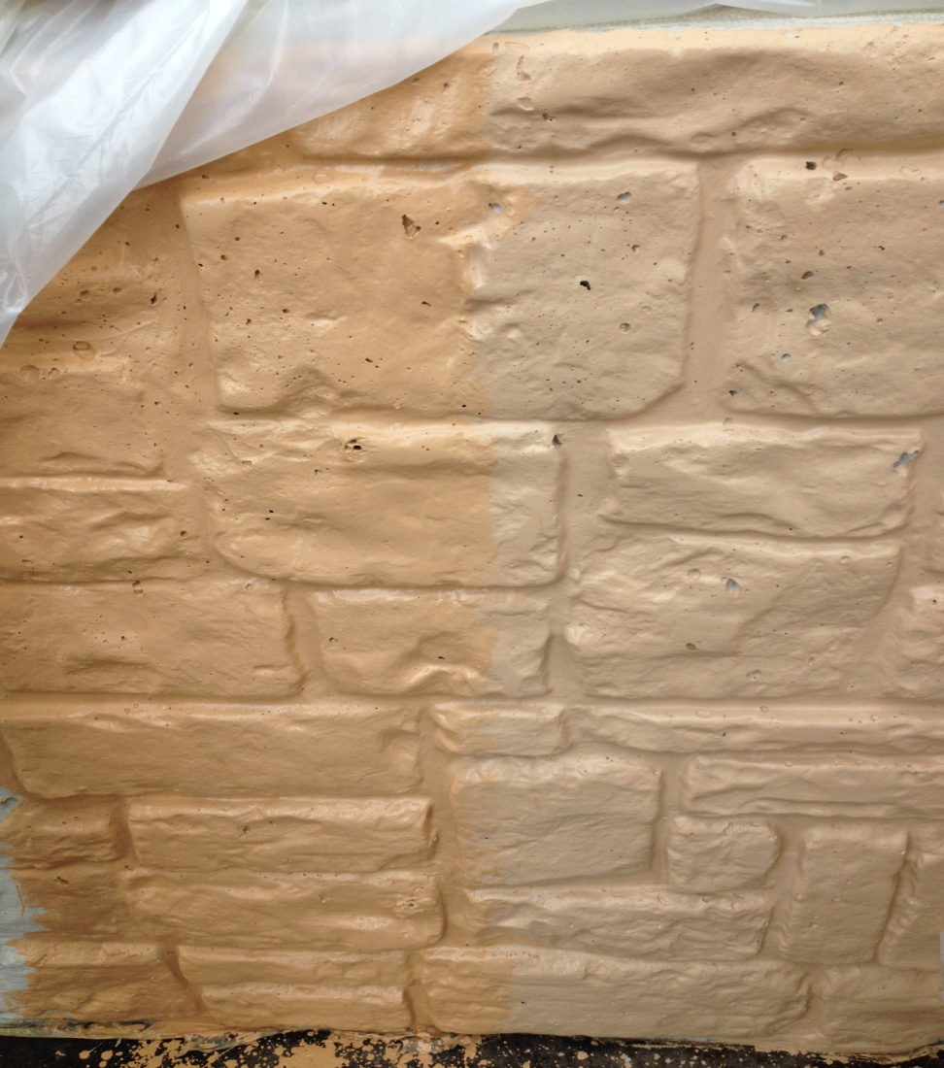
Proposed Plan to address Barbourville’s Historic Heritage
Aesthetic Treatment on Barrier Walls using Form Liners
Greenstreak architectural form liners
Pattern 330 (Ashlar Stones)
Concrete Stain and Sealer
List of approved materials
Sherwin Williams
SWD DOT Bridge and Highway Concrete Sealer B97 Series
or Pittsburg Paints
Perma-Crete Vertical Concrete Stain
Yellow Sand
Federal Standard 595B Color Number 30400 (AKA Thousand Island Dressing)
Mock-up Wall
12 feet long
Constructed on site
Used to experiment with stain color and application methods and to verify suitability.
Findings
Specified Stain did not meet the Historical look that the Department and the City of Barbourville was looking for.

Slide 3
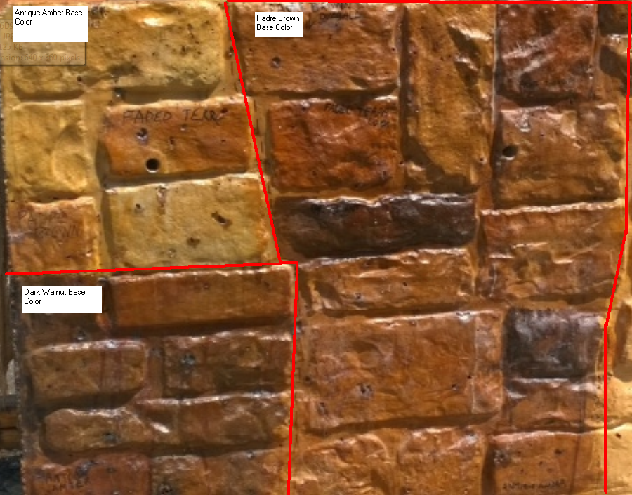
Revised Plan to address Barbourville’s Historic Heritage
Try to find a stain that would provide a more natural stone look.
Looked at several alternatives
Scofield Systems
Lithochrome Chemstain
Chemical Stain that reacted with the concrete to alter the color of the concrete

Slide 4
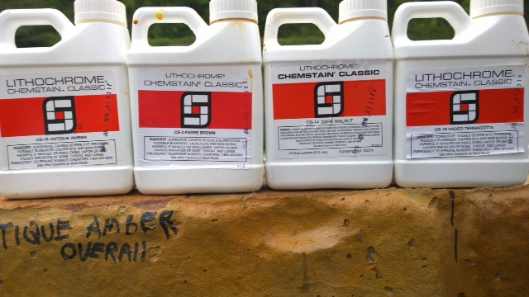
Revised Plan to address Barbourville’s Historic Heritage
Scofield System (Lithochrome Chemstain) provide the most natural stone appearance.
Both State and City Officials were please with the look.

Slide 5
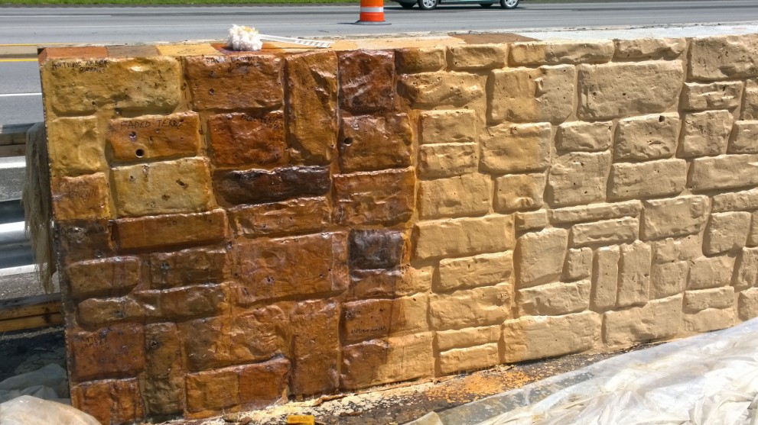
Challenges in Revising Plan to address Barbourville’s Historical Heritage
Scofield product was not on list of approved materials.
Had not been used on any Highway Projects in the state.
Contractor was concerned that it was much more labor intensive than the planned stain and was concerned about the hazards of handling the acid stain.
Would we use one color or try several colors.
Department was worried about how rubbing and patching would alter the color.

Slide 6
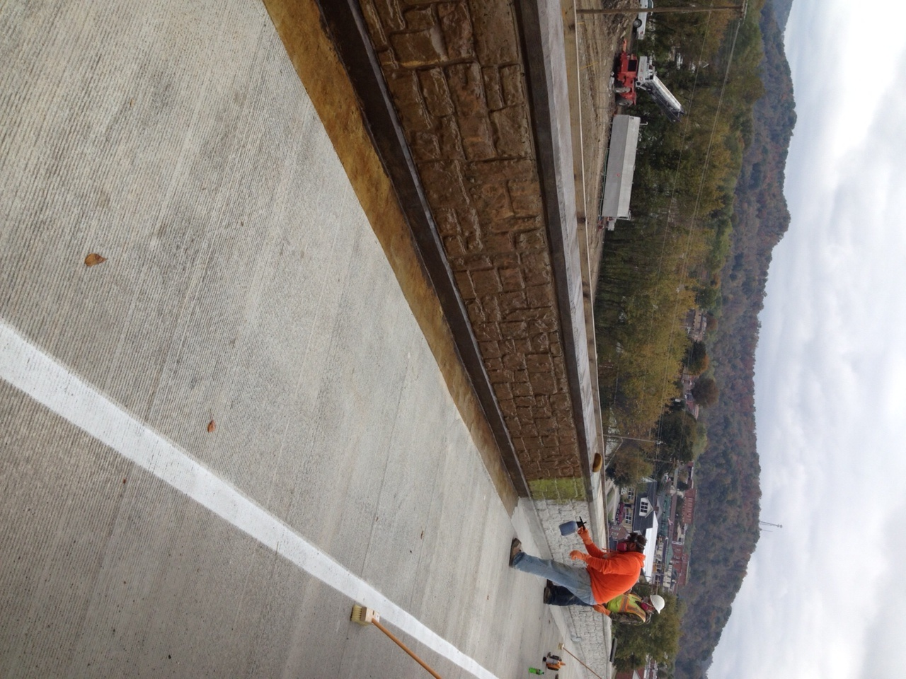
Application
Department chose to go with a base color and use the other colors to stain individual stones an alternate color.
4 Colors Selected
Antique Amber
Faded Terracotta
Padre Brown
Dark Walnut
Padre Brown selected as the base color and remaining 3 colors were used to add character.
Every 6th stone was stained by hand application with random pattern.
Two applications of Cureseal – W over the acid stain.

Slide 7
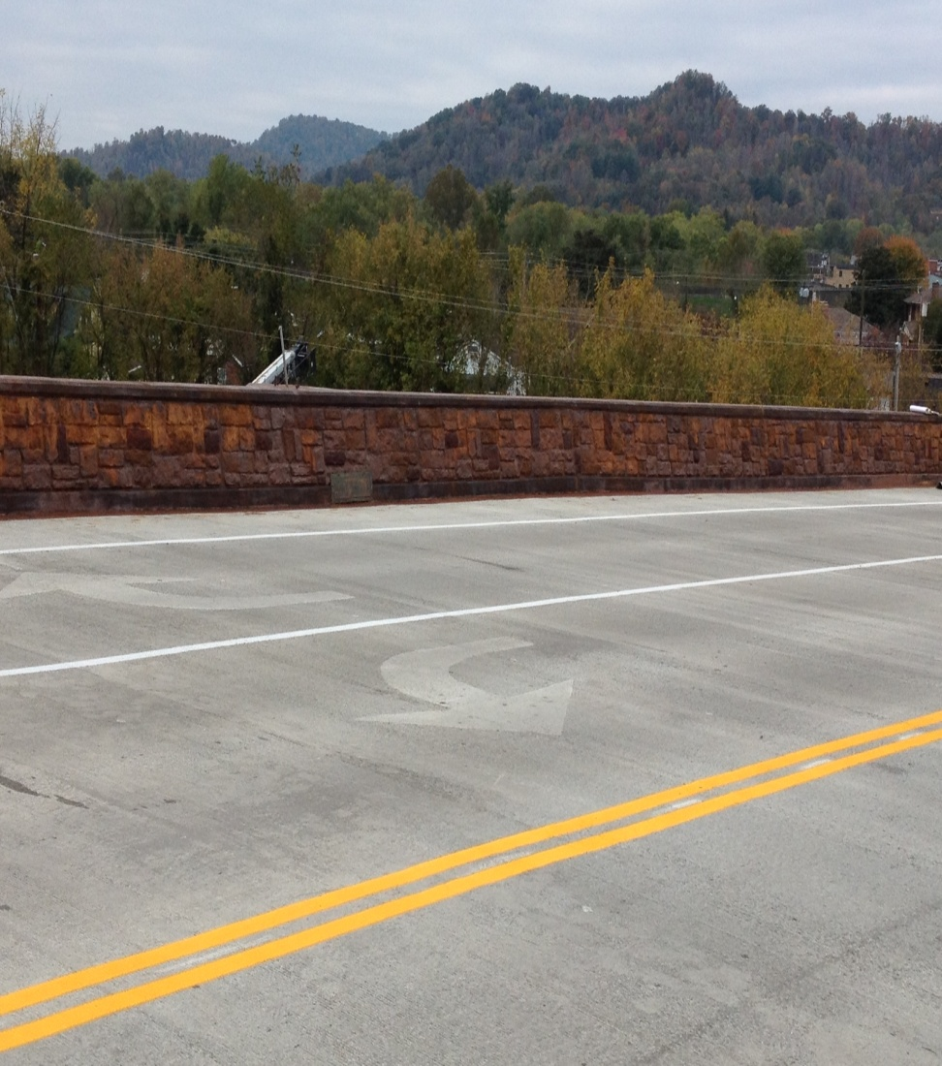
Lessons Learned
Cold Weather
Dying time
Concrete maintained moisture longer.
Could have contributed to hazing.
Application
PPE Required
High Viscosity
Contributed to runs
Cureseal W Application.
Airless sprayer.
Could not apply over curing compound or Masonry Coating.
Probably should have started with a lighter color base coat and have ample cure time before applying additional colors.
Form lined areas and wood form areas appeared to stain differently.

Slide 8
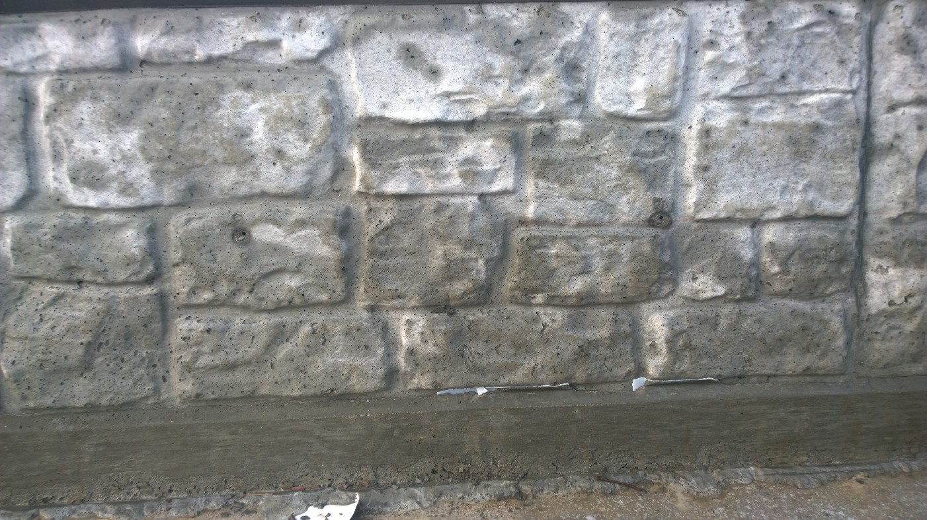
Barrier Wall prior to Stain

Slide 9
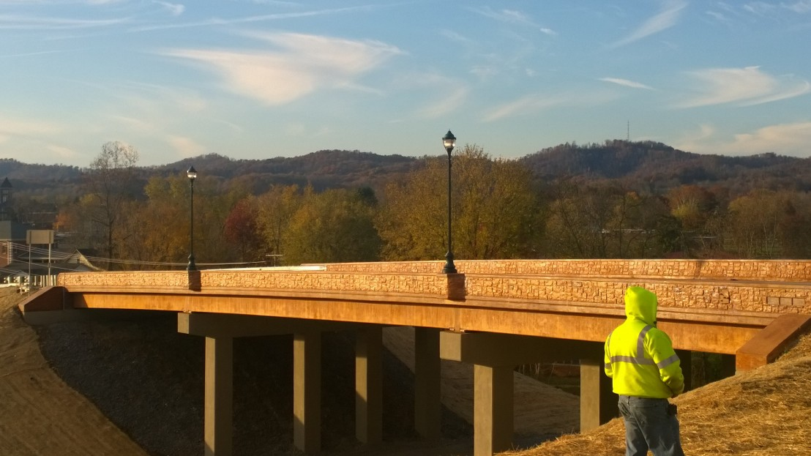
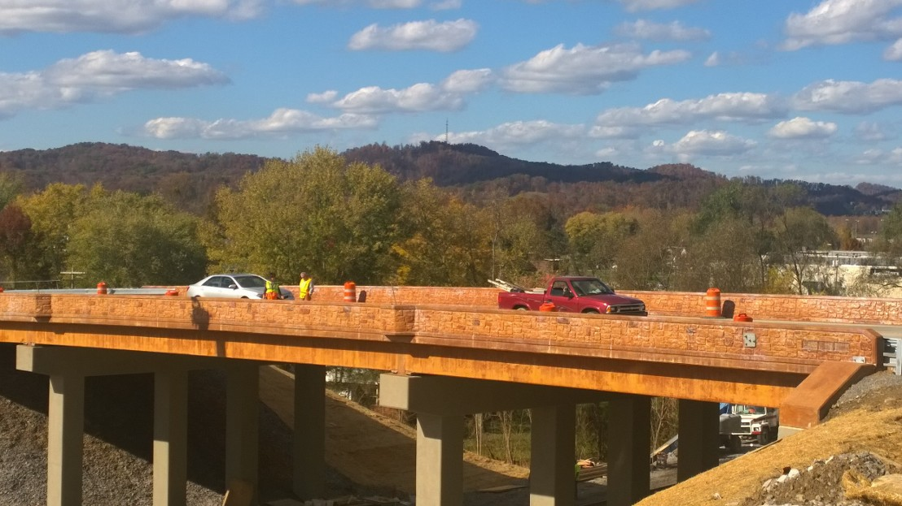
KY 11 Bridge Stained Barrier Walls

Slide 10
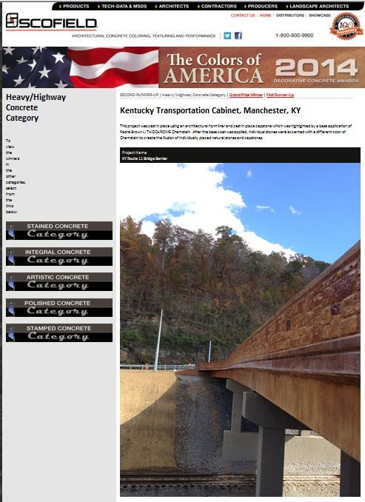
Conclusion
This project won a LM Scofield’s Yearly Decorative Concrete Award.
Alternative to Colored Stains or Masonry Coatings
Acid Stain vs Stain and Masonry Coating.
Masonry Coating - $12.00 per sf
Planned Concrete Staining – $8.50 per sf.
Acid Staining - $23.00 per sf.

