Slide 1
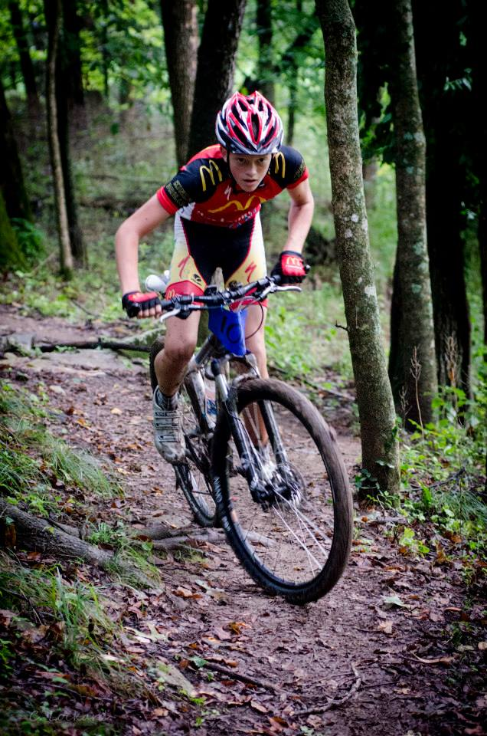
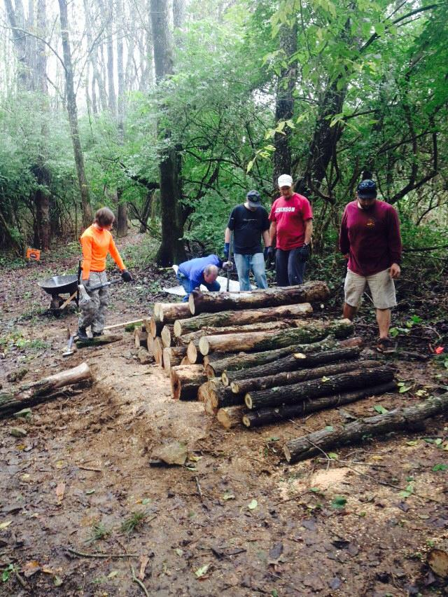
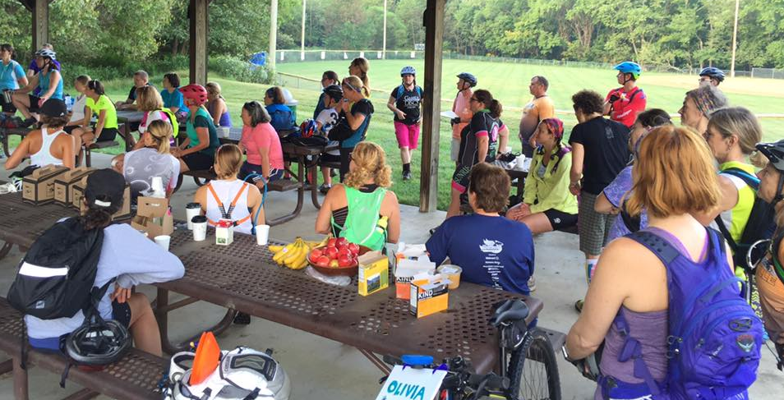
Mountain Biking is?
Part of the bike/ped master plan
Within our/your City
Opportunity
A gateway to other types of cycling
Community building!
Notes:
Today mountain biking is much more than just a select few college kids or wanna be middle aged men; it’s all ages of men and women from just about all ends of the social economic spectrum.

Slide 2
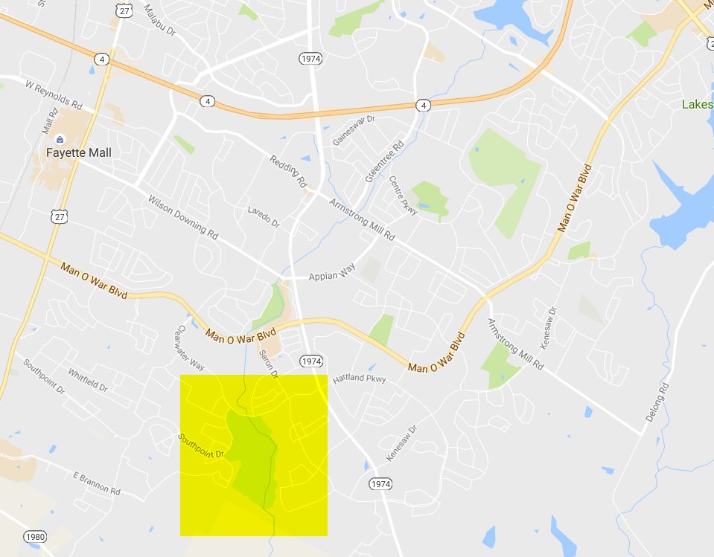
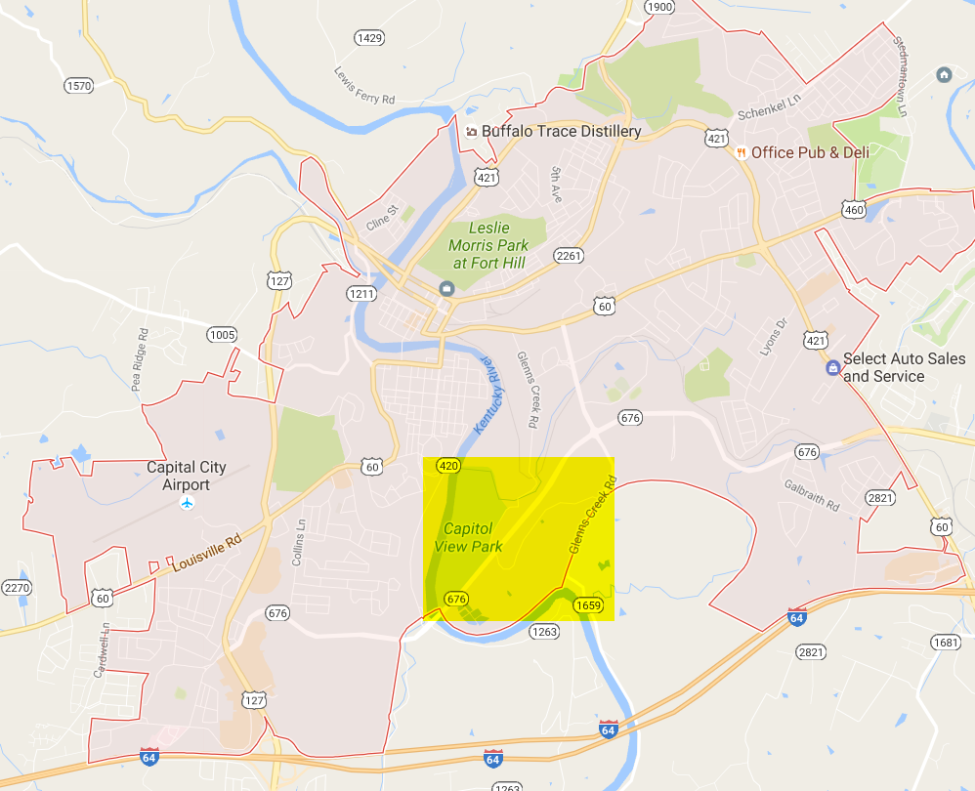
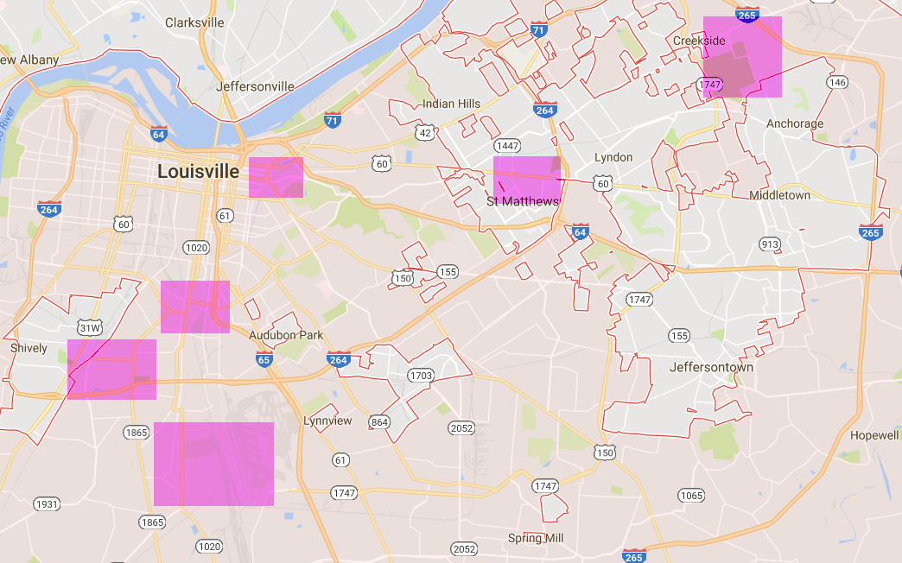
Mountain Biking is?
Part of the Master Plan
Within our City
Lexington
Frankfort
Louisville
Notes:
You can see how these trails are in the central areas of the city. Next to residential and commercial areas. Local people don’t drive to these trails, they ride to them. Planning for the movements of these citizens has been incorp. into the master plan (bike lanes, sharrows, and share the road signs). In some cases multi-use paths have been planned, design, and built to accommodate safer and more accessible travel.

Slide 3
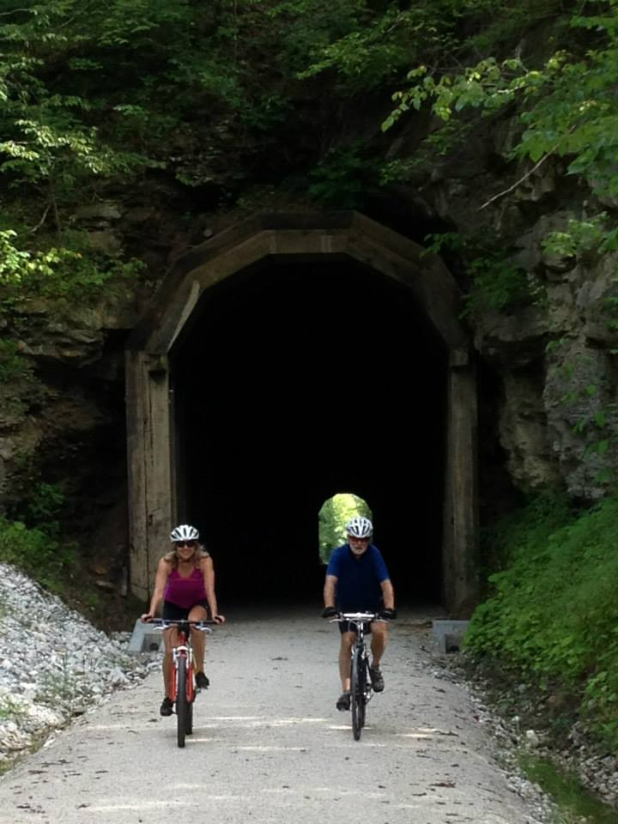
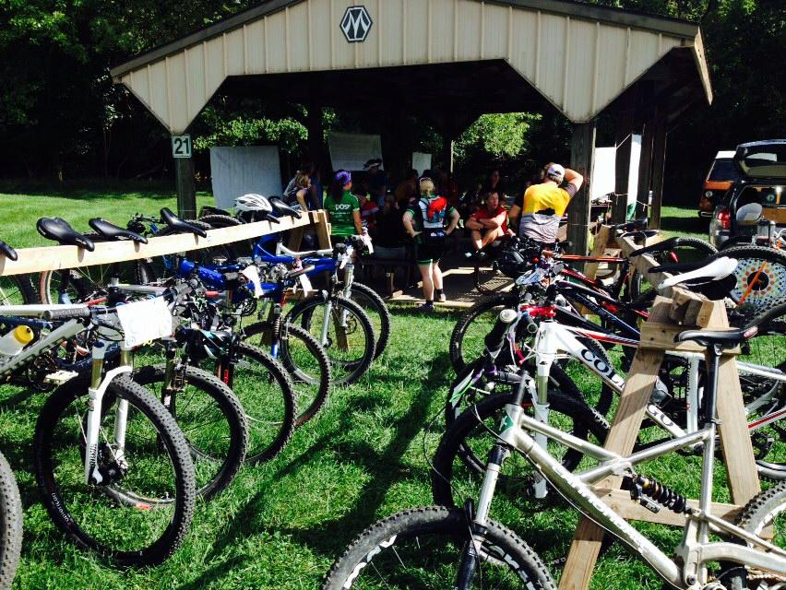
Mountain Biking is?
Opportunity
”Mountain bikers are willing to travel to a destination, ride their bikes, and spend more money.”
“These trails may be the “new” golf courses of the future!”
Notes:
Most people don’t want to ride on the road with cars and trucks. Riding off-road is a completely different experience
You can provide trails for all levels of riders (depending on the terrain and the size of the area). In most cases these trails are also for hikers and trail runners
Natural Surface trails are much less cost to design, build, and maintain. In many cases volunteer groups and private organizations can and will build these trails. These groups are professionals and have raised the level of standards to the highest possible extent.
Economic Opportunity / http://www.pinkbike.com/news/economic-impacts-of-mountain-bike-tourism-2016-update.html
http://www.browncountymountainbiking.com/index.html / http://www.ourbrowncounty.com/0709s2.htm
“we have enough miles in here now that it’s worthwhile for someone from, say, Chicago, to come ride part of it, get a place to stay, take the spouse out for dinner that night, and come back to ride more the next day,” says Logterman. What criteria prompt a national magazine to rate the Brown County system among the continent’s best? According to Stewart, variety and trails that bikers of each ability level can enjoy are the keys. “Grizzled veterans can find some fun here,” he observes.
In many examples; mountain bike trails may be the new golf courses for the next generation. (http://www.bikemag.com/features/indiana-mtb/#Xhm67JTOl3it8kBv.97)
Nani’s Deli in Nashville, IN sales in 2009 (second year of being open) was around $125,000 a year. Their sales for 2015 were $270,000. They attribute the #1 success to this increased business to tourism (and mountain bikers and hiker being the number 1 costumers).

Slide 4
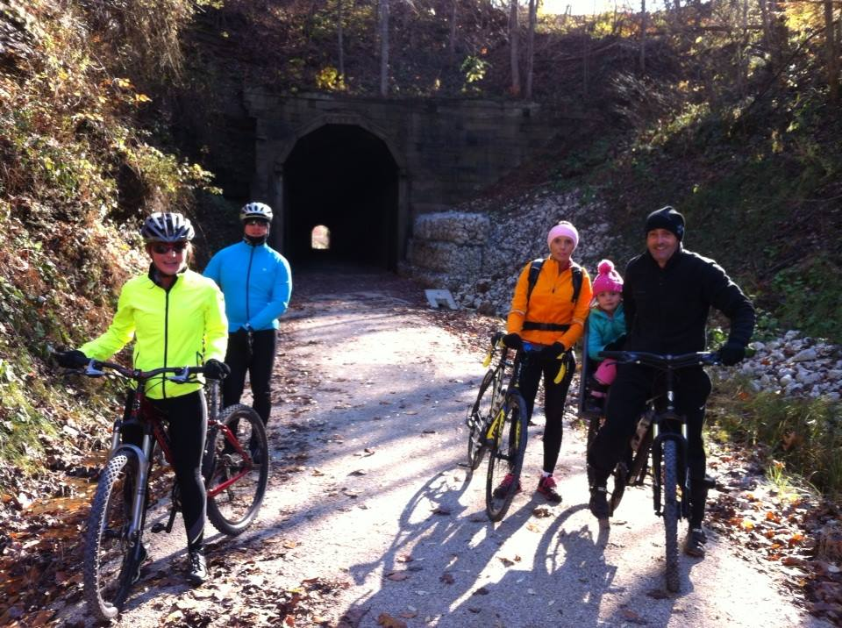
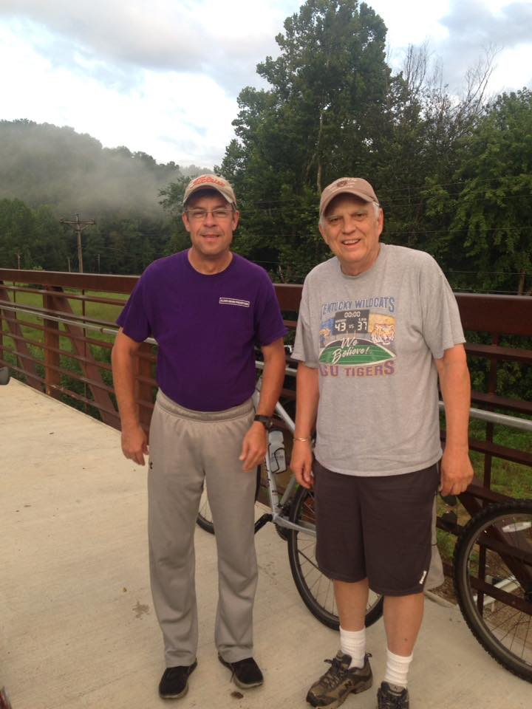
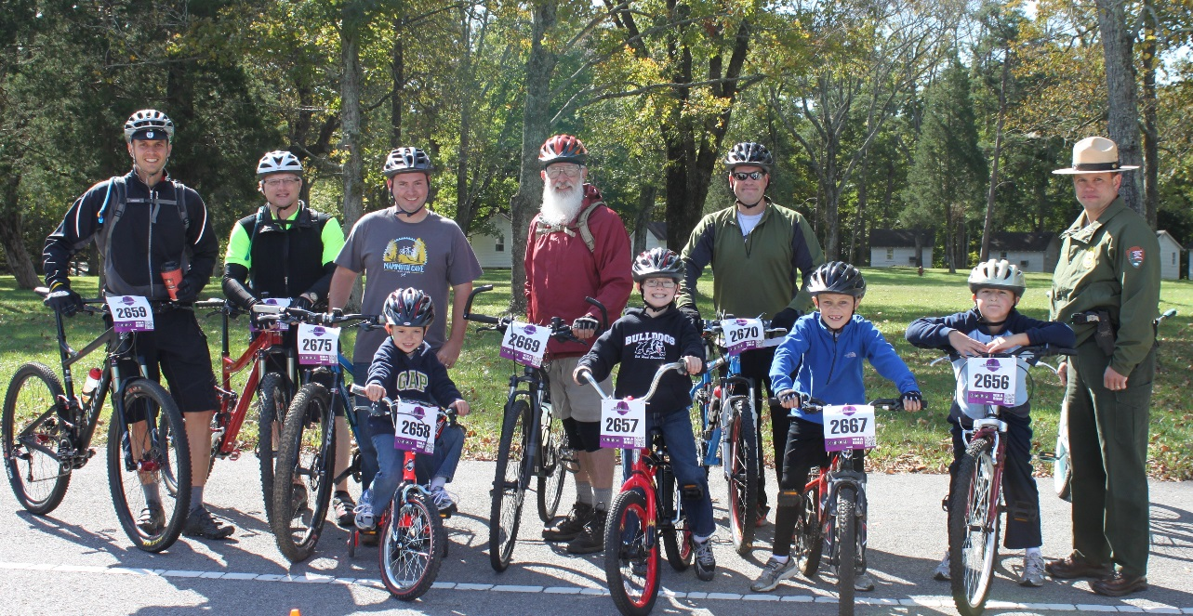
Mountain Biking is?
A gateway to other types of bicycling/activities
Notes:
Mountain biking can be a great way for kids to see the outdoors, ride with parents, provide riding opportunities away from cars & trucks.
People that would never ride bikes on the road (with cars) may love riding dedicated (easy) trails. Who know, some of them may become more advanced cyclists down the road (statistics show that over 30-50% of people that start riding off-road Segway into some type of road riding and are better riders for starting out as mountain bikers) / https://www.usacycling.org/encyclingpedia/encycstory.php?id=7408 & http://ask.metafilter.com/37410/Is-mountain-biking-good-crosstraining-for-road-biking
Places like the Dawkins Line in Eastern KY is where you will see folks that don’t look like the stereotype bicycle riders (because the are just normal people that don’t were the super hero outfit; yet).

Slide 5
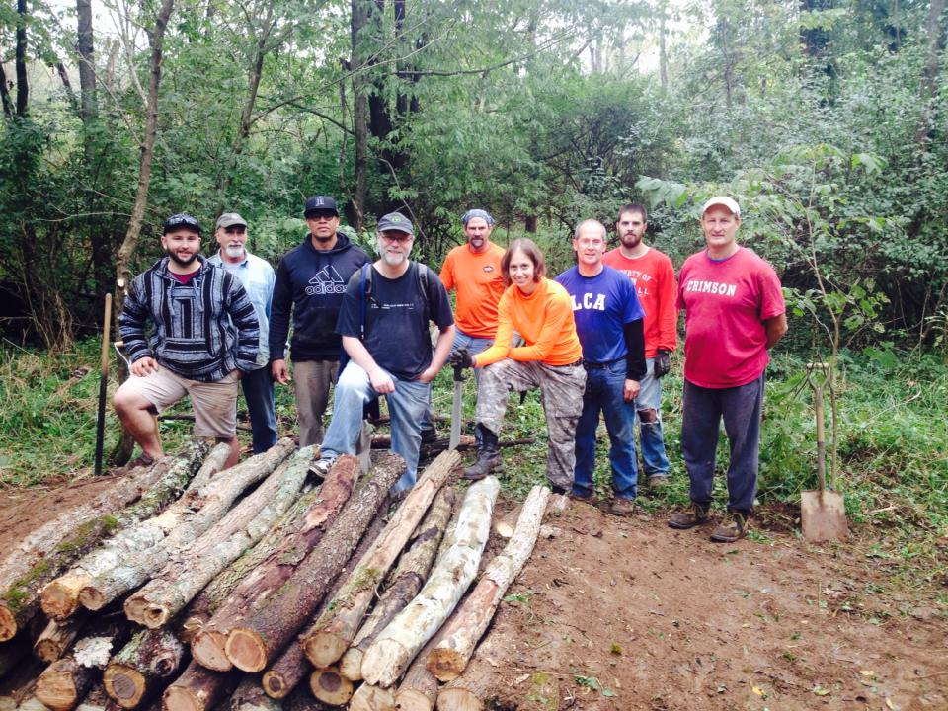
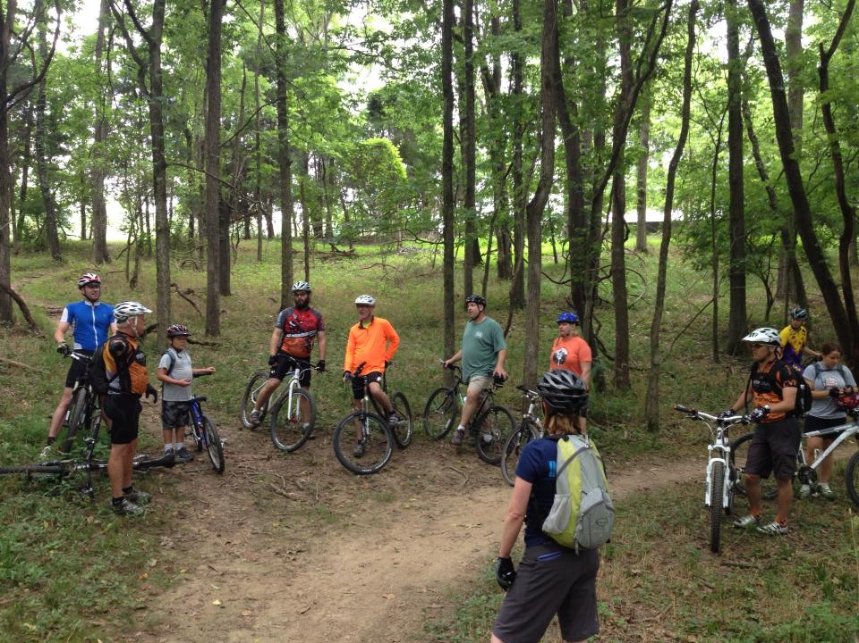
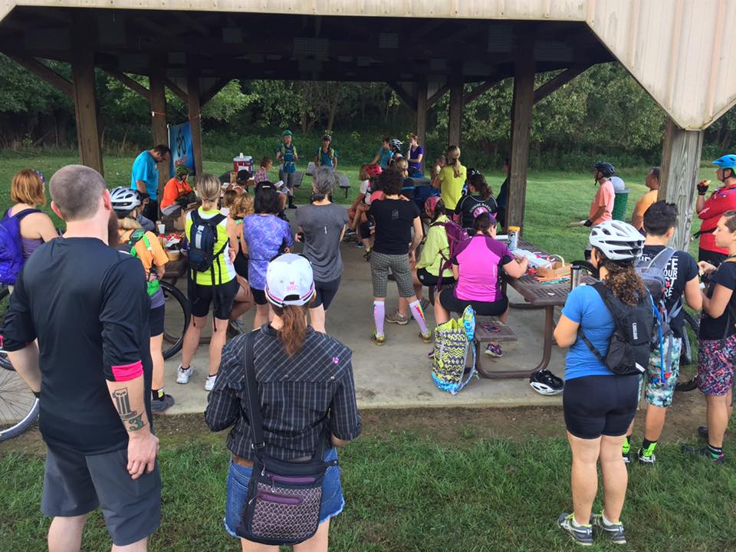
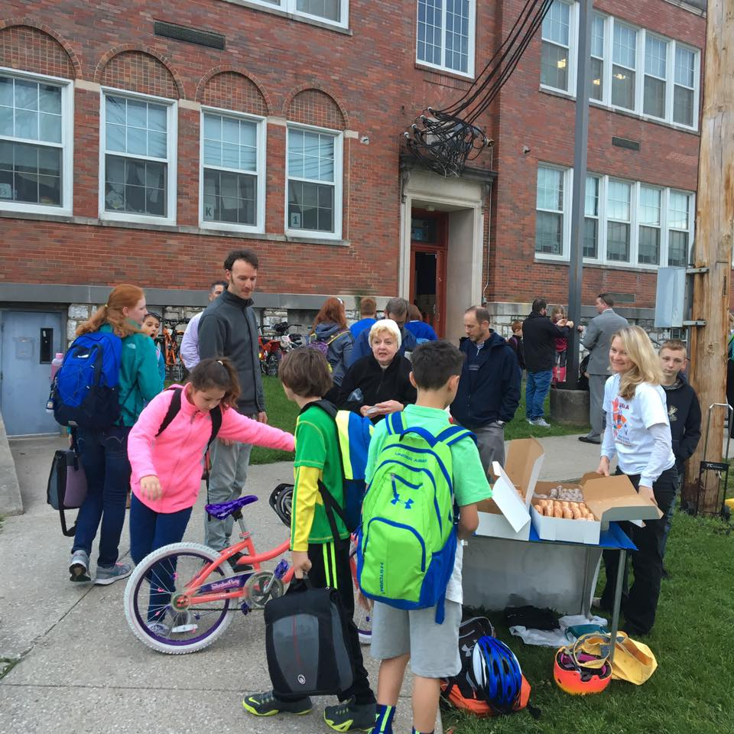
Mountain Biking is?
Community Building!
Notes:
The KY Mountain Bike Association holds several events throughout the year (most are free to the public); kids events, school events, social rides, trail work days, and so on.
The people that use these trails take personal ownership of these trails. Crime rates and issues with illegal activities has been proven to lowered as these trails have more use.
The KYMBA social media pages have over 3,000 likes and or members. These group pages and web sites are bringing people into these towns to ride. And guess what, they also eat there, stay there, and come back!

