Slide 1


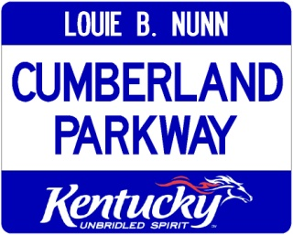

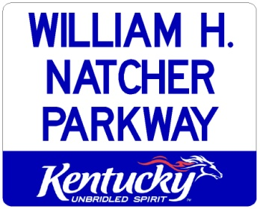















District 3
Traffic Incident Management Team
2014 4th Quarter
November 5, 2014

Slide 2
Agenda
Welcome / Introductions
TNDOT TIM & TMC initiatives update
KSP Post 3: Crash scene evidence preservation
District 3 Major Incident Plan
TIM Training in D-3
Update on Cumberland Pkwy /I-65 Construction
Recent incident review

Slide 3

Tennessee DOT
TIM & TMC Update

Slide 4
Kentucky State Police – Post 3
Post Commander Capt. John Clark
Crash Scene Evidence Preservation

Slide 5


Interstate / Parkway
Major Incident Plan
Goal
1. Designate and document, in advance, alternate routes and response plan
2. Implement tools to communicate plan to responders and traveling public
3. Identify agencies / crews responsible for implementing plan in emergency responses
Everyone has a plan & is on the same plan

Slide 6
Incident Duration
MUTCD Ch 6 classifies incidents as:
Minor—expected duration < ½ hour
  Incident point control by emergency responders
Intermediate—expected duration ½ - 2 hours
  Onsite diversion of traffic around incident usually by emergency responders
Major*—expected duration >2 hours
  Offsite detour, communication, TTC involving transportation & other offsite resources

Slide 7
I-65 Major Incident Detour Plan
Plan not “etched in stone”, will evolve and be revised as needed
A “living document” available in current form online
Result of input & experience from ALL partner agencies and communities
Must be exercised or lose effectiveness
Detour “A” documented, Plan “B / C” determined but not in document

Slide 8
I-65 Major Incident Detour Plan
Results -
Detour route maps – primary
Route signage – combination of permanent alternate, wayfinding and pre-placed flip-down detour type
Control points for diversion & access closure
Standardized setup for diversion traffic control
Obtain & stage all required devices in each I-65 county

Slide 9
I-65 Major Incident Detour Plan
DMS message templates for TOC use
Assignments for implementing & deactivating deployments including role of TOC
Review & implement with emergency agencies and KYTC staff.
Training / exercise with KYTC crew & partner agencies (Nov/Dec)
Basic Incident Command System (ICS) for KYTC supervisors (Dec/Jan)
Implement plan for Natcher & Cumberland Parkways by 1st Qtr 2015

Slide 10
Results
Designated D-3 IM Contacts
Detour / Response Plan

Slide 11
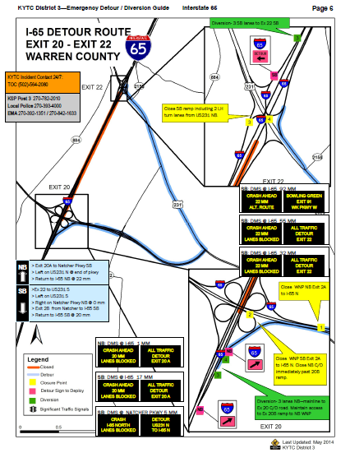
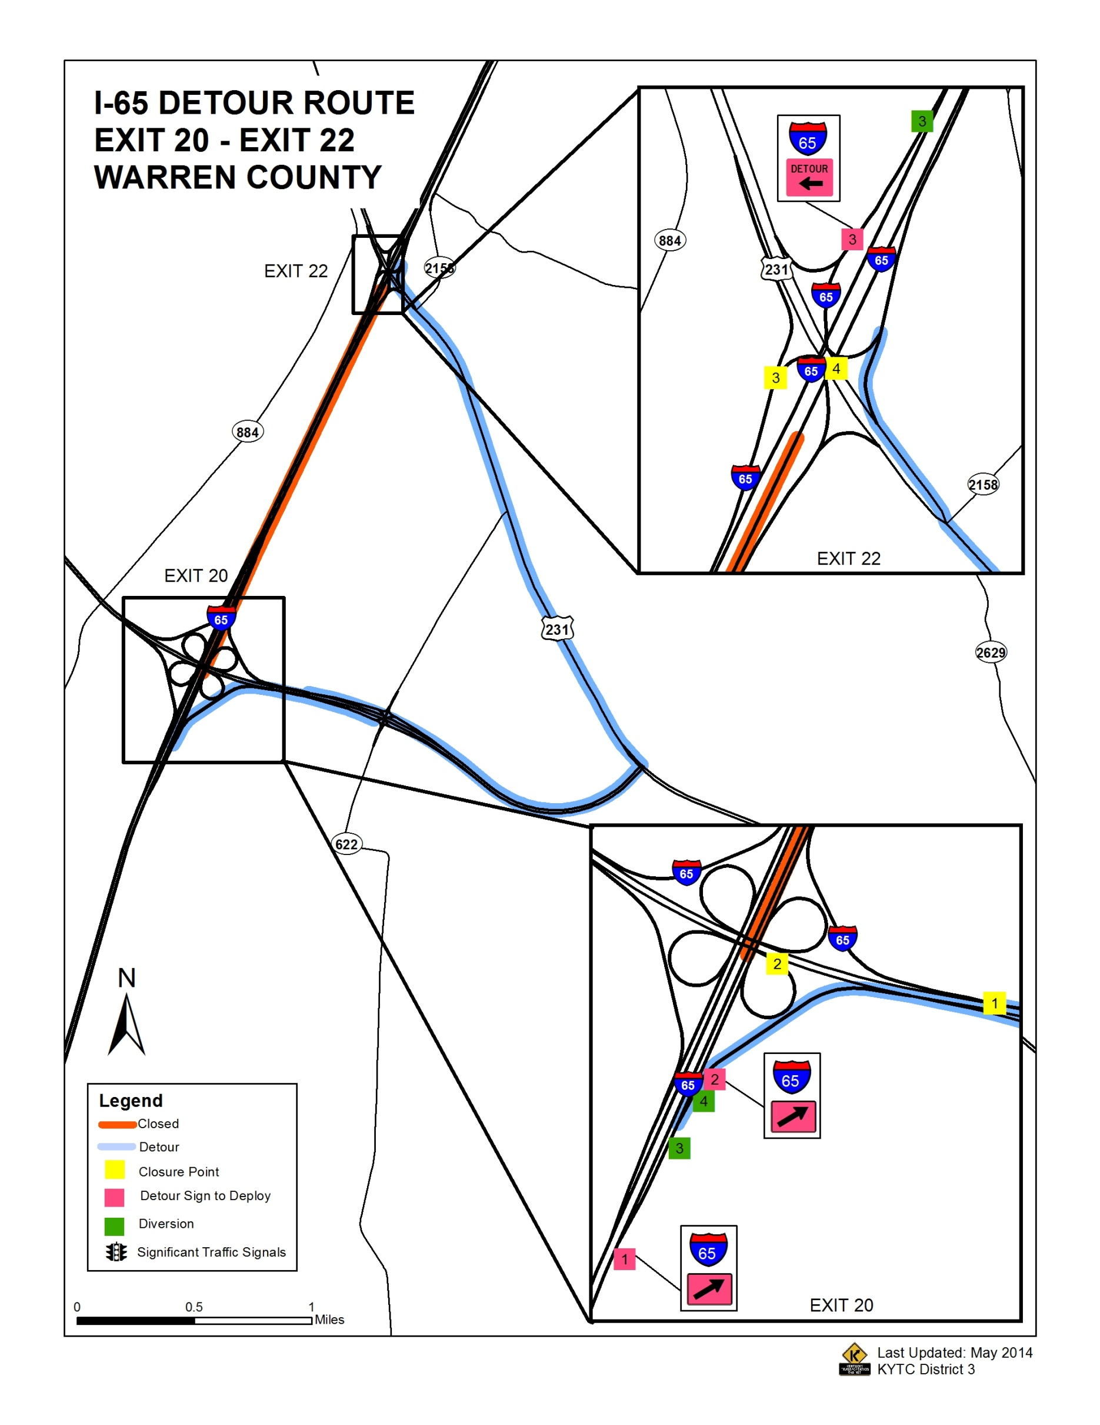
Section (Exit to Exit) Plan
Closed route map
Primary detour route map
Primary detour route directions
Detour sign locations
Diversion / access closure points
DMS message templates
Key primary contact info
KYTC District 3—Emergency Detour / Diversion Guide
KYTC District 3—Emergency Detour / Diversion Guide
Interstate 65
Interstate 65
Page 6
Page 6
Diversion- 3 SB lanes to Ex 22 SB
Diversion- 3 SB lanes to Ex 22 SB
KYTC Incident Contact 24/7:
TOC (502)-564-2080
KYTC Incident Contact 24/7:
TOC (502)-564-2080
SB
SB
KSP Post 3 270-782-2010
Local Police 270-393-4000
EMA 270-392-1351 / 270-842-1633
KSP Post 3 270-782-2010
Local Police 270-393-4000
EMA 270-392-1351 / 270-842-1633
Close SB ramp including 2 LH turn lanes from US231 NB.
Close SB ramp including 2 LH turn lanes from US231 NB.
SB: DMS @ I-65 92 MM
SB: DMS @ I-65 92 MM
CRASH AHEAD
22 MM
ALT. ROUTE
CRASH AHEAD
22 MM
ALT. ROUTE
BOWLING GREEN
EXIT 91
WK PKWY W
BOWLING GREEN
EXIT 91
WK PKWY W
SB: DMS @ I-65 55 MM
SB: DMS @ I-65 55 MM
CRASH AHEAD
22 MM
LANES BLOCKED
CRASH AHEAD
22 MM
LANES BLOCKED
ALL TRAFFIC
DETOUR
EXIT 22
ALL TRAFFIC
DETOUR
EXIT 22
SB: DMS @ I-65 32 MM
SB: DMS @ I-65 32 MM
CRASH AHEAD
22 MM
LANES BLOCKED
CRASH AHEAD
22 MM
LANES BLOCKED
ALL TRAFFIC
DETOUR
EXIT 22
NB
ALL TRAFFIC
DETOUR
EXIT 22
NB
> Exit 20A to Natcher Pkwy SB
> Left on US231 N @ end of pkwy
> Return to I-65 NB @ 22 mm
> Exit 20A to Natcher Pkwy SB
> Left on US231 N @ end of pkwy
> Return to I-65 NB @ 22 mm
Close WNP NB Exit 2A to I-65 N
to I-65 N
SB
Close WNP NB Exit 2A to I-65 N
to I-65 N
SB
>Ex 22 to US231 S
> Left on US231 S
> Right on Natcher Pkwy NB @ 0 mm
> Exit 2B from Natcher to I-65 SB
> Return to I-65 SB @ 20 mm
>Ex 22 to US231 S
> Left on US231 S
> Right on Natcher Pkwy NB @ 0 mm
> Exit 2B from Natcher to I-65 SB
> Return to I-65 SB @ 20 mm
NB: DMS @ I-65 1 MM
NB: DMS @ I-65 1 MM
CRASH AHEAD
20 MM
LANES BLOCKED
CRASH AHEAD
20 MM
LANES BLOCKED
ALL TRAFFIC DETOUR
EXIT 20 A
ALL TRAFFIC DETOUR
EXIT 20 A
NB
NB
Close WNP SB Exit 2A to I-65 N. Close NB C/D immediately past 20B ramp.
Close WNP SB Exit 2A to I-65 N. Close NB C/D immediately past 20B ramp.
SB: DMS @ I-65 17 MM
SB: DMS @ I-65 17 MM
CRASH AHEAD
20 MM
LANES BLOCKED
CRASH AHEAD
20 MM
LANES BLOCKED
ALL TRAFFIC DETOUR
EXIT 20 A
ALL TRAFFIC DETOUR
EXIT 20 A
Diversion- 3 lanes NB—mainline to Ex 20 C/D road. Maintain access to Ex 20B ramp to NB WNP
Diversion- 3 lanes NB—mainline to Ex 20 C/D road. Maintain access to Ex 20B ramp to NB WNP
SB: DMS @ NATCHER PKWY 5 MM S
SB: DMS @ NATCHER PKWY 5 MM S
NB
NB
CRASH
I-65 NORTH
LANES BLOCKED
20-22 MM
CRASH
I-65 NORTH
LANES BLOCKED
20-22 MM
DETOUR
US231 N
TO I-65 N
DETOUR
US231 N
TO I-65 N

Slide 12
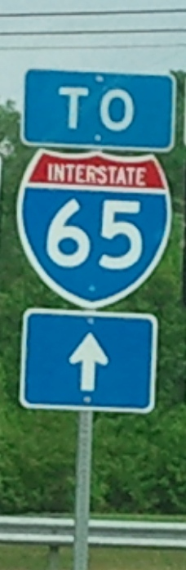
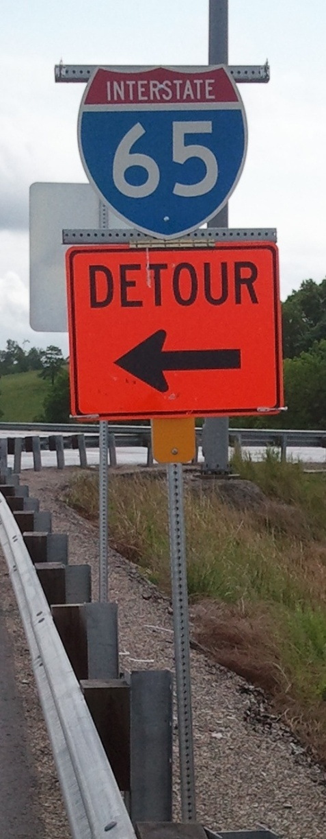
Flip-down detour signs
Use permanent signage where possible
Use flip-down detour signage only where necessary
Permanent alternate or wayfinding signs

Slide 13
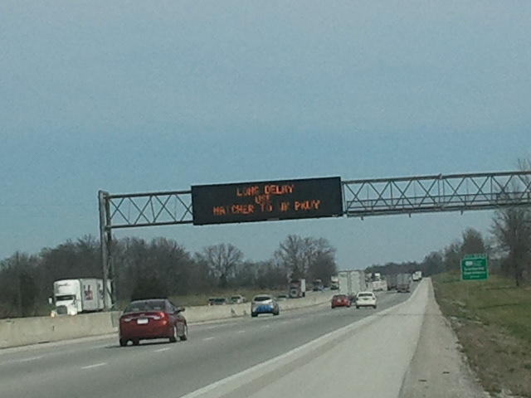
DMS System
All KYTC DMS assets now controlled by single system
Sole control point is Transportation Operations Center (TOC) – no District control
I-65 0.2 mm NB
I-65 17 mm NB
I-65 36 mm NB *
I-65 92 mm SB
I-65 55 mm SB *
I-65 32 mm SB
WNP 5 mm SB
LNP 3 mm WB
KY446 EB
US231 6 mm NB

Slide 14
Incident Notifications & TOC
Effective now initial notification of KYTC
  Primary notification point is TOC 24/7 502-564-2080
  TOC will maintain KYTC current / on-call contact list and activate initial KYTC response
  TOC will activate digital message signs (DMS) – sole control point for all DMS in state.
  Non-emergent issues can still go to county contact or District Office.
  Any issues with TOC report to D-3 IM Coordinator

Slide 15
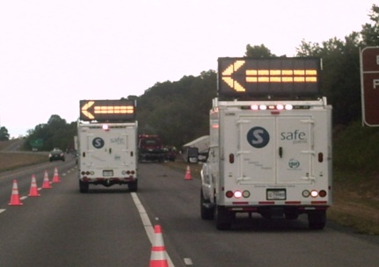
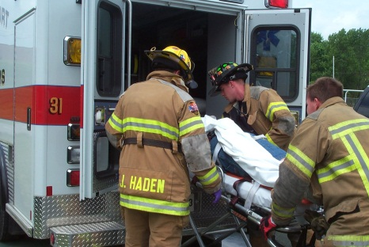
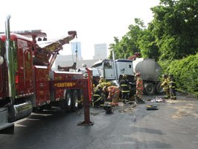
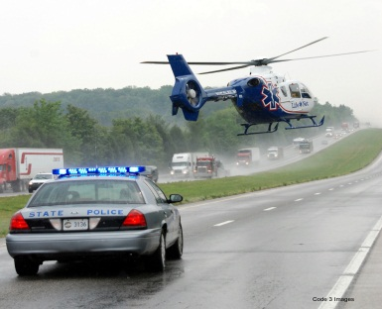
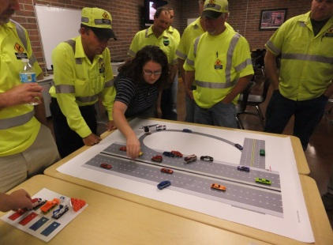
National Traffic Incident Management Responder Training Program
UK Transportation Center
District 3 – Winter 2014-2015
Day or Evening ?
Location?

Slide 16
Post Incident Reviews
Can be effective way to solve problems
Can be requested by any agency involved in response
Discuss what went well & what we can do better next time
Solutions oriented - non-confrontational / non-blaming
Should be within 48-72 hours
KYTC District 3 IM Coordinator can coordinate

Slide 17
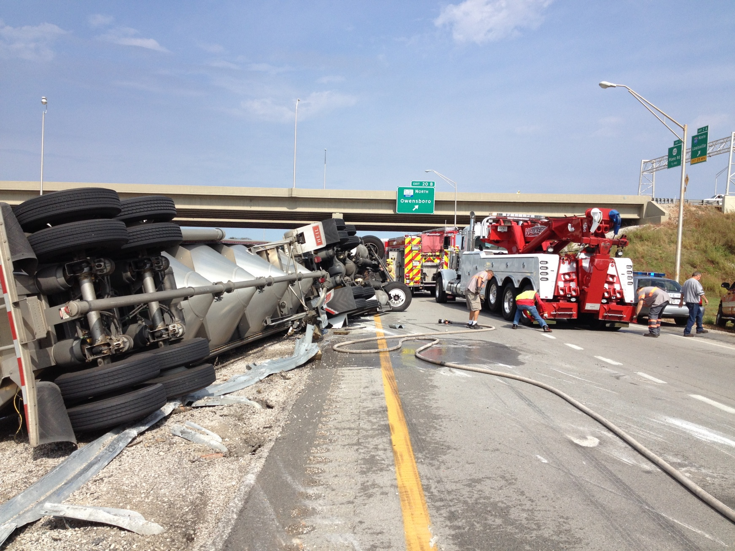
Oct. 9th I-65N 20A/B & Natcher S 2A

Slide 18
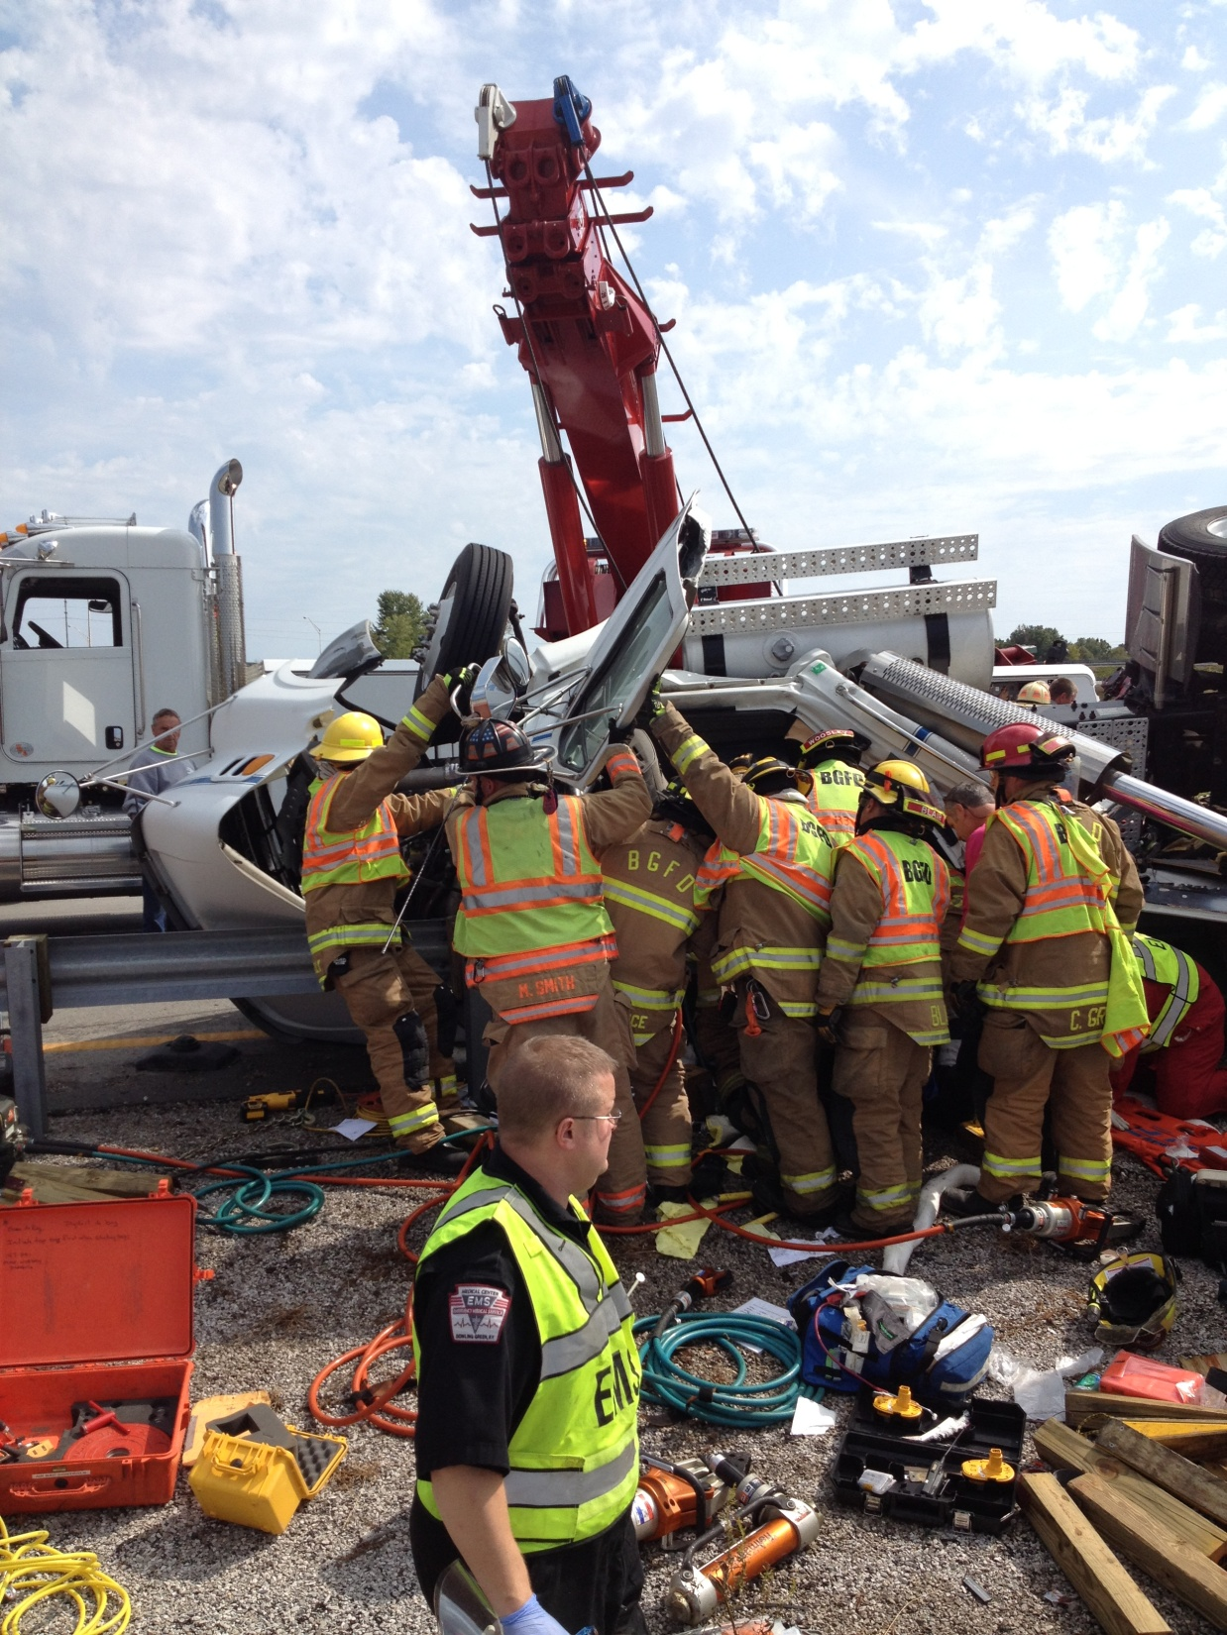

Slide 19
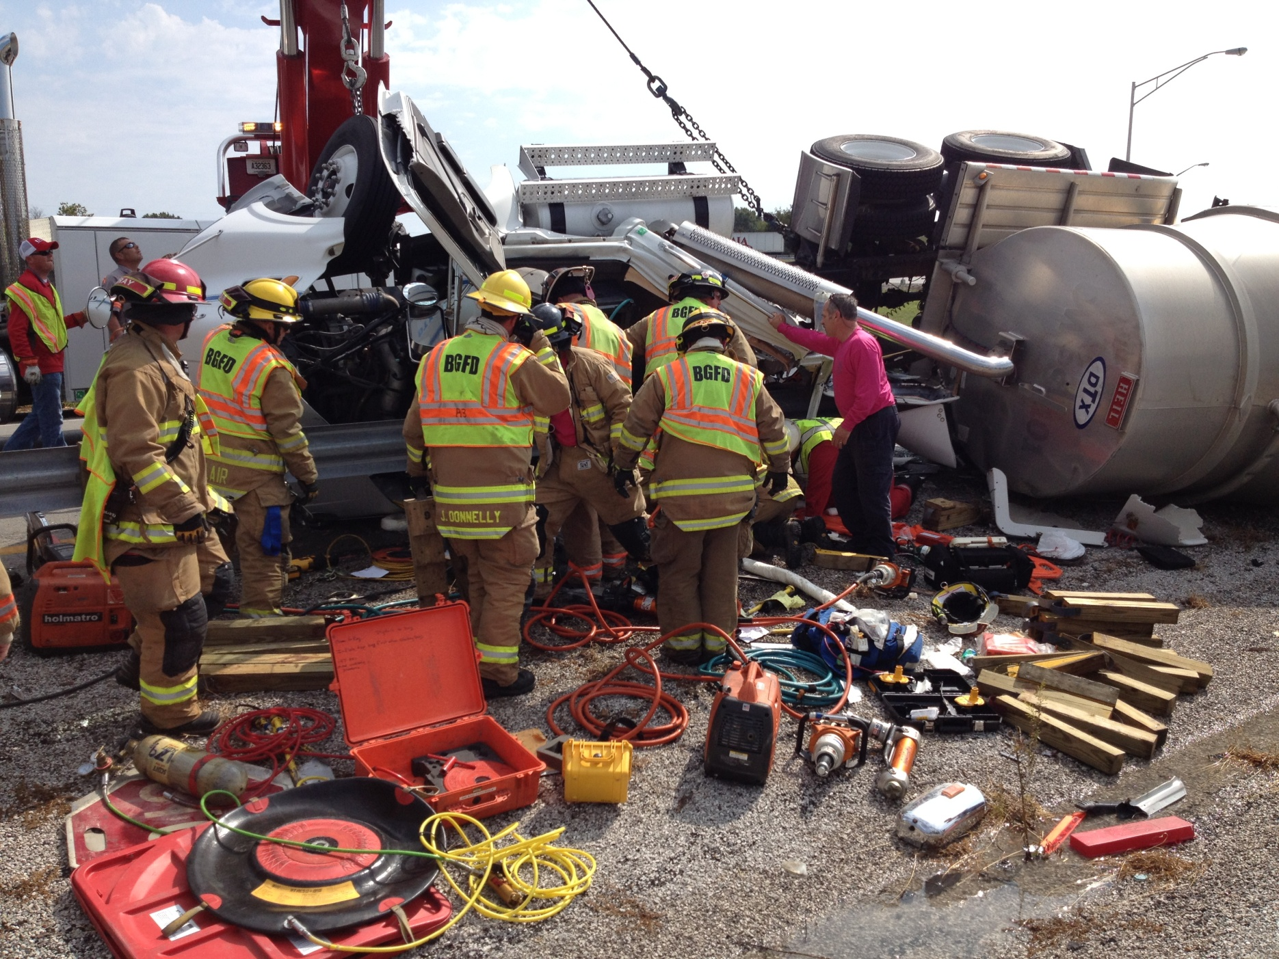

Slide 20
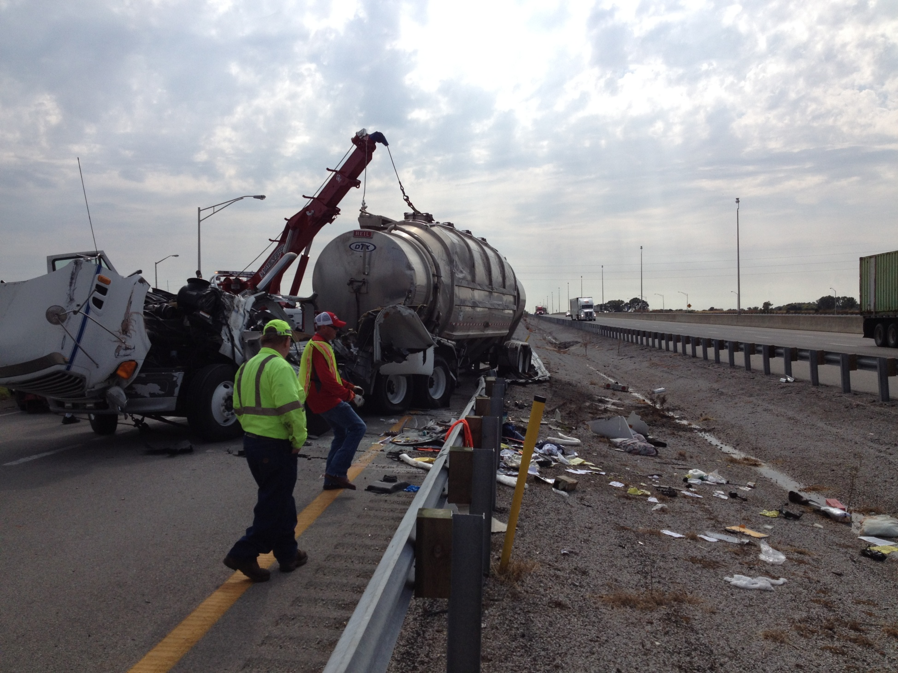

Slide 21
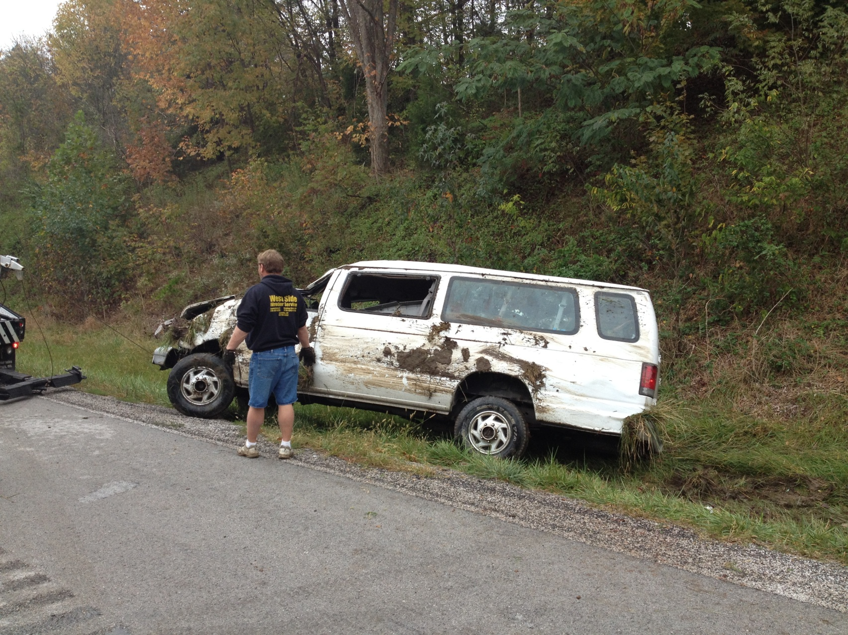
Oct 10th, Natcher 32 NB
11 passengers, rollover 9 transported

Slide 22
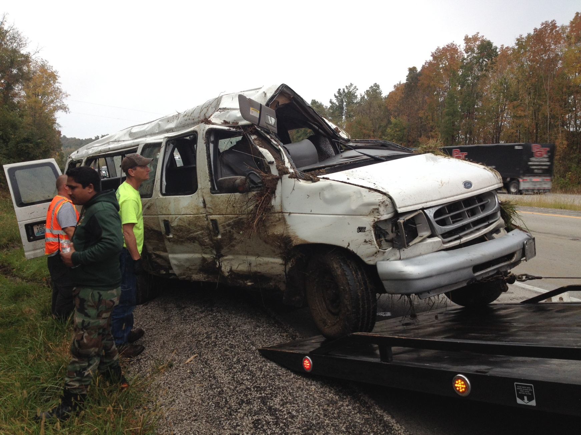
2 hr NB closure

Slide 23
Other Recent Closures
Sunday Sept 14th 9:06 pm
Simpson Co I-65 8.6 mm, 2 CMVs one with carnival ride, large debris field
Tuesday Oct 27th 05:30 am
  Adair Co / D4 Cumberland Pkwy EB 40 mp
  Tanker w/ 7500 gal diesel overturned. Total closure both directions through approximately noon.

Slide 24




D-3 Traffic Impact Updates
Most current information is always available from PIO Wes Watt via
@KYTCDistrict3
kytcdistrict3

Slide 25
Project Updates
Cumberland Pkwy – new interchange 29 @ Edmonton East US68
  Goal early December, but may slide to March due to interchange lighting installation.
Cumberland Pkwy – new interchange 9 @ US68 “Outer Loop”.
  Spring 2015 due to paving / weather
I-65 to US31W Transpark Connector
  Bridge construction @ new I-65 interchange & US68 started. Total 7 bridges.
  Plan completion end 2015

Slide 26
Future Meetings
Share information / educate other team members on what is new or important for your role in Incident Management.
****IM Team is ALL of us not just KYTC *****
EPC: Small Spill Reporting & Cleanup
State Police: Crash scene evidence preservation
Emergency Management
  Role & authority of EM & outside resource integration
Towing & Recovery Operators or Association
  Operator standards or certifications
Health Dept
Others

Slide 27
Other Team / Meeting Issues

Slide 28
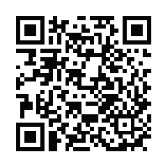
Next Meeting
February 3rd 2015
Presentations & other D-3 IM Team files can be found at
http://transportation.ky.gov/District-3/Pages/TIM.aspx
Jon Lam
District 3 IM Coordinator
Office 270-746-7898 xt 225
Cell 270-392-8760 or 270-784-8570
Jon.lam@ky.gov

