Slide 1



















KYTC D-3 Incident Mgt Meeting
2014 2nd Quarter
May 6th, 2014

Slide 2
Agenda May 6th, 2014
Welcome / Introductions
Review of recent incidents
Update on “Hold-Harmless” protection
KYTC D-3 Interstate / Parkway Emergency Plan
Construction projects
ERT Small Spill cleanup – Kevin Strohmeier
Upcoming training opportunities
2014 Goals and planning

Slide 3
Review of Recent Incidents
3/15/14 I-65 40 mm SB - Semi crash/fire
4/14/14 Nunn Pkwy 24 mm – Semi crash / spill

Slide 4
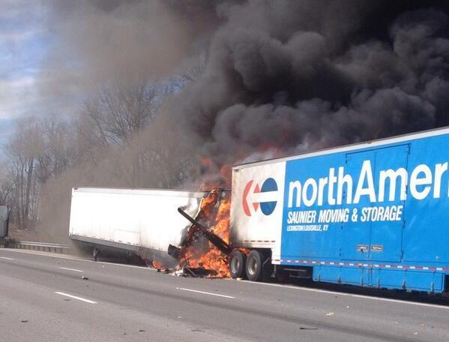
Mar. 15th, I-65 40 mm SB Crash / Fire
SB truck rear-ended another moving SB truck. Resulted in fire and 1 fatality.
13:30 est – crash
13:51 KSP notifies KYTC
14:20 KSP estimates 5 hr closure
14:43-15:00 Detour implemented
DMS signs activated
KSP, Warren EMA, KYTC, MCEMS,
Smiths Grove, Park City, South Barren, and Gott FD

Slide 5
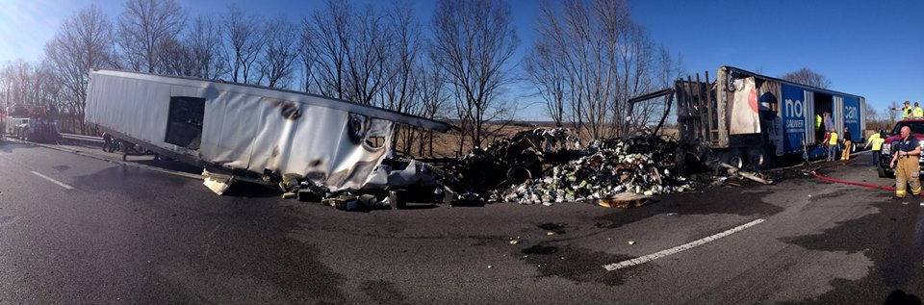
Mar. 15th, I-65 40 mm SB Crash / Fire
15:20 est – 1 LH lane opened to clear SB traffic queue
17:19 – US68 @ Denton Rd blocked due to TT in ditch (self-detoured off I-65)
21:00-21:15 site cleaned up, remaining lanes reopened.
8+ hour total incident duration, 3 hr total closure.
KYTC D-3 held an internal AAR within 3 days – action items

Slide 6
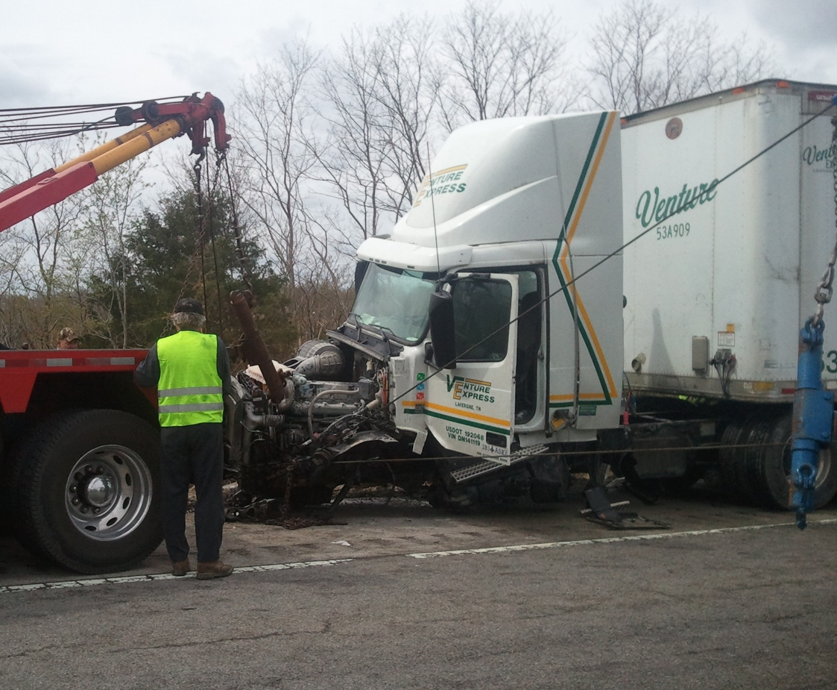
Apr. 14th Nunn Pkwy 26mm Crash
EB semi-truck struck bridge over KY640 in Metcalfe Co, slid down LH bridge rail, crossed to rest on RH guardrail. Damage to bridge, debris below on KY640, 100+ gal fuel spill.
08:00 est – Crash
08:10 EB diversion at Glasgow
requested
09:20 EB diversion setup
completed
09:30-09:50 EB queue
emptied

Slide 7
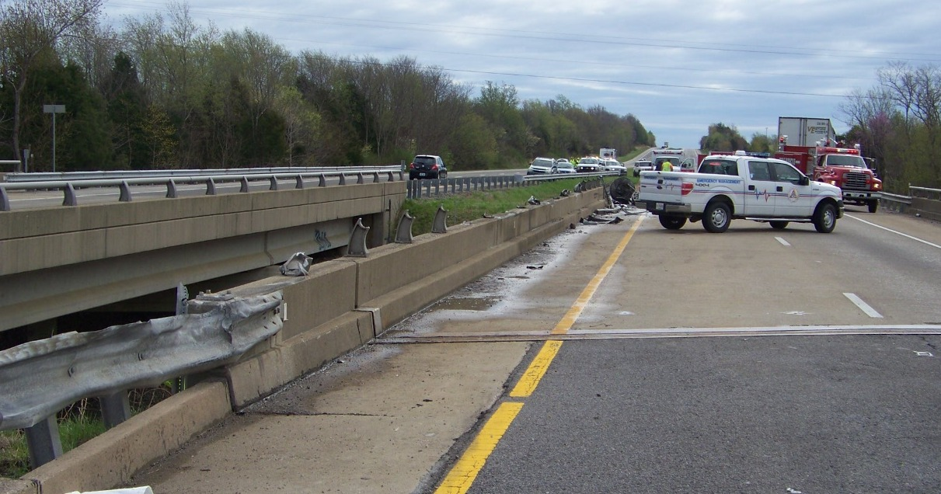
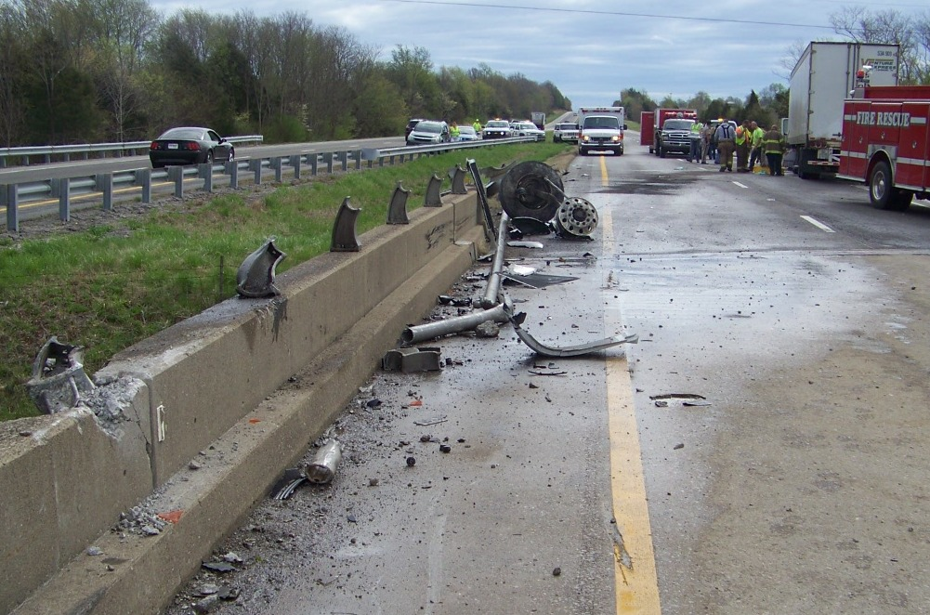
Apr. 14th Nunn Pkwy 26mm Crash
12:05 EB RH lane opened & EB
diversion removed
LH lane remained closed through April 16th for bridge repairs

Slide 8
Incident Clearance “Authority removal”
28 of 50 states have some form of AR statute
Authorization to pre-designated public agency / agencies – generally law enforcement or state DOTs – to remove damaged or disabled vehicles and/or spilled cargo from roadway that is determined to be a hazard.
If the driver is unwilling or unable to remove the vehicle or cargo, designated authorities may require or perform removal without consent of the owner.

Slide 9
Kentucky Authority Removal statute
KRS 189.580 (4) & (5)(a)-(b)
(4) Except as provided for in subsection (5) of this section, a peace officer or safety officer may remove or cause to be removed from the roadway of an interstate highway or parkway or any on-ramp or off-ramp thereto, without consent of the owner or operator, any vehicle, cargo, or other property which is obstructing the roadway, creating or aggravating an emergency situation, or otherwise endangering public safety. Any vehicle, cargo, or other property obstructing the roadway of an interstate highway or parkway shall be removed by the most expeditious means available to clear the obstruction, giving due regard to the protection of the property removed.
(a) In accidents that involve fatalities or known or visible injuries, the removal provisions of subsection (4) of this section shall apply only after all medical assistance, fire supervision, and site investigation have been
completed.
  (b) The removal provisions of subsection (4) of this section shall not apply
  if an accident involves, or is believed to involve, a release of hazardous
  materials.

Slide 10
“Hold Harmless” / Liability protection
“Hold Harmless” statutes in many of the AR states protect public agencies from liability for damage to cargo or wrecked vehicle except for gross negligence.
LRC recommended to not bring bill to last General Assembly – duplicate law (Sovereign Immunity)
D-4 IM Team has asked for OAG opinion affirming this protection.

Slide 11


Interstate / Parkway Emergency Plan
Goal
1. Designate and document, in advance, alternate routes and response plan
2. Implement tools to communicate plan to responders and traveling public
3. Identify agencies / crews responsible for implementing plan in emergency responses
Everyone has a plan & is on the same plan

Slide 12
Interstate / Parkway Emergency Plan
Planned results -
Route maps – primary & secondary
Route signage – combination of permanent alternate, wayfinding and pre-placed flip-down detour type
Control points for diversion & access closure
Standardized setup for diversion traffic control
Pre-loaded message packages for electronic message boards for rapid activation
Assignments for implementing & deactivating deployments.

Slide 13
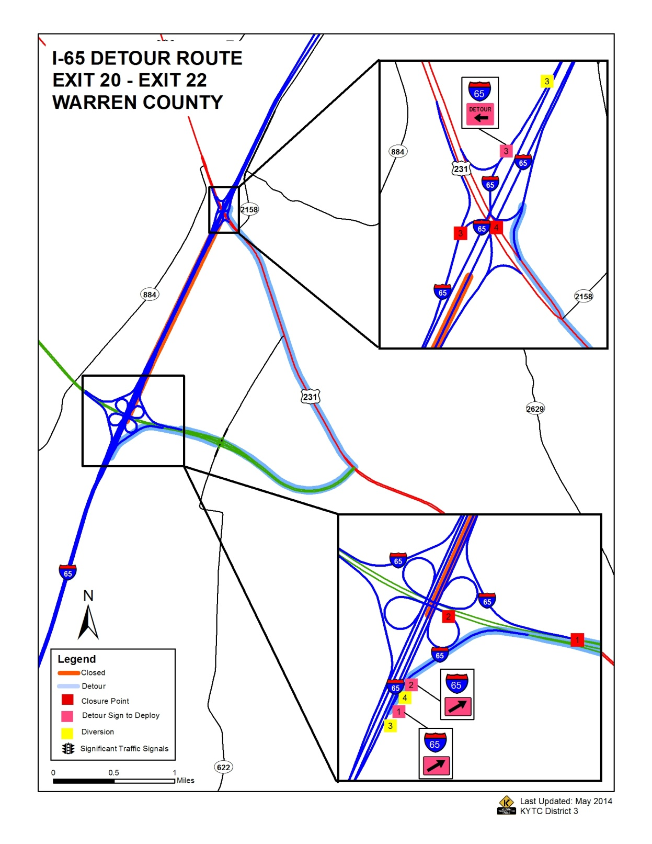
Plan Map
Referenced to plan
Detour route
Diversion & access closure points
Flip-down detour guide signs
Traffic signals to monitor during event.

Slide 14
Emergency Plan
Emergency contacts – KYTC and emergency response agencies
Detour route
Closure / diversion points
DMS messages preloaded
Detour signs to deploy
Critical traffic signals
Additional information

Slide 15
Standard Diversion Plan : I-65 3-lane

Slide 16
Completed Elements I-65
Segment emergency plan 0.0 – 53.4 mm
Diversion TTC plan agreed, equipment obtained & staged
  Warren has trailer pre-loaded
  Barren purchasing trailer to pre-load
  Butler, Metcalfe, Simpson have equipment staged.
Maps - detour route, diversion & closure points, flip-down detour signs 0.0-28 mm
Alt route / detour route sign engineering plan completed & approved to proceed.

Slide 17
Next steps –
Finalize maps with all elements in place 28-53 mm
Begin Alternate I-65 & detour sign installation / updating work
Work with TOC on message board process
Review with emergency response agencies & KYTC crews
Training / briefings with involved & affected crews / agencies to implement
Continue same process for Natcher & Nunn Parkways
Goal : all I-65 plans complete by end of 3rd Qtr. 2014
Permanent sign installation by EOY 2014

Slide 18
Construction Projects
I-65 Reconstruction – Barren & Hart
I-65 Transpark / US31W connector - letting June
Nunn Parkway / Glasgow Outer Loop
Nunn Parkway / Edmonton US 68 interchange
US 31-W / University Roundabout
Get added to PIO Wes Watt’s e-mail list for weekly traffic impact reports & other info.

Slide 19
Kevin Strohmeier
Call Coordinator / State On-Scene Coordinator
Dept for Environmental Protection
Div. of Enviromental Program Support / Emergency Response Branch
Office 502-564-2150
Cell 270-734-5236
Kevin.Strohmeier@ky.gov
http://dep.ky.gov/Pages/ERT.aspx
Spill Reporting Hotline 24/7
1-800-928-2380 or 502-564-2380

Slide 20
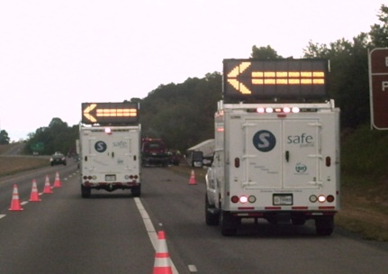
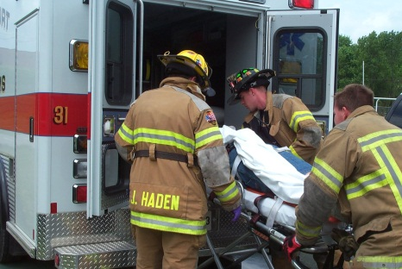
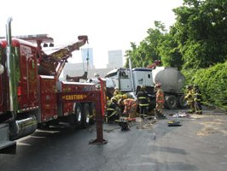
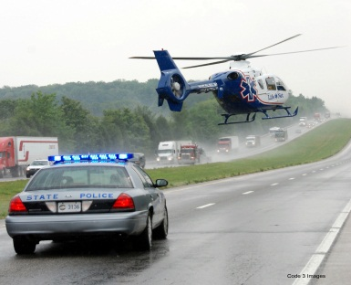
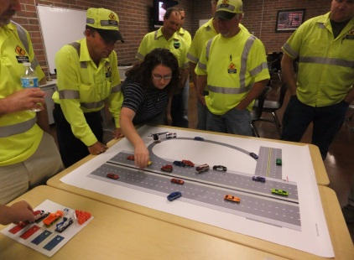
National Traffic Incident Management Responder Training Program
Thursday, May 29, 2014, 9:00am – 1:00pm (CST)
Hart County Extension Office,
505 A.A. Whitman Lane, Munfordville.
Register for this free training online:
http://www.kyt2.com/training/event/traffic-incident-management

Slide 21


Slide 22
2014 - Meetings
Involving all IM Team members and interests
Interest in other team agencies co-hosting?
  KSP
  County SO,
  KYEM, County EM,
  Towing / recovery,
  KY DEP – Emergency Response
Outside subject matter experts or presentations?

Slide 23
2014 IM Team Goals
OUR TEAM –
OUR CHALLENGE
IM Team Mission Statement
Your agencies role in TIM
Please respond to the questionaire you will receive by e-mail

Slide 24
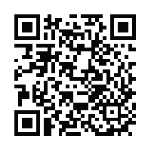
Next Meeting
Tuesday August 5th, 9 am
Presentations & other D-3 IM Team files can be found at
http://transportation.ky.gov/District-3/Pages/TIM.aspx
Jon Lam
District 3 IM Coordinator
Office 270-746-7898 xt 225
Cell 270-392-8760 or 270-784-8570
Jon.lam@ky.gov

