Slide 1
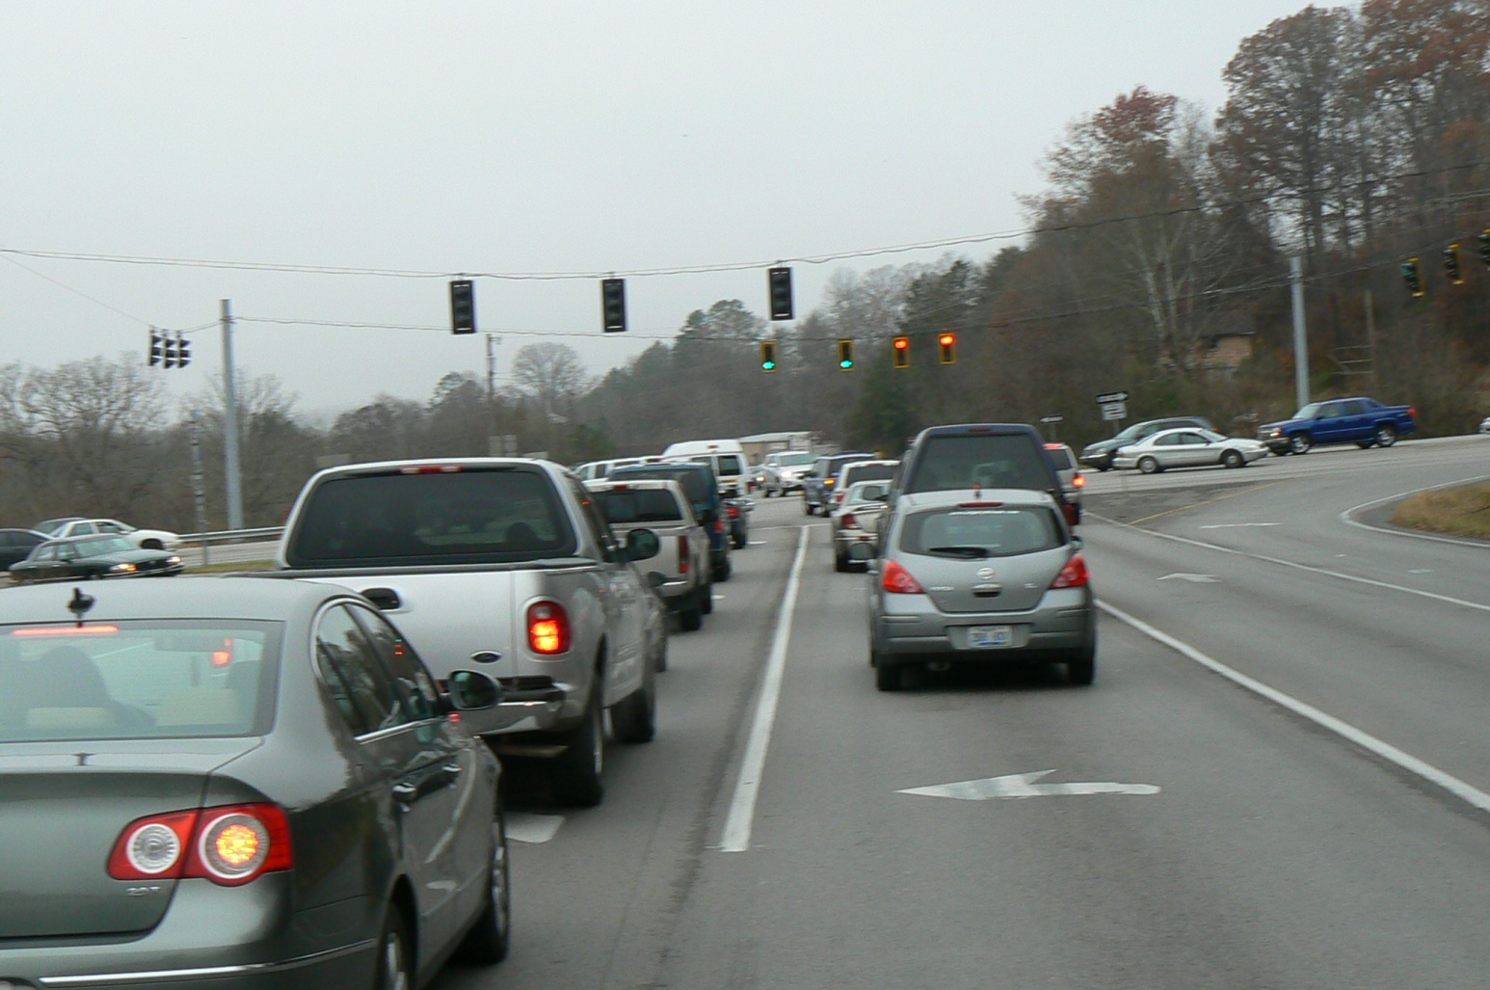
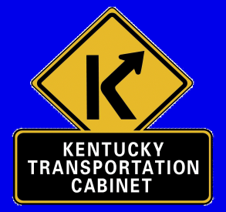
US 25 Corbin to London
Citizens Advisory Committee Meeting #2
March 2012

Slide 2
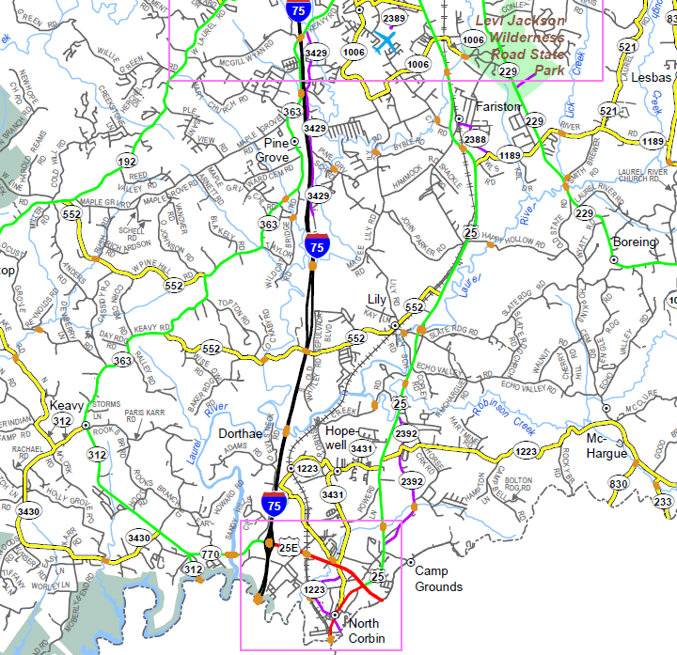
Project Limits
End Project
Begin Project

Slide 3
US 25 - Project Flow
1st Citizen Advisory Group meeting
1st Public Meeting
**2nd Citizen Advisory Group meeting**
3rd Citizen Advisory Group meeting
4th Citizen Advisory Group meeting
2nd Public Meeting
5th Citizen Advisory Group meeting
6th Citizen Advisory Group meeting
Public Hearing

Slide 4
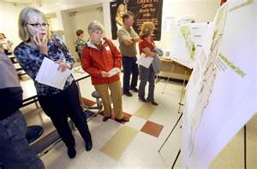
1st Public Meeting
February 21st – Hunter Hills Elementary
77 Individuals Attended
20 Comment Sheets turned in
Lots of comments on the maps
Mostly Daily Users
Nearly split Residential/Commercial

Slide 5
Comment Sheet Summary
Majority of Comments Pertain to Safety
Second Highest Concern Seems to be Traffic / Delays
Number of Entrances is also a concern
Enhanced Tourism & Economic Development a priority
Trucks By-passing I75 Scales
Only one seemed to oppose Project
Several concerned by proximity of widening and relocation of the roadway to another area

Slide 6
Next Advisory Group Meeting
Introduce Concepts to Achieve Goals for Project
Enhance Safety
Reduce Traffic Delay
Access Management (Entrances)
Morning or Afternoon?
Possibly Longer Meeting

Slide 7
Thank You!
Brad Gregory – Municipal Engineering Co.
bgregory@mecconsultants.com
502-875-3787
David Fields – KY Transp0rtation Cabinet - Manchester
David.Fields@ky.gov
606-598-2145

