Slide 1
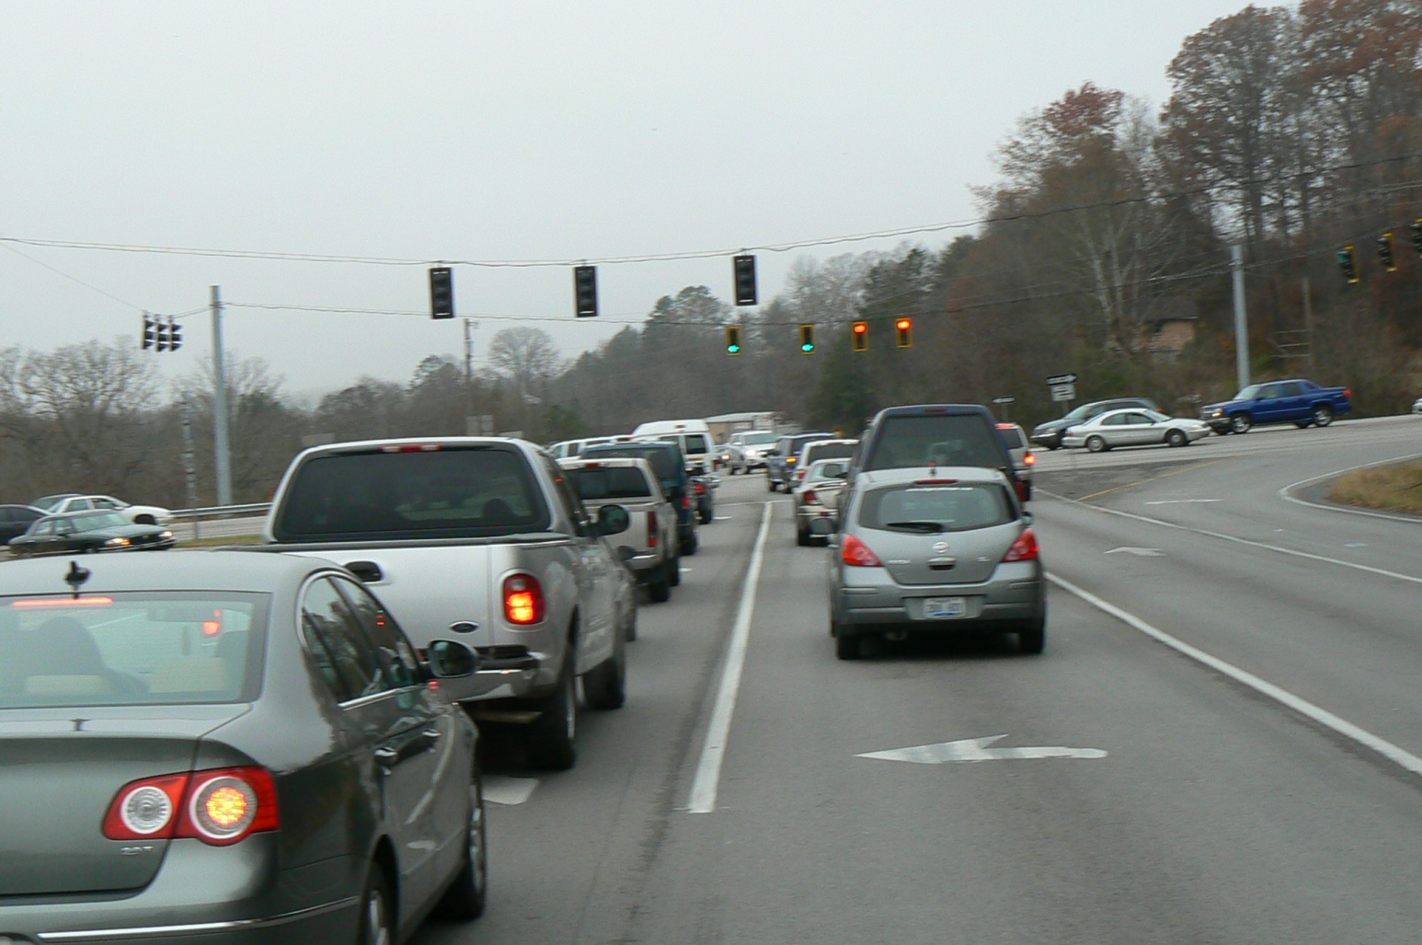
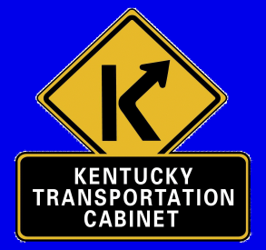
US 25 Corbin to London
Citizens Advisory Committee Meeting
December 2011

Slide 2
Project Design Team
Members
David Fields – KYTC Project Manager – Manchester District Office
Randy Gnau – Municipal Engineering Company
Brad Gregory – Municipal Engineering Company
Randall Thomas - HMB Professional Engineers

Slide 3
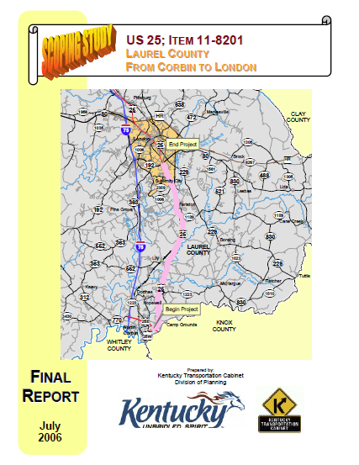
2006 Kentucky Transportation Cabinet Scoping Study
Highway Geometries
Type of Roadway Facility (Rural/Urban)
Vehicle Crash History
Traffic and Level of Service (Current & Future)
Resource Agencies
Environmental Concerns

Slide 4
Crash History
Between 1/1/01 to 12/31/05 – 809 Vehicle Crashes
208 Injuries & 9 Fatalities
46% of all Crashes Along the Route were Rear End
At 4 Spots the Rear End Crashes are 70% or Higher

Slide 5
Scoping Study Summary
Study Goals – To Develop a Purpose & Need Statement
“The primary goals of this project are to address highway capacity and growth needs in Laurel County, improve safety by providing an improved route that complies with current design standards, and provide an alternative route during incidents or closures on I-75.”

Slide 6
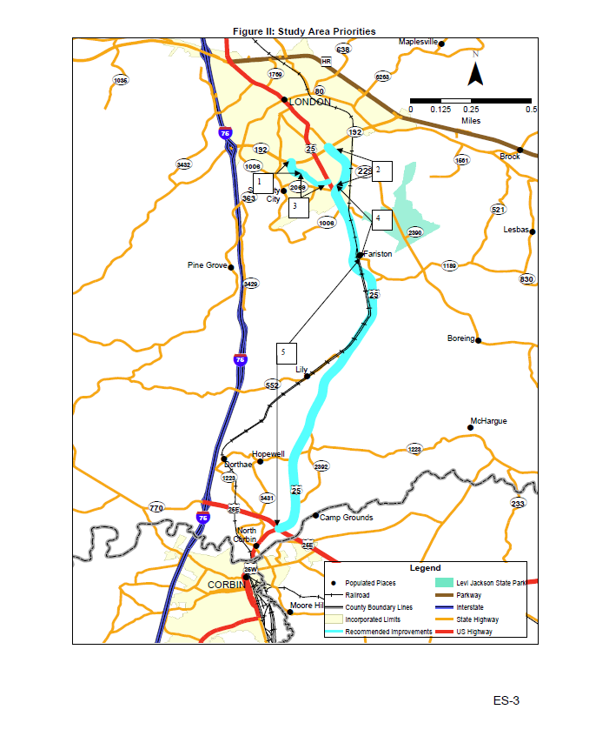
Scoping Study Project Recommendations
5 Separate Priority Improvement Recommendations
Focus on Recommendations 4 & 5
Expanding US 25 between US25E &
KY 1006 (Levi Jackson Road)
Develop an Access Management Plan
Coordinate with London and Laurel County
Establish an Advisory Team

Slide 7
US 25 / 25E / 25W
Intersection
In October 2007 a Phase I Engineering Study was Completed for this intersection by KYTC D-11
Several Intersection Configurations were evaluated
Lengthening Auxiliary Lanes
Adding Turn and Thru Lanes
Improving Radii
Adding Acceleration Lanes
All Configurations Still Produced a L.O.S. of “F”
Grade Separated Interchange Needed

Slide 8
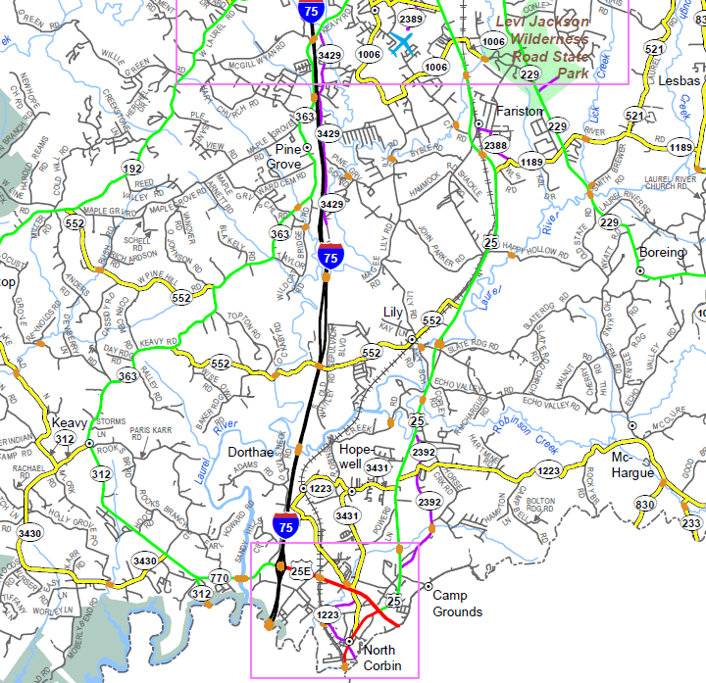
Project Limits
End Project
Begin Project

Slide 9
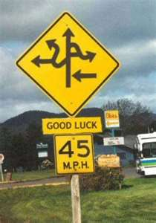
Where Do We Go From Here?

Slide 10
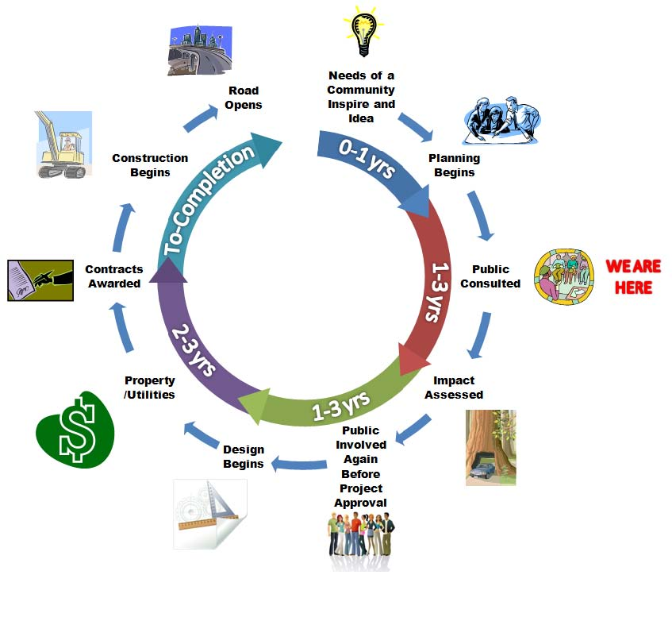
Typical Project Development

Slide 11
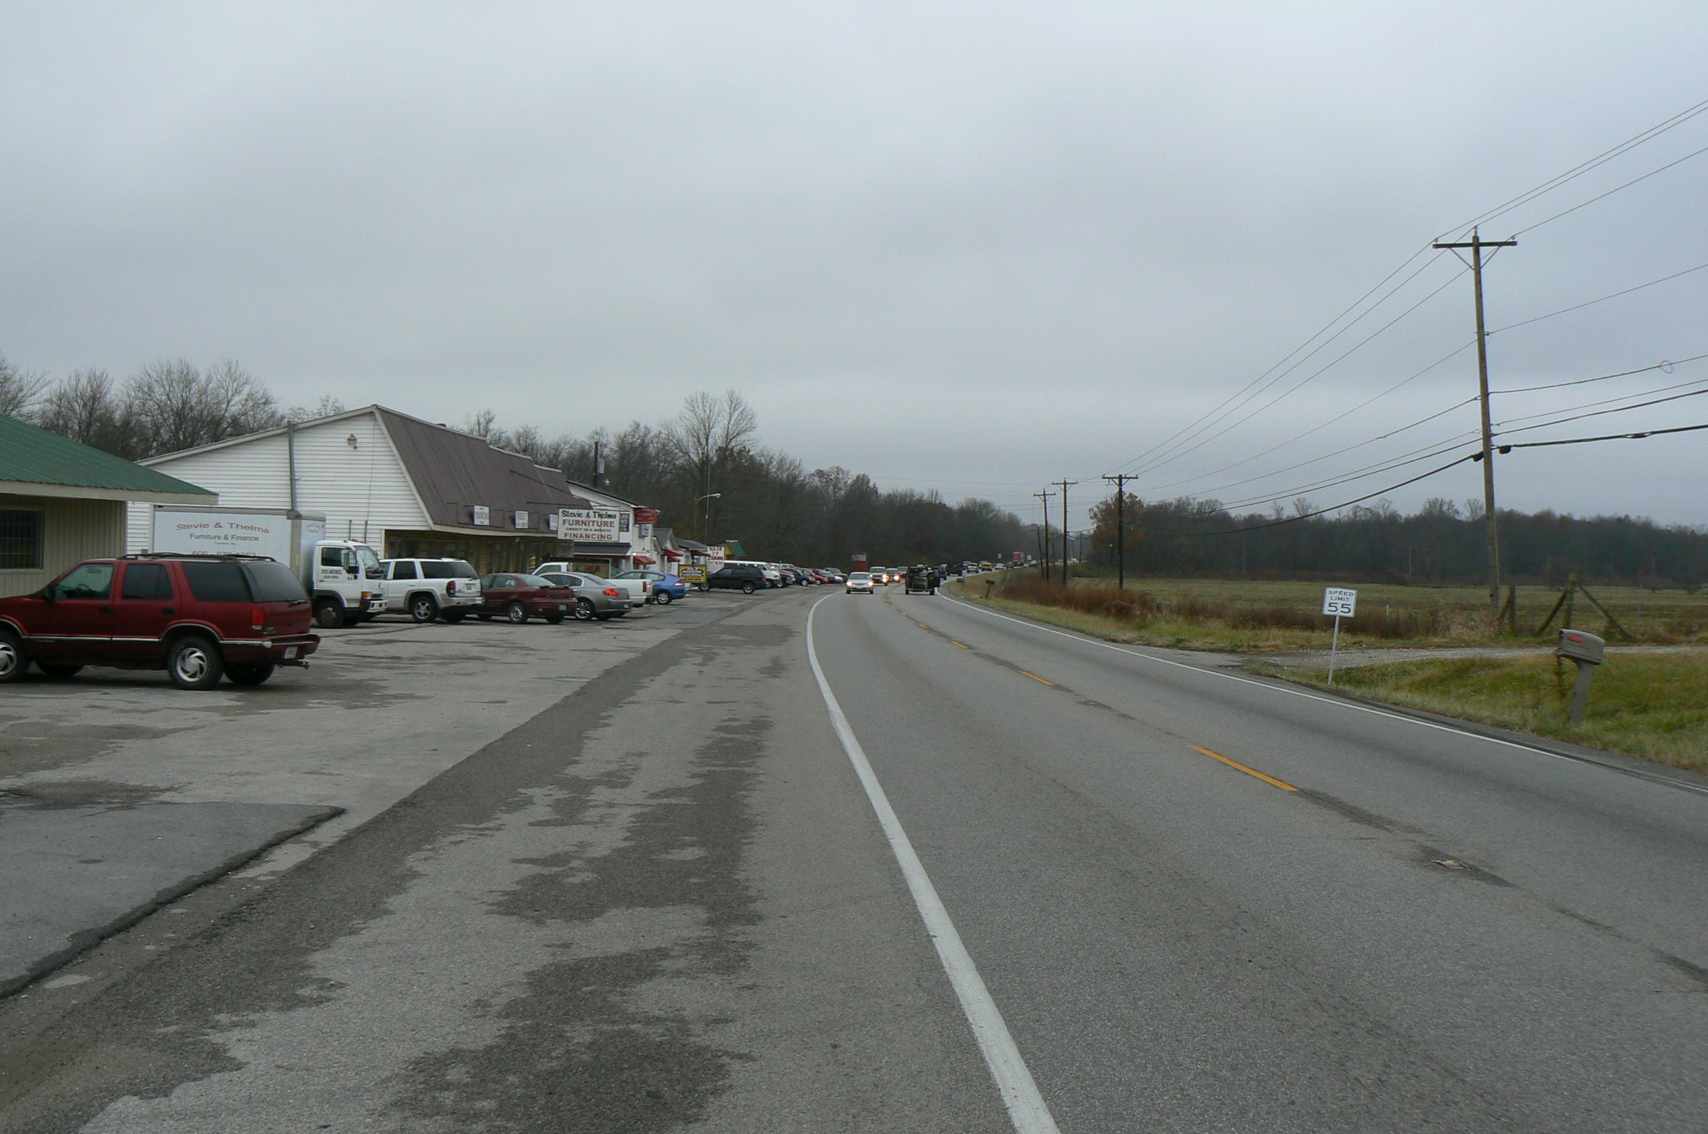
Project
Schedule & Funding
Current funding is for the Design Phase
Preliminary Engineering Complete – Fall 2012
Public Hearing – Summer 2013
Environmental Document Approval – Winter 2014
Detailed Engineering Design Begins on Preferred Alternate

Slide 12
Citizen Advisory Group
We Want You!

Slide 13
Citizen Advisory Group
We need you to be our eyes and ears during this process
This Project is for the Citizens of Laurel County
This project needs to meet your needs and concerns

Slide 14
US 25 - Project Flow
1st Citizen Advisory Group meeting
1st Public Meeting
2nd Citizen Advisory Group meeting
3rd Citizen Advisory Group meeting
4th Citizen Advisory Group meeting
2nd Public Meeting
5th Citizen Advisory Group meeting
6th Citizen Advisory Group meeting
Public Hearing

Slide 15
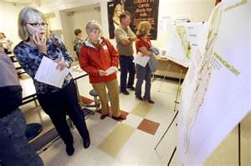
1st Public Meeting
January/February
Open Format
Detailed Maps of the existing area
Fact Finding
We need your Help!

Slide 16
Thank You!
Brad Gregory – Municipal Engineering Co.
bgregory@mecconsultants.com
502-875-3787
David Fields – KY Transp0rtation Cabinet - Manchester
David.Fields@ky.gov
606-598-2145

