Slide 1
Pavements Working Group
July 19, 2011 – Meeting No. 2

Slide 2
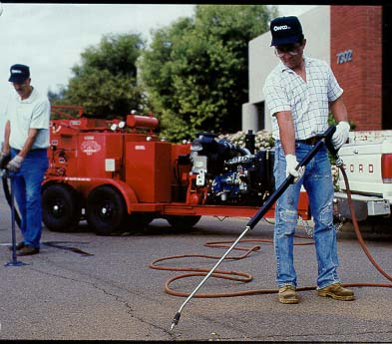
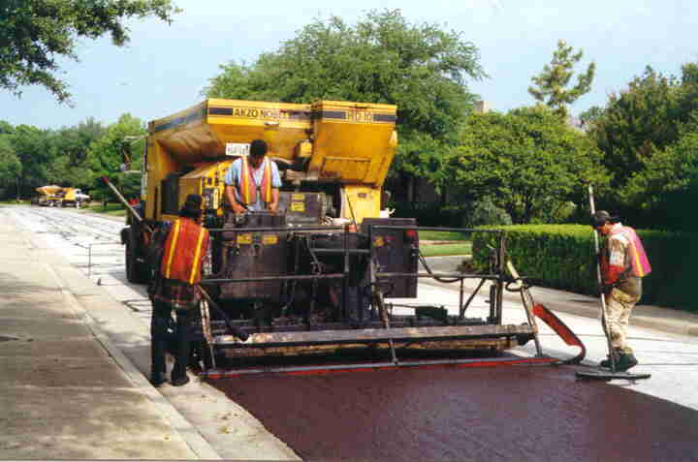
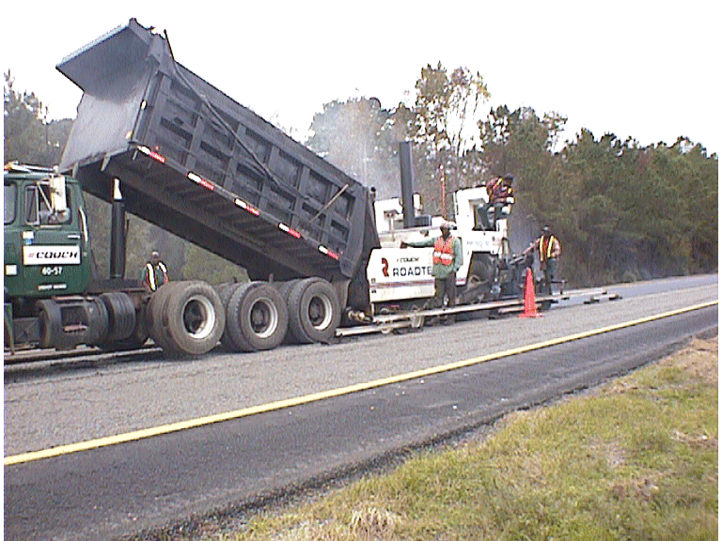
Pavements Technical Working Group AASHTO Standing Committee on Highways, Subcommittee on Maintenance July 19, 2011 8:00-10:00 am Louisville, Kentucky
Eric Pitts, GADOT – Chair
Jennifer Brandenburg – Vice Chair
Tim Lattner, FLDOT – Vice Chair
Steve Mueller - FHWA Liaison

Slide 3
AGENDA Tuesday, July 19 – Salon C & D (2 hrs)
NCHRP Synthesis 411: Microsurfacing
Mr. Rusty Price, Intermountain Slurry Seal
Preservation Research at Georgia Tech
Dr. James Tsai, Georgia Tech
Results from 7-18-11 TWG Meeting
Abstract Review Progress
NCHRP Report Recommendations for AASHTO
New Business
Nominations for PTWG Vice-Chair
Development of 2011 Work Plan
Research Problem Statements Discussion
Resolutions Discussion

Slide 4
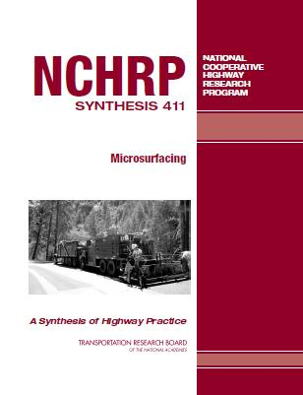
NCHRP Synthesis 411: Microsurfacing
Mr. Rusty Price, Intermountain Slurry Seal

Slide 5
Preservation Research at Georgia Tech
Dr. James Tsai, Georgia Institute of Technology
Dr. Tsai is an Associate Professor in the School of Civil and Environmental Engineering at Georgia Tech. He received his Ph.D. in 1996 from the School of Civil and Environmental Engineering at Georgia Tech. Since 1997, he has led a research team and worked with GDOT pavement engineers, successfully implementing a large-scale Oracle GIS-based pavement preservation and management system for GDOT to effectively preserve and manage its 18,000-centerline miles of highway.

Slide 6
Draft Results from 7-18-2011 Meeting 2012 AASHTO/TRB Maintenance Management Conference Abstracts AASHTO Publication Recommendations

Slide 7
7-18-2011 Draft Abstract Prioritization
Number | 7-18-11 Votes | Reviewed | Pres Only Pres/Pub | Program Entry
103 | 7 |  | Pres/Pub | Using Automated Pavement Condition Measurements to Indicate Appropriate Pavement Preservation and Maintenance Options (MMC-2012-103), M. Stroup-Gardiner, Gardiner Technical Services; Dharamveer Singh, University of Oklahoma
115 | 7 |  | Pres/Pub | Network Perspective on the Allocation and Justification of Resources to Meet Preventive Maintenance Needs (MMC-2012-115), Mohammad Hafizur Rahman Arman, Eleni Bardaka, and Matthew J. Volovaki, Purdue University
134 | 6 |  | Pres/Pub | Roller-Compacted Concrete Pavements for Highways and Streets (MMC-2012-134), Gregory E. Halsted, Portland Cement Association
145 | 4 |  | Pres/Pub | Improvements in Asphalt Rubber Chip Seal Application with Warm Mix Technology (MMC-2012-145), DingXin Chen and R. Gary Hicks and LeRose Lane, California Pavement Preservation Center
136 | 3 |  | Pres/Pub | An Optimization Model for Pavement Maintenance Planning and Resource Allocation (MMC-2012-136), Mary I. Panagopoulou and Athanasios P. Chassiakos, University of Patras, Greece
143 | 3 |  | Pres/Pub | Level of Service Ranking using the Percent Within Limits Measure (MMC-2012-143), Robert L. Schmitt and Samuel Owusu-Ababio, University of Wisconsin; Richard M. Weed, Consultant
132 | 2 |  | Pres/Pub | Cement-Modified Soil for Long Lasting Pavements (MMC-2012-132), Gregory E. Halsted, Portland Cement Association
144 | 2 |  | Pres Only | Partnering in Maintenance Management – It Works! (MMC-2012-144), Milton Thacker, DBi Services

Slide 8
7-18-2011 Draft Abstract Prioritization
Number | 7-18-11 Votes | Reviewed | Pres Only Pres/Pub | Program Entry
127 | 1 | NONE | Pres Only | Better Sidewalks Through Systematic Inspection and Maintenance (MMC-2012-127), Dave Bergner, International Municipal Signal Association; Janet Luessenheide, Overland Park, KS Public Works Department
133 | 1 | NONE | Pres/Pub | Minimizing Reflective Cracking in Cement-Stabilized Pavement Bases (MMC-2012-133), Gregory E. Halsted, Portland Cement Association
147 | 1 | NONE | Pres/Pub | Using a Pavement Preservation Database to Support the Alaska Pavement Preservation Program (MMC-2012-147), Anglea Parson and James Horn, Alaska Department of Transportation and Public Facilities; DingXin Cheng and R. Gary Hicks, California Pavement Preservation Center
108 | 0 | NONE | Pres/Pub | Character, Extent, and Severity of Corrosion in Continuously Reinforced (CRC) Pavements in South Dakota (MMC-2012-108), Allen L. Jones, Nadim Wehbe and Stephanie L. Klay, South Dakota State University
119 | 0 | NONE | Pres/Pub | Regional Asset Management Efforts and a Performance-based Approach to Local Streets and Roads Funding Allocation (MMC-2012-119) Theresa Romell and Sui Tan, Metropolitan Transportation Commission
140 | 0 | NONE | Pres/Pub | Developing an Integrated Asset Management System for Nigeria (MMC-2012-140), Emeka Agbasi, Federal Roads Maintenance Agency (FERMA), Nigeria
141 | 0 | NONE | Pres/Pub | Techniques to Guide the Implementation and Removal of Seasonal Load Restrictions (MMC-2012-141), Robert D. Hart, Leon F. Osborne, Jr., and John J. Mewes, Meridian Environmental Technology, Inc.

Slide 9
Recommendations for AASHTO Publications
NCHRP Year |  | Project Number | Project Title | Report # | PTWG Recommended Action
Duluth (‘03) | 2005 | 9-41 | Performance and Maintenance of Permeable Friction Courses | Report 640, web-only 138 | A) Keep on SCOM Website PTWG to Review in 2012 Work Plan
 | 2005 | 10-68 | Guidelines for the Use of Highway Pavement Warranties | Publication decision pending | A) Keep on SCOM Website Refer to SOC for possible action
Bismarck (’04) | 2006 | 14-17 | Manual for Emulsion-Based Chip Seals for Pavements | Report 680 | B) Move it forward for balloting by the SCOM, where it would then become a published AASHTO document.
Charleston (’06) | 2008 | 14-18 | Determining Actual Cost of Performing Routine and Preventive Maintenance Operations on Highway Systems | Report 688 | A) Keep on SCOM Website
 | 2008 | 20-74A | Development of National Level of Service Criteria for the System | Report 677 | A) Keep on SCOM Website PTWG to Review in 2012 Work Plan
Madison (’07) | 2009 | 20-81 | Challenges and Successes in Attracting and Retaining a Skilled Transportation Workforce | Being prepared for publication | A) Keep on SCOM Website PTWG to Review in 2012 Work Plan
 |  |  | SHRP-2 R-26 |  | A) Keep on SCOM Website PTWG to Review in 2012 Work Plan

Slide 10
2012 AASHTO TIG Technology Solicitation
AASHTO is pleased to announce the 2012 Solicitation for Focus Technologies. Innovative technologies are accepted for consideration from State and local departments of transportation, organizational units of AASHTO (AASHTO members include member departments and associate members), and the Federal Highway Administration. Interested producers of innovative technologies must work with eligible submitters who have successfully used these technologies. Note: Applications may be developed by DOT partners (academia, industry, other associations, etc), however actual submissions must be proposed by one of the agencies listed above. Solicitation HYPERLINK http://www.transportation1.org/tig_solicitation/Default.aspx
NOMINATIONS:
· All nominations shall be submitted electronically.
· Please visit 2012 Nomination Site to submit your nomination. The deadline for nominations is Friday, September 16, 2011.
· Nomination HYPERLINK http://www.transportation1.org/tig_solicitation/Blank.aspx
Please contact me if you have any questions. Thank you.
Keith M. Platte, P.E.
Associate Program Director, Project Delivery
American Association of State Highway and Transportation Officials
Ph: 202 624 7830
Fax: 202 624 5469
Email: kplatte@aashto.org

Slide 11
New Business
Nominations for PTWG Vice-Chair
Development of 2012 Work Plan
Research Problem Statements Discussion
Resolutions Discussion

Slide 12
Statement of Direction The purpose of the Pavement Technical Working Group is to promote the preservation of pavements.
The PTWG will attempt to accomplish this purpose by the following activities: (page 1 of 2)
Coordinate and support the development of guidelines, specifications, terminology and best management practices relative to pavement preservation and maintenance;
Share information on pavement preservation and maintenance;
Support and participate in development of pavement preservation projects and the use of innovative pavement materials;
Develop partnerships and coordinate task force activities with other pavement groups (such as FHWA, TRB AHD18 and AHD20 Committees, the regional pavement preservation partnerships, etc.);

Slide 13
Statement of Direction The purpose of the Pavement Technical Working Group is to promote the preservation of pavements. - Page 2 of 2 -
Identify research needs, support development of problem statements and identify potential funding sources;
Sponsor technical presentations to communicate new developments in pavement preservation and maintenance;
Support training courses in pavement preservation; and
Support the development of new technology that leads to the extension of pavement life in a cost-effective manner, and identify and promote the implementation and usage of products and processes which achieve this goal.

Slide 14
2012 Goals
Sustain high level of maintenance interest and involvement in the area of System Preservation.
Promote the Transportation System Preservation Technical Services Program. (TSP²)
Support the development and expansion of Regional Pavement Preservation Partnerships.
Assist in the implementation of the Pavement Preservation Roadmap.
Promote the utilization of the National Center for Pavement Preservation for research management.
Review TRB/NCHRP Completed Research for possible publication as AASHTO Manuals: 9-41 Performance and Maintenance of Permeable Friction Courses; 20-74A Development of National Level of Service Criteria for the System; 20-81 Challenges and Successes in Attracting and Retaining a Skilled Transportation Workforce; SHRP-2 R-26
Enhance the Internal Communications of the PTWG by: expanding the membership list; improving the e-mail address list; and conducting quarterly telephone conference calls and/or webinars.

Slide 15
2011 PTWG AGENDA
Wednesday, July 20 – Salon C & D
10:30 am – Noon
TSP2 Presentation
Larry Galehouse, Executive Director, NCPP
Wrap-Ups
Vice-Chair Election
Proposed Research Problem Statements
Resolutions
2012 SCOM/TRB Maintenance Management Topic Selection

