Slide 1
Performance Measures: Attaining Results, Accountability, and Predictability in Maintenance
The Contractor’s Voice for Transportation Operations and Maintenance

Slide 2
WHAT IS AMOTIA?
ASSOCATION FOR THE MANAGEMENT AND OPERATIONS OF TRANSPORTATION INFRASTRUCTURE ASSETS
Mission: To build partnerships with industry and public agency stakeholders to disseminate information on innovative, cost effective programs for managing, operating, and maintaining transportation infrastructure assets.
Formed in 2007
Notes:
Thank you for the opportunity to speak to you today. My name is David Rader and I am the Executive Vice President and Co-Founder of Infrastructure Corporation of America. Better known as ICA, we are a comprehensive asset management maintenance solution provider . Today however, I am wearing a different hat. Today I am speaking to you as the current President of AMOTIA.
AMOTIA is the Association for the Management and Operations of Transportation Infrastructure Assets. For those who are not familiar with AMOTIA, let me repeat that the Associations for the Management and Operations of Transportation Infrastructure Assets. Members of our organization hold performance based asset management contracts to operate and maintain a very significant array of transportation infrastructure throughout the US and around the world.
From Interstates to simple and complex bridges, and from rest areas to tunnels and toll roads, our members provide turnkey, performance based, fixed priced solutions to transportation agencies. Our membership base is composed of all of the recognized Industry Leadings Contractors as Tier I. Consulting Engineers and Advisors – Tier II, and Industry Suppliers as Tier III members
Asset Maintenance for Roadways, Tunnels, Bridges, Operation Centers, Rest Areas
Nine State DOT’s and is growing. FL-DC-VA-MD-AK-NC-TX-SC-GA and growing
Toll Agencies and Public Private Partnerships
Asset Rehabilitation and Maintenance

Slide 3
CHALLENGES
2009 Report Card for America’s Infrastructure
ROADS D-
Estimated 5-year funding needs for bridges and roads $930 Billion
Estimated spending
$380.5 Billion
Projected shortfall
-$549.5 Billion
AGING HIGHWAY SYSTEM
SHRINKING RESOURCES
GROWING DEMANDS FOR PERFORMANCE AND ACCOUNTABILITY
Notes:
Fifteen years ago in the US our industry did not exist. While the performance based maintenance model has been widely accepted in Europe, Asia, and Australia it had simply not made it here. The problem then that we saw is still prevalent today – we have an aging highway network, more traffic thus wear and tear, and shrinking resources. I am preaching to the choir. The expectation is simply do more for less.
How do you do that – well let’s talk about accountability. You cannot go a day without hearing about accountability. The federal government along with state and local politicians love to use the word Accountability in conjunction with efficiency seems to be the battle cry for the budget issue of the day. When there is news about the transportation funding or the reauthorization bill, or for that fact, news about virtually anything, you often will hear that expanded accountability or performance measures are being considered. What does this all mean? Well when it comes to balancing the federal budget or getting our nation back on track – I simply have no earthly idea. But, AMOTIA does believe passionately that clear and concise performance standards or expectations coupled with a simple, clear and concise way of measuring the performance standards is a very cost and performance effective management tool.

Slide 4
PERFORMANCE MEASUREMENT
JOHN E. JONES, LEADERSHIP TRAINER:
‘What gets measured gets done. What gets measured and fed back gets done well. What gets rewarded gets repeated.’
Notes:
Noted leadership trainer John E. Jones said, ‘What gets measured gets done. What gets measured and fed back gets done well. What gets rewarded gets repeated.”
We should remember that ‘measuring things’ is not about the numbers or data but rather about guiding and monitoring improvement toward a measurable, observable goal. It is about understanding the causes and effects of problematic performance as well as successes and then leading human performance improvement in our organizations. The point here is that the performance based model leads to sustainable gains because of behavioral change. Performance management causes the contractor to act more like the owner than a contractor. If implemented correctly - It puts us all onto the same team.

Slide 5
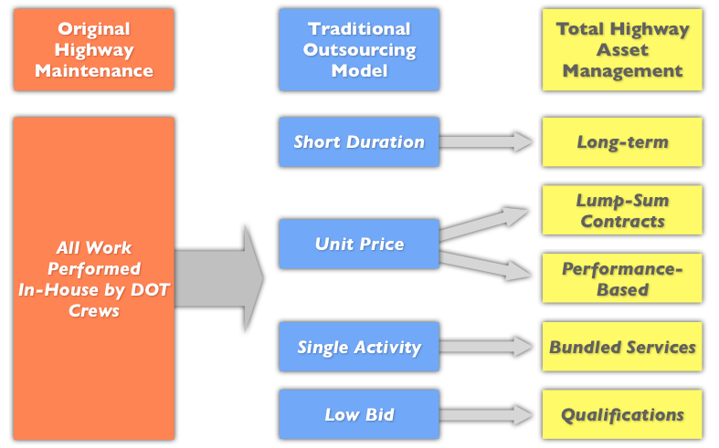
PERFORMANCE-BASED MAINTENANCE MODEL
Notes:
Noted leadership trainer John E. Jones said, ‘What gets measured gets done. What gets measured and fed back gets done well. What gets rewarded gets repeated.”
We should remember that ‘measuring things’ is not about the numbers or data but rather about guiding and monitoring improvement toward a measurable, observable goal. It is about understanding the causes and effects of problematic performance as well as successes and then leading human performance improvement in our organizations. The point here is that the model leads to sustainable gains because of behavioral change. Performance management causes the contractor to act more like the owner than a contractor. If implemented correctly - It puts us all onto the same team.

Slide 6
PERFORMANCE MANAGEMENT PLAN
KEY SUCCESS FACTORS - ‘MUST DO’S’
Transform strategic goals into measures
Apply measures uniformly
Ensure performance results
Operate PMP as on-going program
Incorporate lessons learned
Notes:
What are the keys to a successful program?
To obtain the desired results, accountability and predictably - your Performance measures must be tied to your strategic goals, and be meaningful.
For instance if safety is a paramount strategic goal - then make sure that the standards reflect this first and foremost. If aesthetics is the priority then go in that direction. Point being is use the right measures: and do not lose sight that long term goals are essential.
Next, the measures should apply to all. For maximum benefit - measure your entire system using the same standards. It will ensure the the entire system is headed towards your long-term strategic goals and result in consistency across your entire maintenance program.
Finally, operate your Performance Maintenance Plan as an ongoing program. This small but important step accelerates the behavioral change that is key to long-term success

Slide 7
PERFORMANCE MEASURES
ESSENTIAL TOOL FOR OWNERS & INDUSTRY
Improve decision making
Promote long term preservation
Demonstrate effectiveness
Link value to dollars spent
Build trust
Notes:
Let’s talk a little bit more about performance standards. What are the benefits of a performance based maintenance program?
They improve decision making because for the most part they move the decision from the “in the moment” to “a long term preservation strategy.”
Often When we operate contracts that are not under a performance based approach, we find our managers managing “it”. “It” is people and equipment on a daily basis and is not based on what the asset needs but what can I do to keep Billy, Johnny and Joe busy.
Performance Measures Links Value to Dollars Spent – because after a short while you can actually see the cost difference between an 85 and 90 level of service.
As a result – It Builds Trust – When done correctly it builds trust trust between Contractor and Owner, the district and upper management, and upper management and the legislature.

Slide 8
PERFORMANCE MEASURES
USING PERFORMANCE DATA AS A MANAGEMENT TOOL
Optimize use of resources
Tie resources to results
Detect trends
Notes:
While I stated earlier that measuring performance is not about the numbers or data but rather about guiding and monitoring improvement toward a measurable, observable goal. It is about understanding the causes and effects of problematic performance as well as successes and then leading human performance improvement in our organizations.
The data gained from the process can be very helpful. It can be used to:
Optimize use of resources
Tie resources to results
Detect trends

Slide 9
PERFORMANCE CONTRACTING
KEY FEATURES
Multi-year, lump-sum contract
Best value award / Qualification-based (Technical + Price Proposal)
Bundled services
Fixed monthly payments
Performance standards with measurements
Notes:
There are certain key features that we feel are important to success.
Multi-year, lump-sum contract
Best value award / Qualification-based (Technical + Price Proposal)
Bundled services
Fixed monthly payments
Performance standards used in conjunction with clear measurement protocols

Slide 10
AMOTIA
PERFORMANCE CONTRACTING OFFERS:
Cost efficiencies – Do More With Less
Increased productivity without staffing
Specialized expertise on demand
Predictability of fixed prices
Accountability through performance measurement
Notes:
So what are the benefits?
Cost efficiencies – Do More With Less – You heard this from Ontario on Monday they are experiencing 12.5% audited savings.
Increased productivity without staffing
Specialized expertise on demand
Predictability of fixed prices
Accountability through performance measurement

Slide 11
AMOTIA PROMOTES
PERFORMANCE AND ACCOUNTABILITY
Effective & strategic performance measures that apply to all
Results driven maintenance program
Accountability and transparency
Maintain in-house staffing and resources; supplement with PB contracts as needed
Notes:
In closing, I would like to reiterate that AMOTIA supports Performance Based Contracting and we believe that it is the path to attaining Results, Accountability, and Predictability in your maintenance program.
We believe that it will move your organization towards a
Results driven maintenance program
Towards accountability and transparency
Maintain in-house staffing and resources; supplement with PB contracts as needed

Slide 12
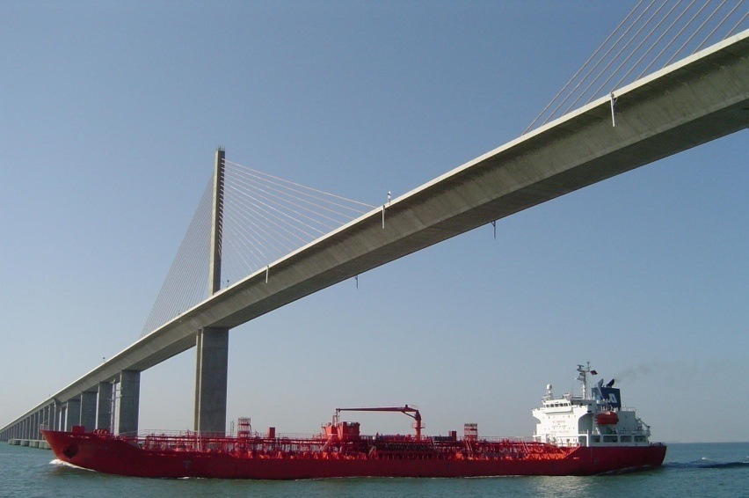
PERFORMANCE CONTRACTING
AMOTIA POSITION STATEMENTS
Scope of Services
Bonding
Best Value Contracting
Emergency Response
Performance Measures
Retainage/Penalties
Incentives
Contract Liability Limits
Notes:
Our industry association has put together a number of position statements that benefit from the lessons learned represent today’s best practices in performance based contracting. We are also developing a Performance Based Maintenance Contracting Guide that will be available later this year. All of these resources are available to anyone considering embarking on a program.

Slide 13
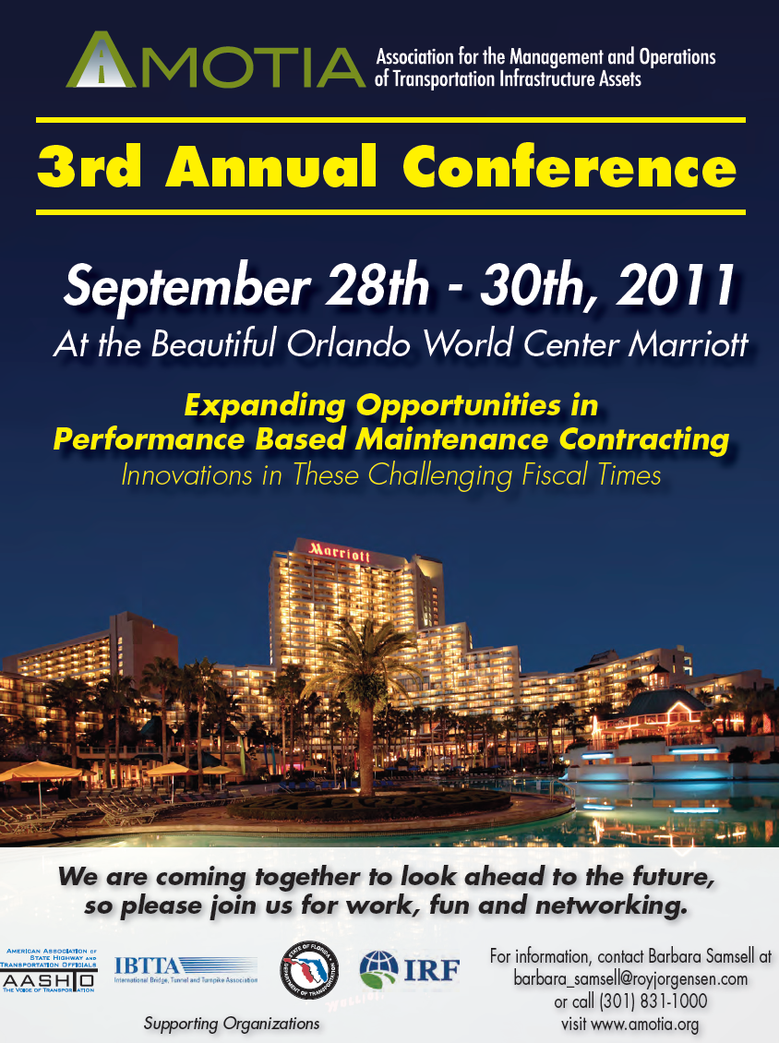
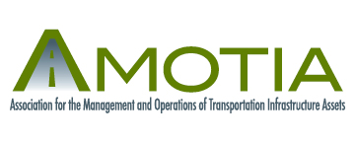
You’re Invited
2011 AMOTIA ANNUAL MEETING
SEPTEMBER 28 - 30
Orlando Florida
Mark Your Calendar
13
Notes:
If you would like to learn more about Performance Based Contracting, I would like to invite all of you to our AMOTIA Annual Meeting coming up Sept. 28-30 in Orlando, FL. It will be two days of excellent programming specifically on performance based contracting. I hope that all of you will consider attending.

Slide 14
The Contractors Voice for Transportation Operations and Maintenance
Peter Loughlin, Executive Director
202-253-0331
info@amotia.org
www.amotia.org
Notes:
If you would like more information or need further information about either the upcoming conference or the resources available through AMOTIA please feel free to contact me or Peter Loughlin, who serves as our Executive Director.
Thank you so much for your time and attention.

