Slide 1

FHWA’s Sustainable Highways Initiative
And Self-Evaluation Tool
Michael Culp
Team Leader for Sustainable Transport and Climate Change
Office of Planning, Environment & Realty
SCOM Meeting – Louisville, KY
July 18, 2011

Slide 2
Agenda
Overview of Sustainability and Highways
Changes Since Beta Version
Criteria Included in Pilot Test Version
Website Walk-thru
Pilot Testing
Next Steps

Slide 3
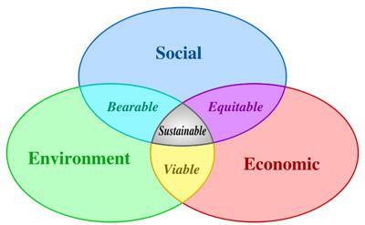
What is a Sustainable Highway System?
Satisfies functional requirements
  Fulfills transportation goals and needs
  Addresses development and economic growth
Avoids, minimizes, reduces impacts
  Environment
  Consumption of resources
Addresses environmental, economic, and social equity dimensions (triple bottom line)
Sustainability addressed throughout the project lifecycle
Notes:
FHWA views sustainable highways as an integral part of sustainable development. A sustainable highway should satisfy life cycle functional requirements of societal development and economic growth while reducing negative impacts to the environment and consumption of natural resources. The sustainability of a highway should be assessed and considered from conception through construction and in maintenance and operations throughout its lifecycle.
A sustainable highway must be considered in its own context; how it relates to its social, environmental and economic setting.
Viewing highways in isolation is not ideal when addressing sustainability. Sustainability in highways should be addressed with the mindset that highways are one part of transportation infrastructure, and transportation is one aspect of meeting human needs. In addition to addressing environmental and natural resource needs, the development of sustainable highways should include focus on access (not just mobility), moving people and goods (not just vehicles), and providing people with transportation choices, such as safe and comfortable routes for walking, cycling and transit.
3

Slide 4
Sustainability and the Project Lifecycle
For sustainability to be fully integrated into highway and transit programs, it must be considered throughout the project lifecycle
Must address sustainability from planning through operations
Project Development
Transportation Systems Management, Operations & Maintenance
System Planning & Processes

Slide 5
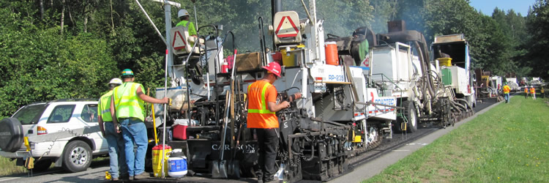
Examples of Sustainable Practices
System Planning
  Integrated Planning
  Mitigation banking
  Fiscal planning
Project Development
  Cost Benefit Analysis
  Construction Equipment Emission Reduction
  Recycling and Reuse of materials
Operations and Maintenance
  Strong asset management
  Roadside vegetation management

Slide 6
INVEST
(Infrastructure Voluntary Evaluation Sustainability Tool)
FHWA’s Sustainable Highways
Self-Evaluation Tool

Slide 7
INVEST Goals
Encourage sustainable highway practices
  Internal improvement
  External recognition
Help agencies measure sustainability and quantify tradeoffs
Provide a framework for communicating with stakeholders about sustainability
Establish a method for evaluating sustainable highway systems, projects, programs
Notes:
Measuring sustainability allows organizations to track and assess progress resulting from their sustainability efforts and investments.
The FHWA Sustainable Highways Tool establishes measures for sustainability that will enable agencies to set sustainability goals, track progress, and apply management strategies.
7

Slide 8
Overview of INVEST
Voluntary Web-based Tool
Lists “sustainable criteria” based on best practices for three project phases:
  Systems Planning
  Project Development
  Operations and Maintenance
Each criterion assigned a point value based on expected sustainability impact
In coordination with ASCE/ACEC/APWA effort
Other sustainable highways tools used as references
  (GreenLITES, I-LAST, Greenroads)
Notes:
Clarified the purpose and goals of the tool in our “FAQ” and “Learn” sections, emphasizing that the Tool is to be used for self-evaluation and not for comparisons among states.
Clearly stated that the tool is not intended to compare states and their projects or practices.
Eliminated references to specific methods or procedures where possible, and added flexibility to allow states to use their own comparable methods to meet credits.
8

Slide 9
Ways INVEST can be used
Project Evaluation
  Single or multiple projects
  Score project and/or inform SOP’s, program-level
  Proactive vs. retroactive
Programs and processes
  Planning or O&M
  Score and/or inform SOP’s
  Proactive vs. retroactive

Slide 10
INVEST
Changes Since Beta Version

Slide 11
Significant Changes from
Beta to Pilot Test Version
Greatly simplifies criteria and scoring
  1-page write-ups for each criteria
  Combined or eliminated criteria (e.g., combined Highway Infrastructure Maintenance and Cleaning and Litter criteria)
Clarified the purpose and goals of the Tool:
  Provide best practice information to enable transportation practitioners to incorporate sustainability into their projects and practices
  Provide a VOLUNTARY method for practitioners to evaluate their transportation projects and to encourage progress in the sustainability arena
Clearly stated that the Tool is not intended to compare states and their projects or practices
Eliminated references to specific states as examples (including case studies)
Notes:
Focuses on the Project Development (PD) credits. The System Planning and Operations & Maintenance credits that were included in the Beta Version will be revised and released later.
Greatly simplifies credits and scoring. Each credit explanation has been simplified. Also, many credits have been eliminated or combined with others.
Makes scoring smaller projects easier. We have created a “Basic” Version of the tool that includes credits that would be more appropriate for rehabilitation, resurfacing, and minor reconstruction projects. An “Extended” Version containing a larger number of credits is also available to score larger reconstruction and new construction projects.
Reduces the Number of Credits by Eliminating or Consolidating Credits: There are now only 20 credits in the “Basic” Version of Project Development component of the tool, and just 30 credits in the “Extended” Version (compared to 39 Project Development credits in the Beta Version you reviewed).

Slide 12
Significant Changes from
Beta to Pilot Test Version
Simplified Principles to the Triple Bottom Line (Social, Environmental and Economic)
  Reduced from 24 categories of benefits and principles to 3
Eliminated references to specific methods or procedures where possible, and added flexibility to allow states to use their own comparable methods to meet criteria
Changed the “Documentation” section in each Criteria to “Sources”
  Clarified that no new documentation needs to be created
Reduced biases toward selection of particular materials
  Asphalt vs. PCC, eliminated thermal pavement criteria
Notes:
Simplified Principles to the three included in the Triple Bottom Line bottom line and simplified terminology to Social, Environmental and Economic. This includes identifying the relevant aspects of the “triple bottom line” that each credit addresses, and how those intersect. Users can now map credits to the three sustainability principles, which makes it easier for selection of credits if particular sustainability goals want to be achieved. We have also tried to increase the emphasis on the “economic” bottom line in the credits that were retained.
Changed the “Documentation” section of the credit write-ups to “Sources” and clarified that no new documentation needs to be created for the evaluation. Simply identifying the relevant source documents is adequate evidence of meeting a particular credit.
Eliminated all references to Examples (including case studies) and Approaches.
Reduced biases toward selection of particular materials.

Slide 13
Significant Changes from
Beta to Pilot Test Version
Specific Operations and Maintenance Criteria Changes
  Consolidated Maintenance Management criteria to align better with AASHTO Maintenance Manual on Roadways and Bridges (e.g. consolidated Cleaning and Litter into Roadside Infrastructure Maintenance)
  Adds Maintenance Management System structured around AASHTO Guidelines for Maintenance Management Systems
  Deletes Pollution Prevention Plan
  Moves Ecological Connectivity to System Planning
  Adds Tracking Environmental Commitments System
  Adds Work Zone Traffic Control
Notes:
Clarified the purpose and goals of the tool in our “FAQ” and “Learn” sections, emphasizing that the Tool is to be used for self-evaluation and not for comparisons among states.
Clearly stated that the tool is not intended to compare states and their projects or practices.
Eliminated references to specific methods or procedures where possible, and added flexibility to allow states to use their own comparable methods to meet credits.

Slide 14
Significant Changes from
Beta to Pilot Test Version
Added Flexibility to Project Evaluation
  Reduces the Number of Criteria by Eliminating or Consolidating Criteria
    Basic Version = 20 Criteria
    Extended Version = 30 Criteria
  Makes scoring smaller projects easier
    Basic Version - includes criteria that would be more appropriate for rehabilitation, resurfacing, and minor reconstruction projects.
    Extended Version – includes larger number of criteria than basic version and is available to score larger reconstruction and new construction projects.
Notes:
Clarified the purpose and goals of the tool in our “FAQ” and “Learn” sections, emphasizing that the Tool is to be used for self-evaluation and not for comparisons among states.
Clearly stated that the tool is not intended to compare states and their projects or practices.
Eliminated references to specific methods or procedures where possible, and added flexibility to allow states to use their own comparable methods to meet credits.

Slide 15
INVEST
Criteria Included
in Pilot Test Version

Slide 16
Operations & Maintenance Criteria
OM-1 Sustainability Plan
OM-2 Environmental Commitments
Tracking System
OM-3 Pavement Management System
OM-4 Bridge Management System
OM-5 Maintenance Management System
OM-6 Highway Infrastructure Maintenance
OM-7 Roadside Infrastructure Maintenance
OM-8 Traffic Control Infrastructure Maintenance
OM-9 Snow and Ice Control
OM-10 Work Zone Traffic Control
OM-11 Transportation Management and Operations
OM-12 Safety Management
OM-13 Renewable Energy
OM-14 Fuel Efficiency
OM-15 Recycle and Reuse
Notes:
Dark and underlined credits included in basic, all credits included in extended.
Note Beta had 39 PD credits, now 20 (basic) or 30 (extended) depending on project category.

Slide 17
Website Walk-thru
www.sustainablehighways.org
Notes:
BEFORE THE MEETING
Login as fhwa.tester@gmail.com with password = nwd27p)G
DO NOT PLAY WITH SCORING UNTIL DEMO
Jump to the score tab, show the pull down menu at the top to pick a project or start a new one
Pick the Test Project – Basic
Note that the Score is already at 20 per the project info
We’re going to score 4 different credits to show the 4 scoring tool options:
Yes/No: PD-1 Cost Benefit Analysis
Click on Cost Benefit Analysis
Choose Score tab
Click on Radio Button for Yes
Click Save
Click on Close Window
Refresh your screen and note that total changed from 20 to 23 points and the project is not rated
Choose 1 (options and ranges provided in scoring tool): PD-20 Energy Efficient Lighting
Click on Energy Efficient Lighting
Choose Score tab
Click on Radio Button for Yes
Choose Radio Button for 40% (refer to intro materials)
Click Save
Click on Close Window
Refresh screen and note that total changed from 23 to 27 points and project is rated bronze
Cascading Questions (when first question is answered, second follows – may be dependent on first answer): PD-14 Pedestrian Access
Click on Pedestrian Access
Choose Score tab
Click on Radio Button for Yes
Choose Radio Button for “Yes, physical or constructed changes to the roadway structure, dimensions, or form were made(2 points)” (refer to intro materials)
Click Save
Click on Close Window
Refer to Requirements & Choose: PD-11 Recycle & Reuse Materials
Click on Recycle & Reuse Materials
Scroll down and note that there are tables included in the Requirements to show how many points are assigned to each calculation of ARC. We’re going to refer to Table 1 (refer to intro materials – Option 2, 50% = 5 points)
Choose Score tab
Click on Radio Button for 5 points
Click Save
Click on Close Window
Refresh screen and note that in last 2 steps the score changed from 27 to 34 points and the project is now rated silver
End demo and change back to PPT for next steps

Slide 18
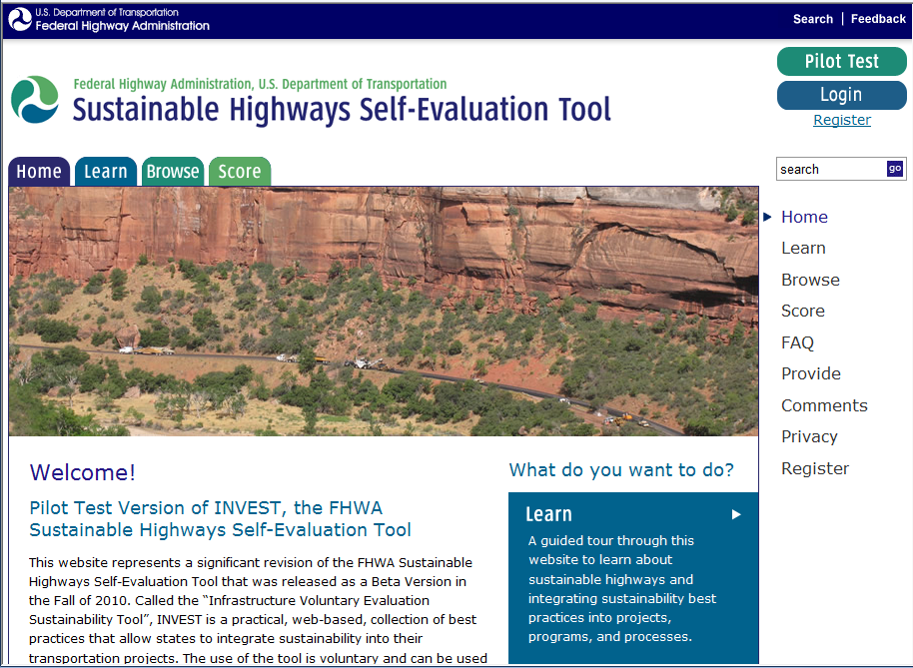
Notes:
3 ways to navigate to Learn/Browse/Score:
Big Boxes
Top tabs
Sidebar links
Note Sidebar links and top tabs are always available.

Slide 19
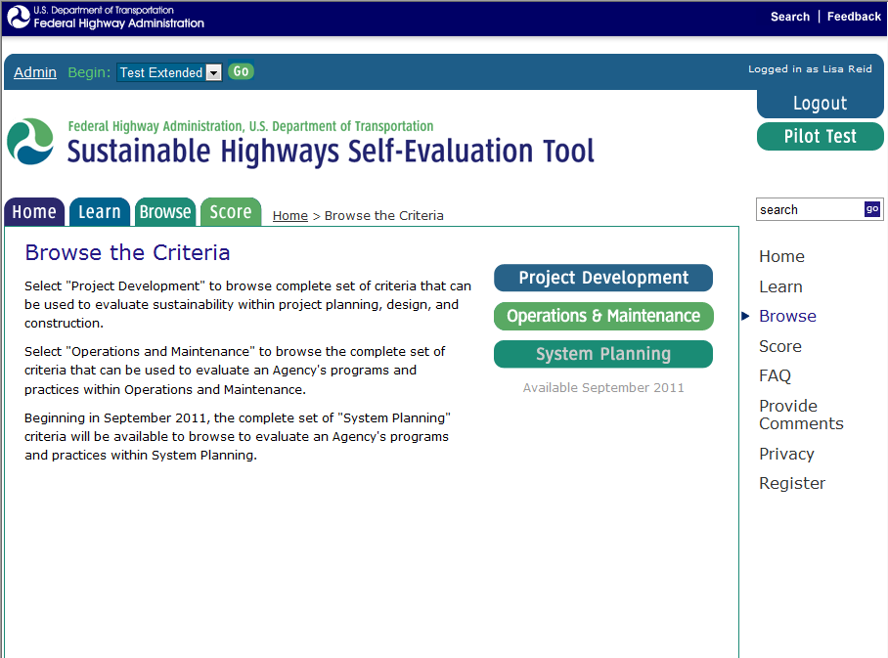
Notes:
Michael – this one is new – note how when you click on the browse tab you’re prompted to choose which criteria you want to browse. We added this step so we could still have the info on the basic and extended scorecards before the PD criteria without confusing the users of the OM and SP criteria

Slide 20
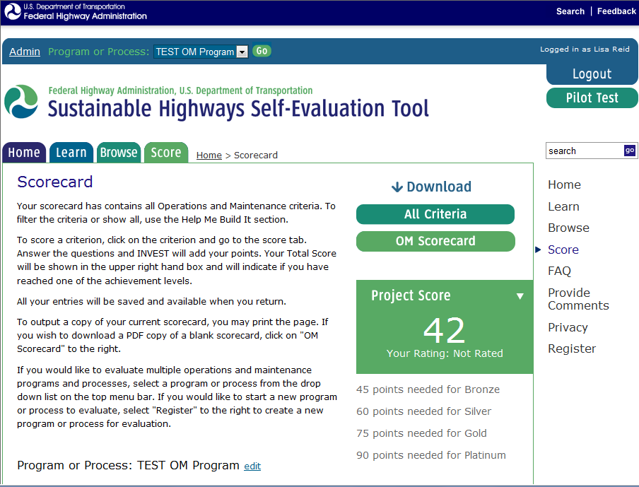
Notes:
After logging in, you’ll have a new header that will show you your saved projects.

Slide 21
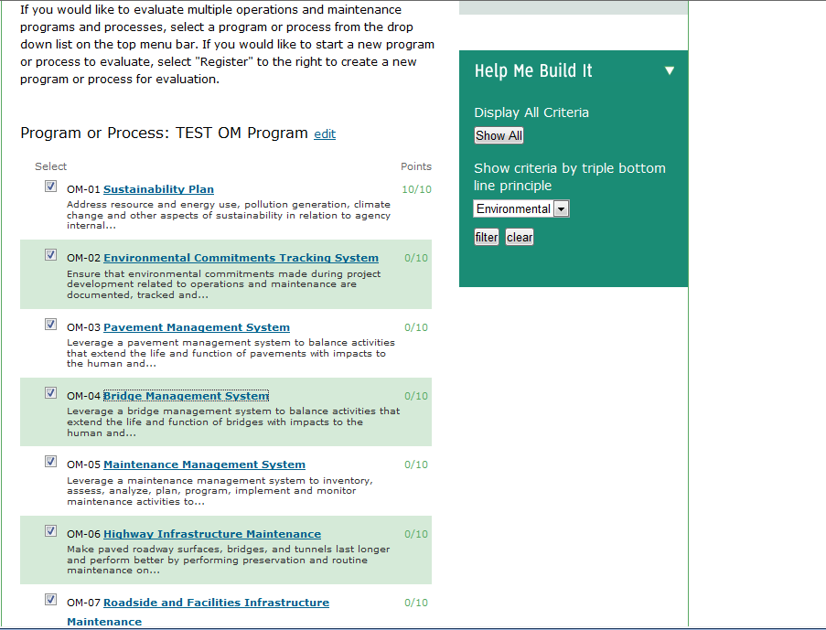
Notes:
After logging in, you’ll have a new header that will show you your saved projects.

Slide 22
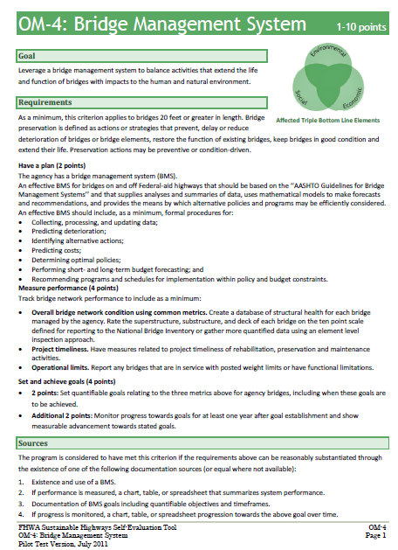

Slide 23
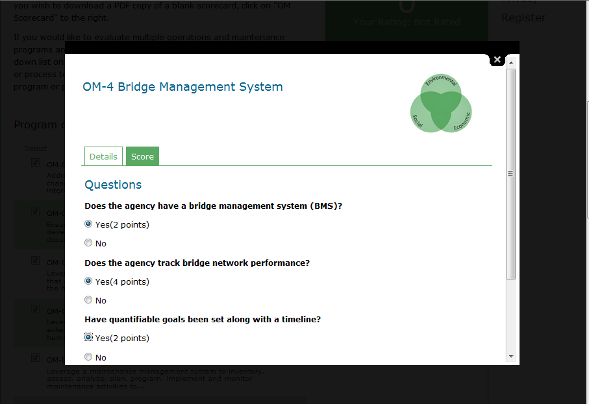

Slide 24
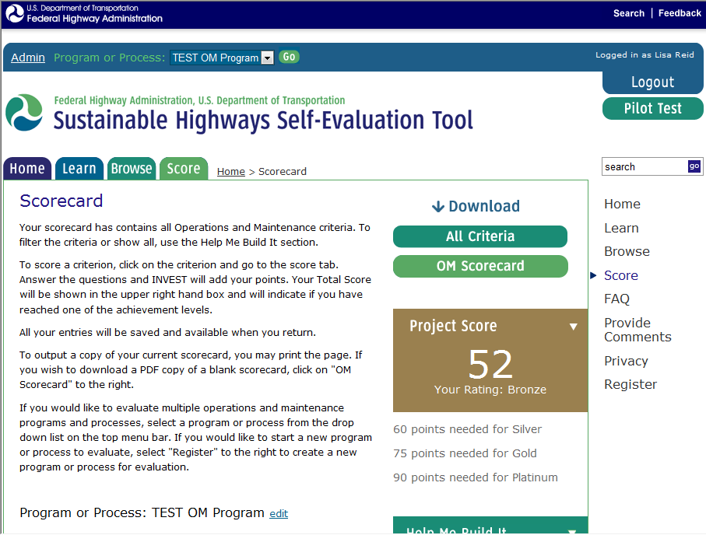

Slide 25
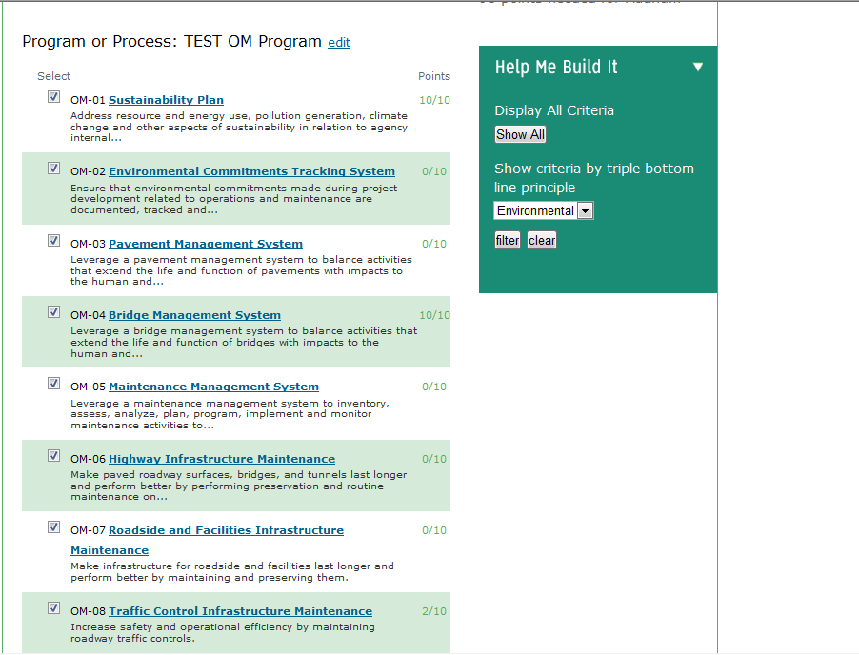

Slide 26
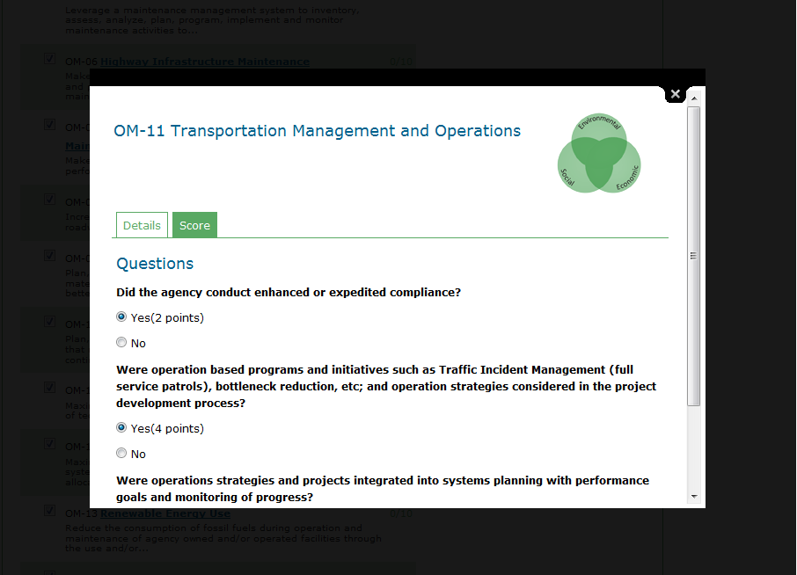

Slide 27
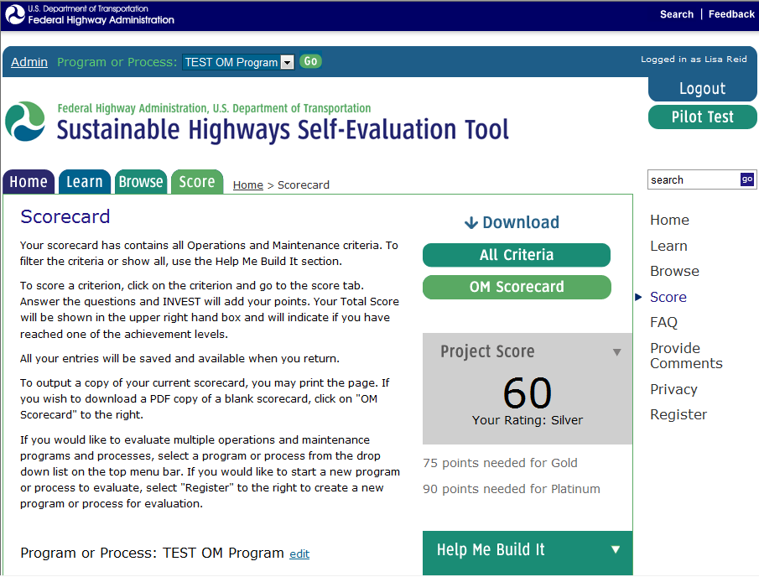

Slide 28
Thresholds for Operations & Maintenance
 | Number of Points Required for Each Level
Total # of Points Possible | 150
BRONZE (30%) | 45-59
SILVER (40%) | 60-74
GOLD (50%) | 75-89
PLATINUM (60%) | 90+

Slide 29
INVEST
Pilot Testing and Next Steps

Slide 30
Pilot Testing of INVEST
Testing will be done on the Project Development (PD), System Planning (SP) and Operations & Maintenance (OM) criteria
Objectives for Conducting the Pilot Test
  Provide input on how to make tool easier to use
  Obtain input on further refinement to criteria
  For calibration of scoring and achievement levels
Schedule for Pilot Testing
  July thru October 2011
Funding available to defray costs of pilot testing

Slide 31
Pilot Testing Process
Task | Description | Duration
1 | Solicitation and selection of Pilot Test projects and programs | 4 weeks
2 | Pilot Test owner coordination and agreement | 2 weeks
3 | Review Pilot Test instructions and participation in orientation webinar | 2 weeks
4 | Preparation, organization and material collection for agency workshop | 2 weeks
5 | Conduct pilot test self-evaluation workshop | 1 day
6 | Prepare summary of results and feedback | 2 weeks
7 | Participation in webinar on Pilot results and feedback | 1 day

Slide 32
Next Steps
For INVEST
Revise additional criteria
  Revise PD criteria – Complete, April 2011
  Revise O&M criteria – July (Live now)
  Revise System Planning criteria – August 2011
Pilot Testing
  Call for Pilot Projects (PD criteria)– Complete
  Call for Pilots: (Planning, O&M) – end of July
Weighting & Scoring Review - ongoing
Updates to Website - ongoing
Version 1.0 Release – December 31, 2011
For Sustainable Highways Program
Continue strong coordination within FHWA and with partners and stakeholders
Create program structure, partner on key program/research gaps
Notes:
32

Slide 33

www.sustainablehighways.org
Thank You!
Michael Culp
Michael.culp@dot.gov
Connie Hill
Connie.hill@dot.gov
Heather Holsinger
Heather.holsinger@dot.gov
Notes:
This is the website address..
33

