Slide 1
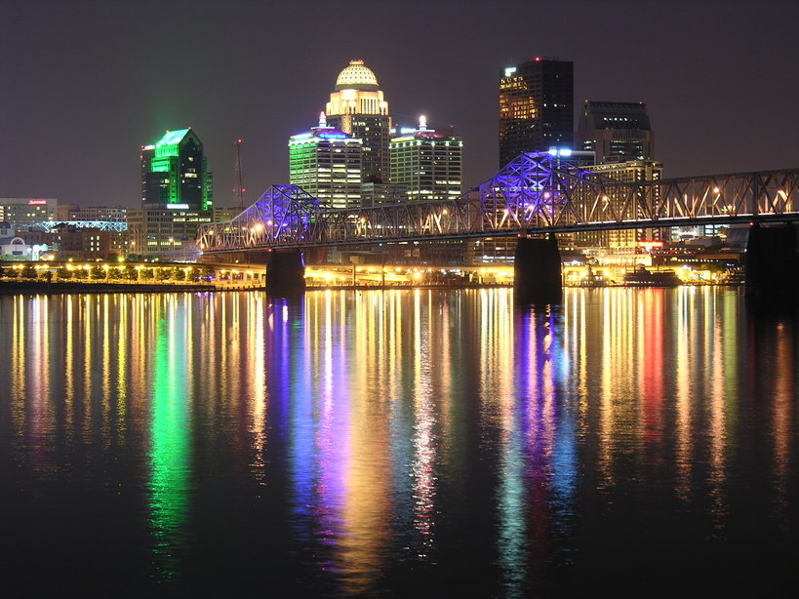


Equipment Working Group

Slide 2
TWG Members
Chair: Erle Potter, Virginia DOT
Vice Chair: Steve McCarthy, UDOT
  (Environmental and Research)
Vice Chair: Ron Pruitt, ALDOT
  (Performance Management and Workforce Development)
FHWA Liaison: Jim Stevenson, FHWA-OK
25 Attendees

Slide 3
New or Updated Publications
  2011 AASHTO Equipment Reference Book

Slide 4
Review Completed Research Projects
NCHRP Project 13-03A, Decision Making for Outsourcing
and Privatization of Vehicle and Equipment Fleet
Maintenance (originally 13-03)

Slide 5
Review Current Research Projects
NCHRP Project 20-7 –Task 309:
Challenges and Opportunities: A Strategic Plan for Equipment Management Research
    9 topics, approximately 5 research problem statements could result
    Consultant is preparing the final report of the workshop deliberations and findings

Slide 6
Completed Activities for the Past Year
2nd year of the Equipment Management Technical Services Program (EMTSP)
    Research Proposal to help accelerate the delivery of action items included the EMTSP Strategic Plan (More later on NCHRP Project 20-07/ Task 309)
    2010 Northeast/Midwest Joint Equipment Management Meeting – Pittsburgh
    Scheduled 2011 Northeast & Midwestern Equipment Management Joint Meeting, Kansas City, KS
    Scheduled 2011 Western States Highway Equipment Managers Association (WSHEMA) 2011 Conference, Seattle, WA
    Working with Southeastern States Equipment Managers Conference (SSEMC) to join EMTSP as a regional partnership

Slide 7
Completed Activities for the Past Year
  Resolution to Officially Change Name from AETO to EMTSP
  Collaborating with TRB Committee AHD60 to schedule national joint TRB/EMTSP Equipment Management Workshop in Mobile AL, June 24-28, 2012
  Collaborating again with Safety & Reliability TWG – Joint General session presentation on AVL/GPS/Telematics Expert Panel
  EMTSP Strategic Plan, assigned responsibilities for each task.
  Clear Roads Meeting on Plug & Play Technology in Winter Maintenance
    The current specification, developed for Clear Roads is a good start, but the minimum requirements and standards for the final specification needs to be further refined.
    Group 2 – Truck Component (CANbus) - Tim Peters, Erle Potter, John Scharfbillig - develop standards for connections between AVL systems and spreaders.

Slide 8
New Business
Request for AASHTO to publish NCHRP Report 692 results as an official AASHTO guide.
Obtain consensus from TWG to present resolution to SCOM
If SCOM approves, send ballot to SCOH and BOD

Slide 9
Activities for the Coming Year
Produce and distribute next year’s AASHTO Equipment Reference Book.
Implement findings from final report of the workshop and Research Project 20-07/Task 309
Follow through on publishing the results of NCHRP Project 13-03A as an AASHTO guide, if consensus is reached
Continue overseeing EMTSP
    Conduct 2011 Northeast & Midwestern Equipment Management Joint Meeting, Kansas City, KS
    Conduct 2011 Western States Highway Equipment Managers Association (WSHEMA) 2011 Conference, Seattle, WA

Slide 10
Activities for the Coming Year
Continue overseeing EMTSP (continued)
  Continue working with Southeastern States Equipment Managers Conference (SSEMC) to join EMTSP as a regional partnership
  Continue collaborating with TRB Committee AHD60 to conduct national joint TRB/EMTSP Equipment Management Workshop in Mobile AL , June 24-28, 2012
  Continue collaborating with Safety & Reliability TWG on issues of mutual concern
  Continue updating EMTSP Strategic Plan
  Enhance EMTSP website
  Continue participation in the “Plug and Play Equipment/ Instrumentation” project being lead by Clear Roads

Slide 11
Discuss New Research Projects
Development of a Computer based Equipment Replacement Process

Slide 12
Oversight Panel Meeting
Review EMTSP Budget and Work Plan
Review Accomplishments
Regional Partnerships Update
  Joint NE & MW Equipment Meeting, Kansas City, Kansas
  Western States Highway Equipment Managers Association in Seattle, Washington
  Southeastern States Equipment Managers Conference, Morgantown, West Virginia
Retired Panel Member Replacement
EMTSP Strategic Plan
  Review for Currency and Relevance
  Review and Update Action Items
Website Enhancements

