Slide 1
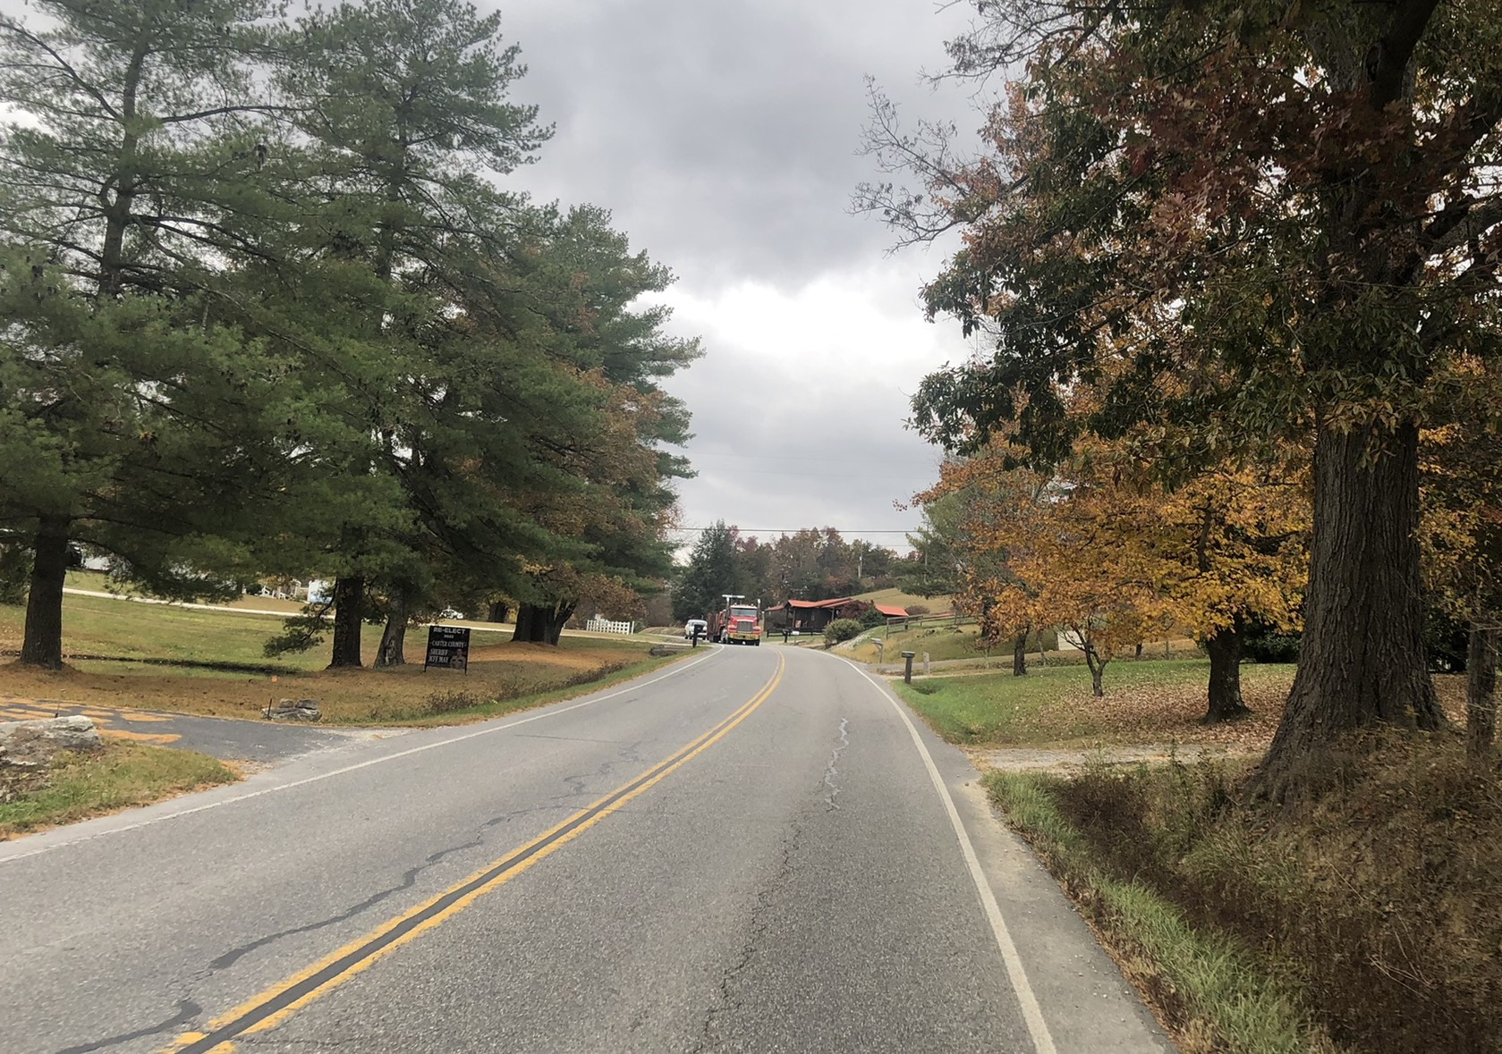
US 60 Public Meeting December 7, 2023
Notes:
Welcome, presentation for brief project overview, Q&A will continue one-on-one afterward

Slide 2
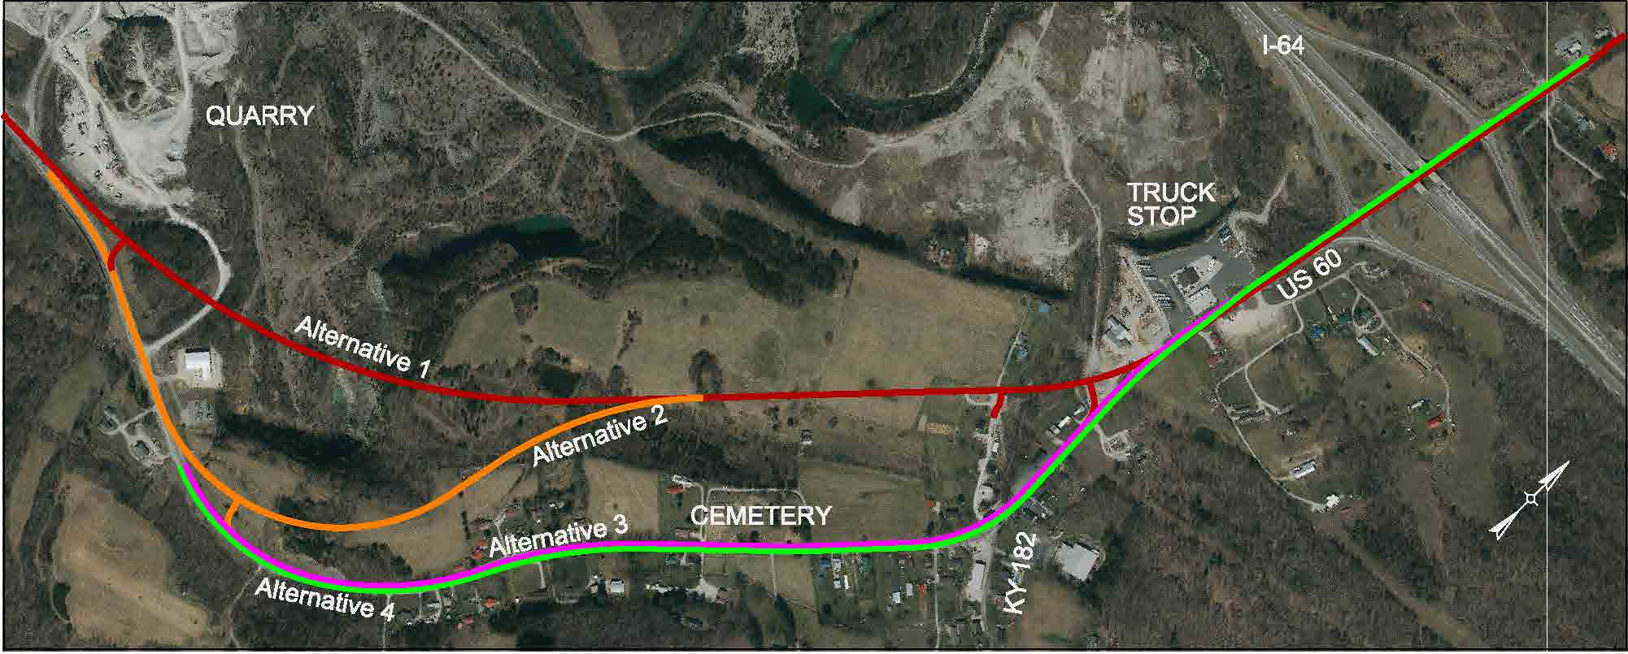
Project Limits
Notes:
Begins near quarry entrance, ends just east of the interchange. Two alternatives go cross-country between the quarry and the truck stop, two others stay on-corridor

Slide 3
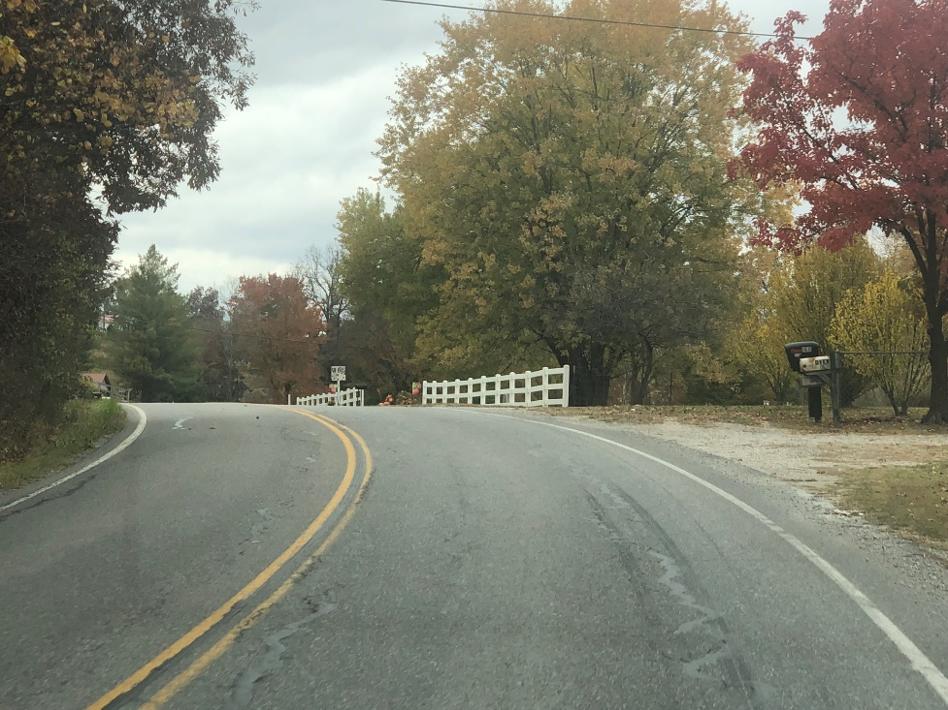
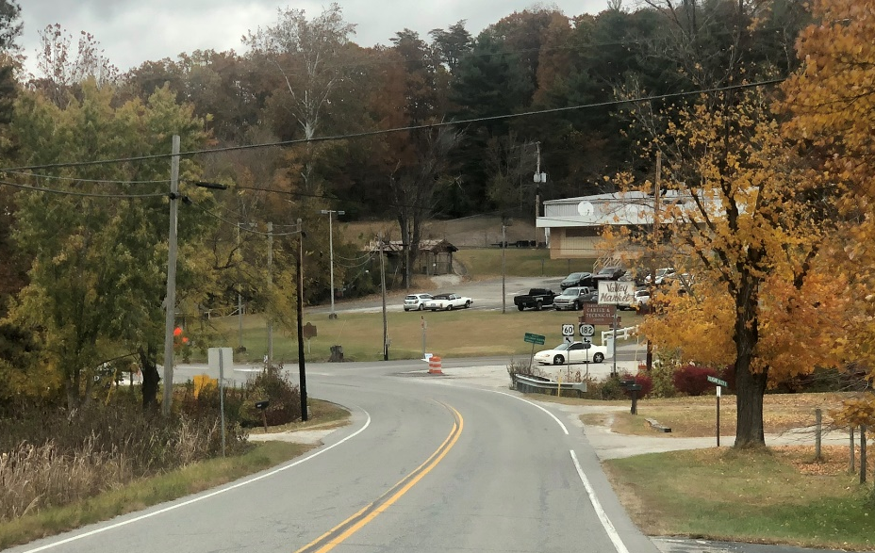
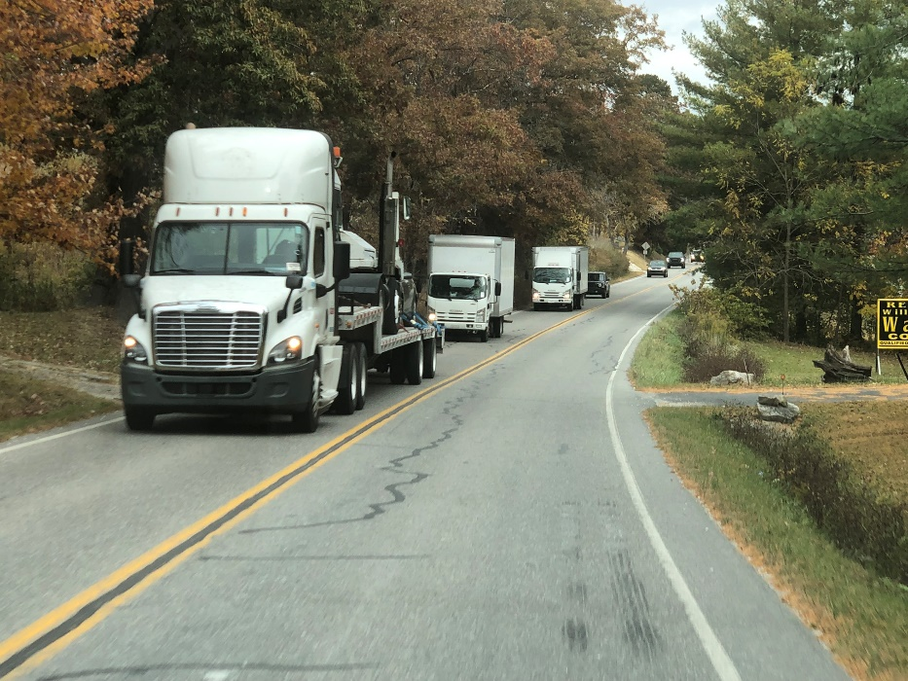
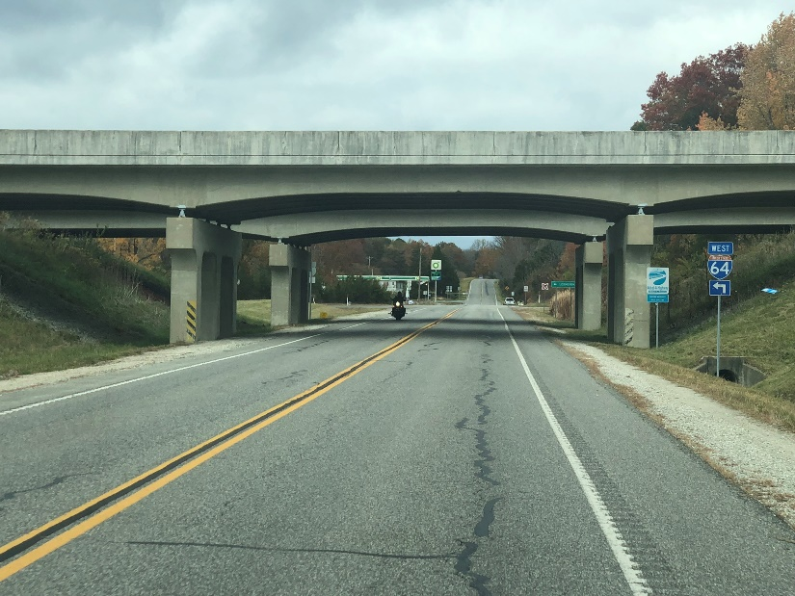
Existing Conditions
Notes:
Existing corridor has a number of hill crests with limited sight distance, intersection at KY 182/Cecil Ave. also has limited sight distance. A high percentage of trucks use the route, and the grade over the hill is steep with no truck climbing lane. A number of residences and businesses are close to the road. The I-64 bridge clearance is lower than current recommendation for interstate bridges.

Slide 4
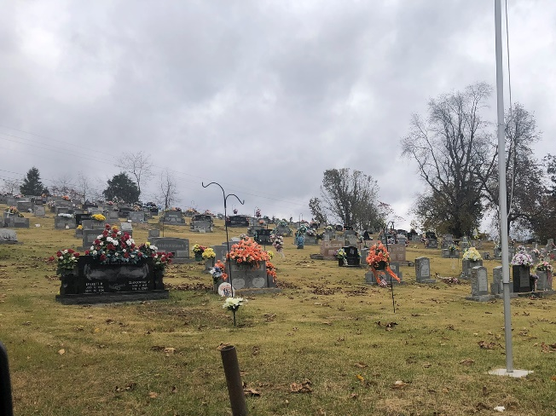
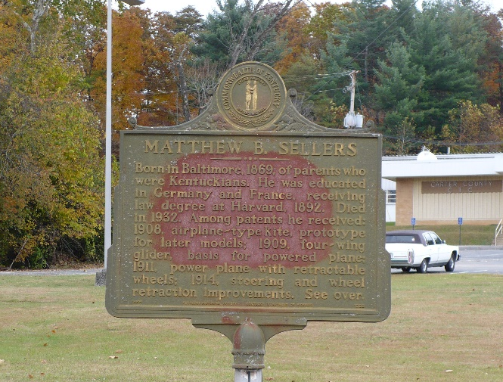
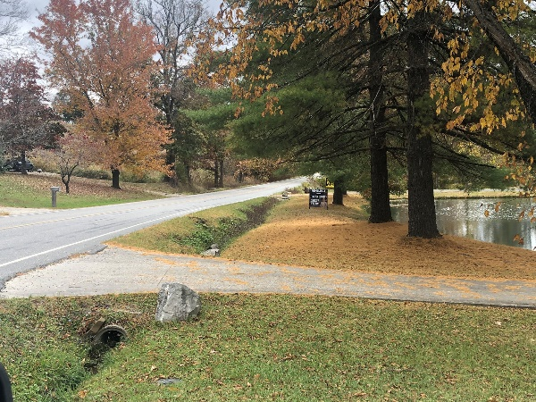
Purpose and Need
This project was undertaken to address the current roadway deficiencies, which include narrow shoulders and inadequate sight distance at intersections and over hilltops, and to improve safety, mobility and connectivity for this region of Carter County.
Environmental Analysis
Notes:
Purpose and need drives the project design. Environmental impacts (cemeteries, historic buildings and properties, waterways and wetlands, etc.) must be documented and to the maximum extent practicable, avoided

Slide 5
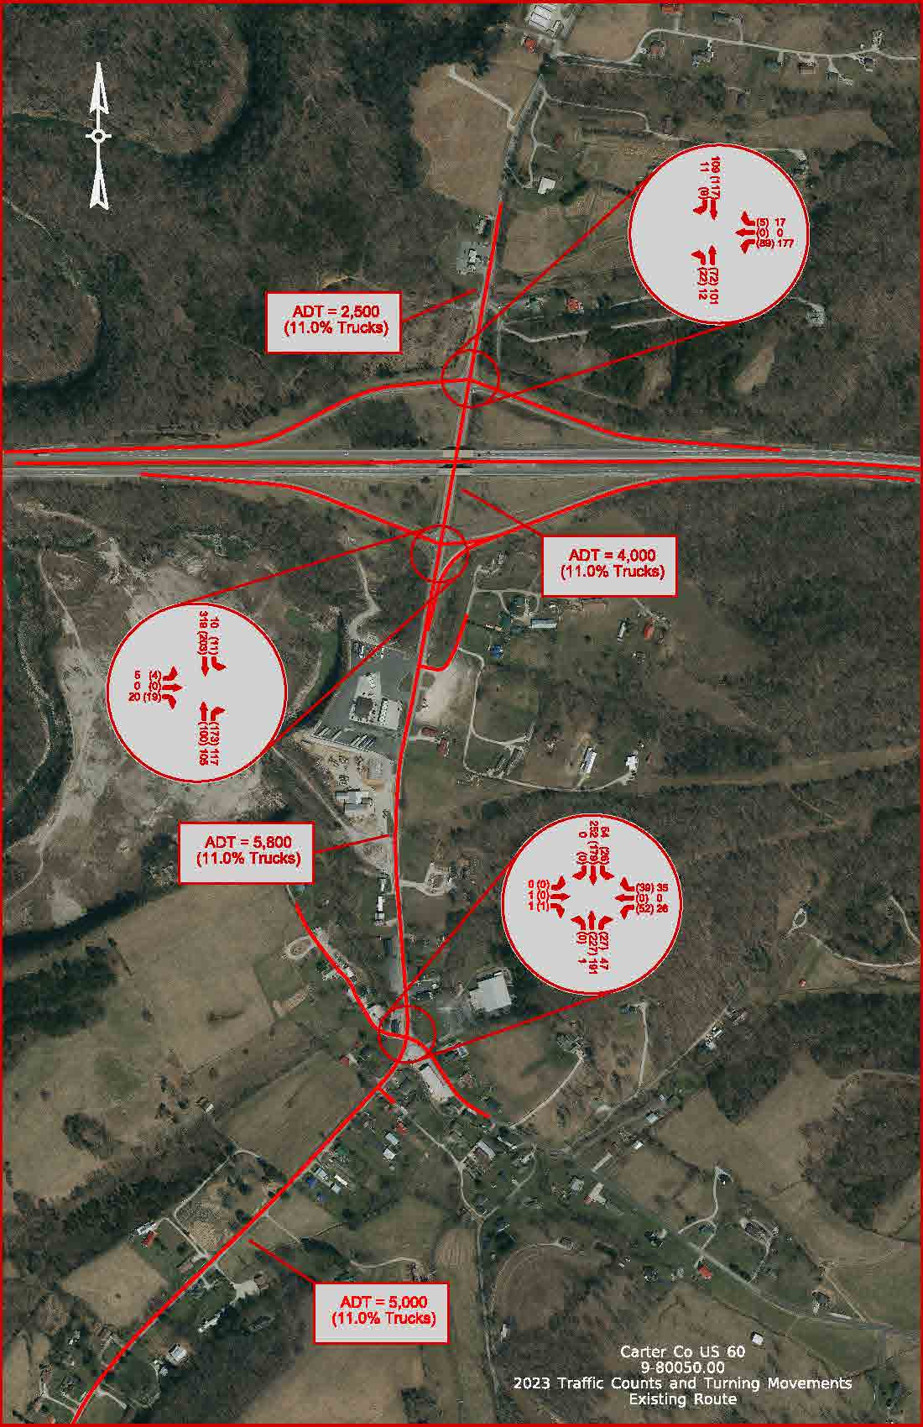
Traffic
Notes:
About 6,000 vehicles per day between KY 182 and the interstate, and is expected to grow slightly. Significant number enter/exit at the interstate and also turn onto KY 182. A print of these is available for anyone who wants to see the details

Slide 6
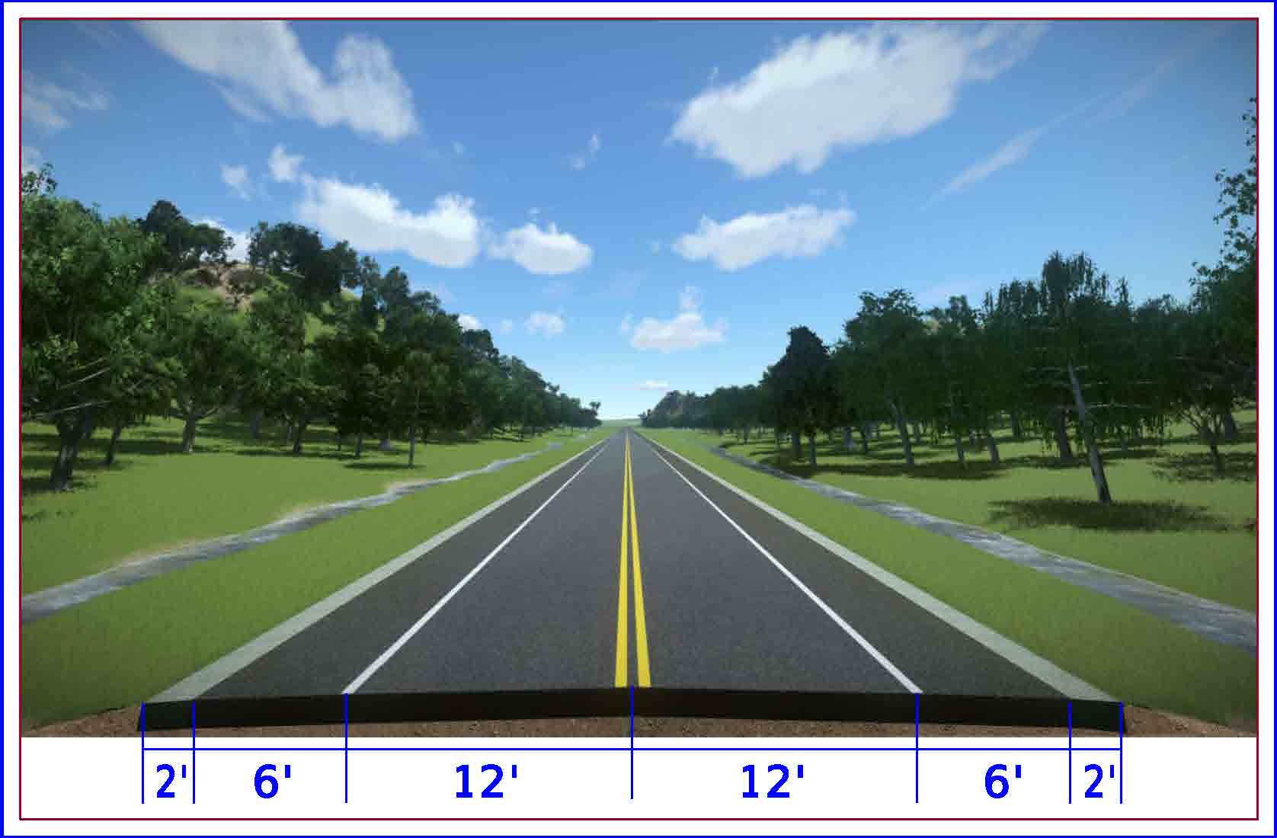
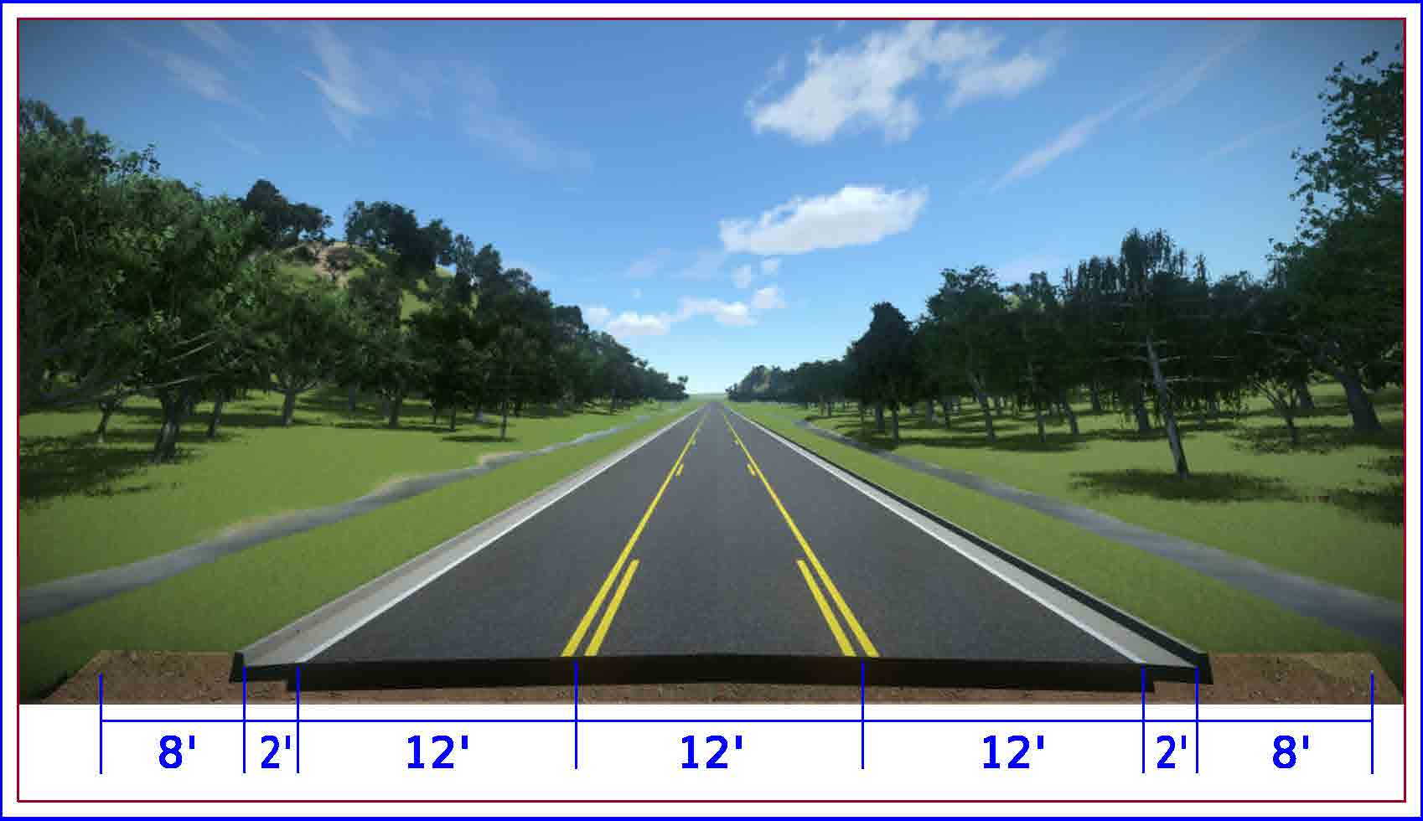
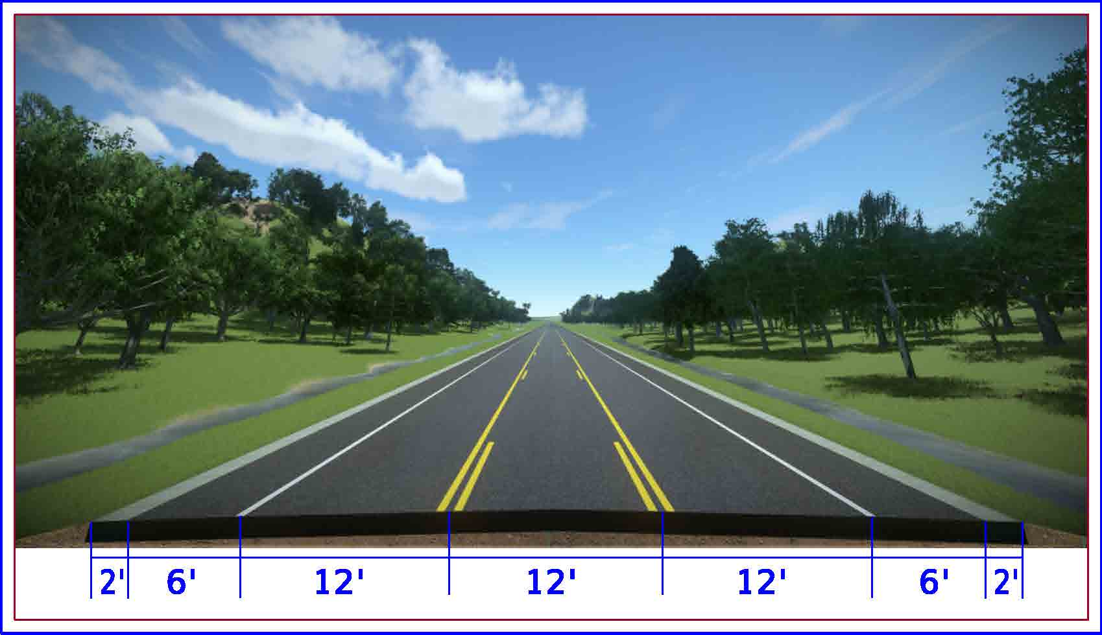
Roadway Design Sections
2-Lane Rural Section With Paved Shoulders
3-Lane Urban Section With Curb and Gutter
3-Lane Rural Section With Paved Shoulders
Notes:
The project has three designs (also referred to as Typical Sections) but all alternatives use a combination of two or more. Cross-country alternatives will have truck climbing lanes over the hill. All alternatives will have 3 lanes between KY 182 and the interstate. The cross-country keeps the 3rd lane through the interchange.

Slide 7
Corridor Alternatives
Notes:
Four alternatives: two cross-country from the quarry to the truck stop, two on the existing corridor. All are on the existing corridor from the truck stop through the interchange.

Slide 8
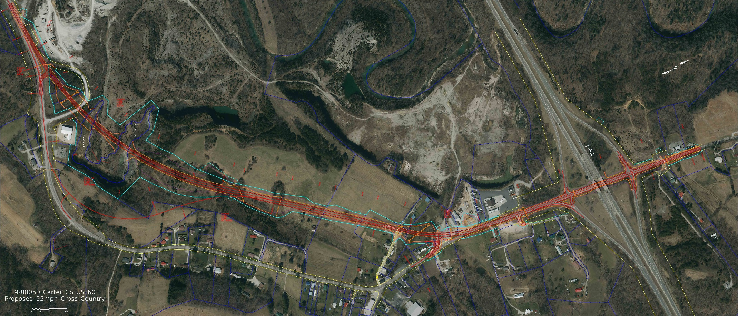
Alternative 1: 55mph Cross-Country 2-Lane and 3-Lane Rural
Total Construction, Right of Way, and Utility Cost: $30,448,000
Relocations: 3 (2 Residential and 1 Commercial)
Right of Way Acreage: 40.9 Acres
Notes:
Begins at the quarry, 2-lane with truck climbing lanes over the hill, 3-lane from the old road connector through the interchange, ends just past the gas station. Review total cost, number of relocations, total R/W acreage.

Slide 9
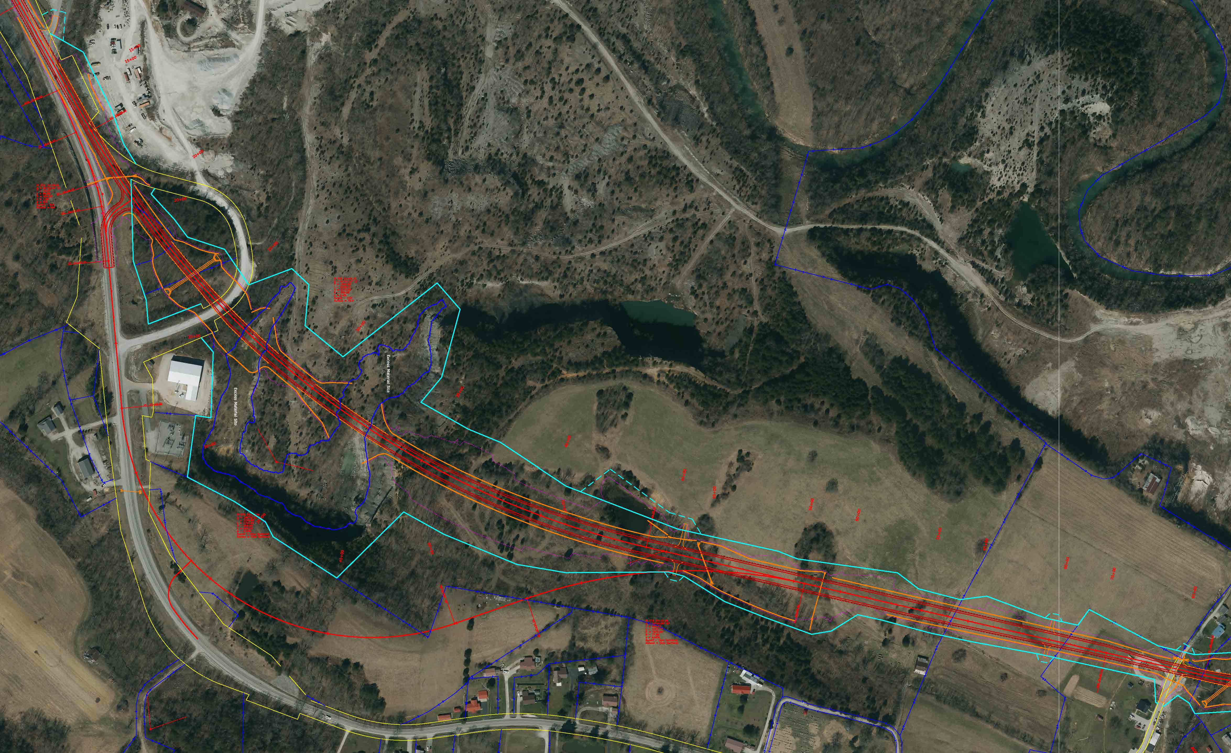
Alternative 1: 55mph Cross-Country 2-Lane and 3-Lane Rural
Notes:
Grades over the hill are not quite as steep as the existing road. Crosses a deep gorge area where the quarry has excavated rock. Excavation over the hill is main reason for the high construction cost of this alternative.

Slide 10
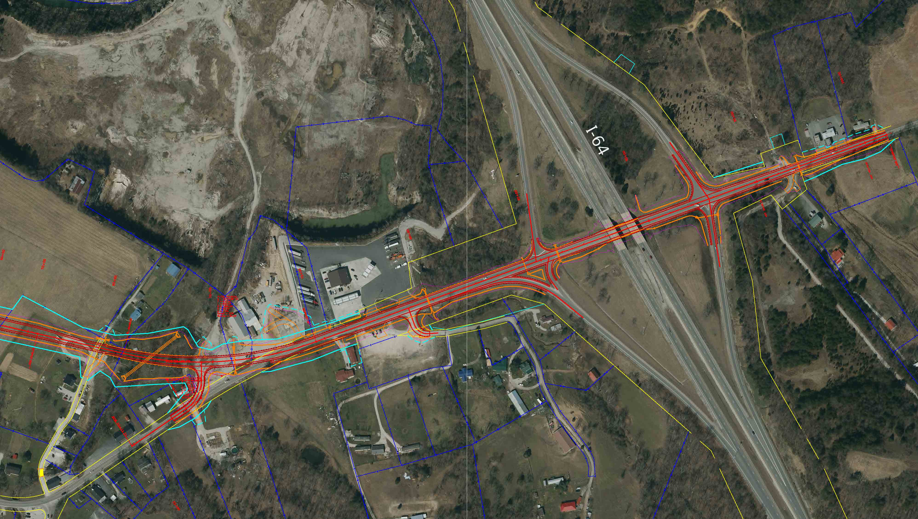
Alternative 1: 55mph Cross-Country 2-Lane and 3-Lane Rural
Notes:
Cecil Avenue will be cut at the existing stream crossing and redirected to the new road (safer intersection). Reconstruction for the 3-lane section through the interchange will require lowering the road to accommodate the bridge.

Slide 11
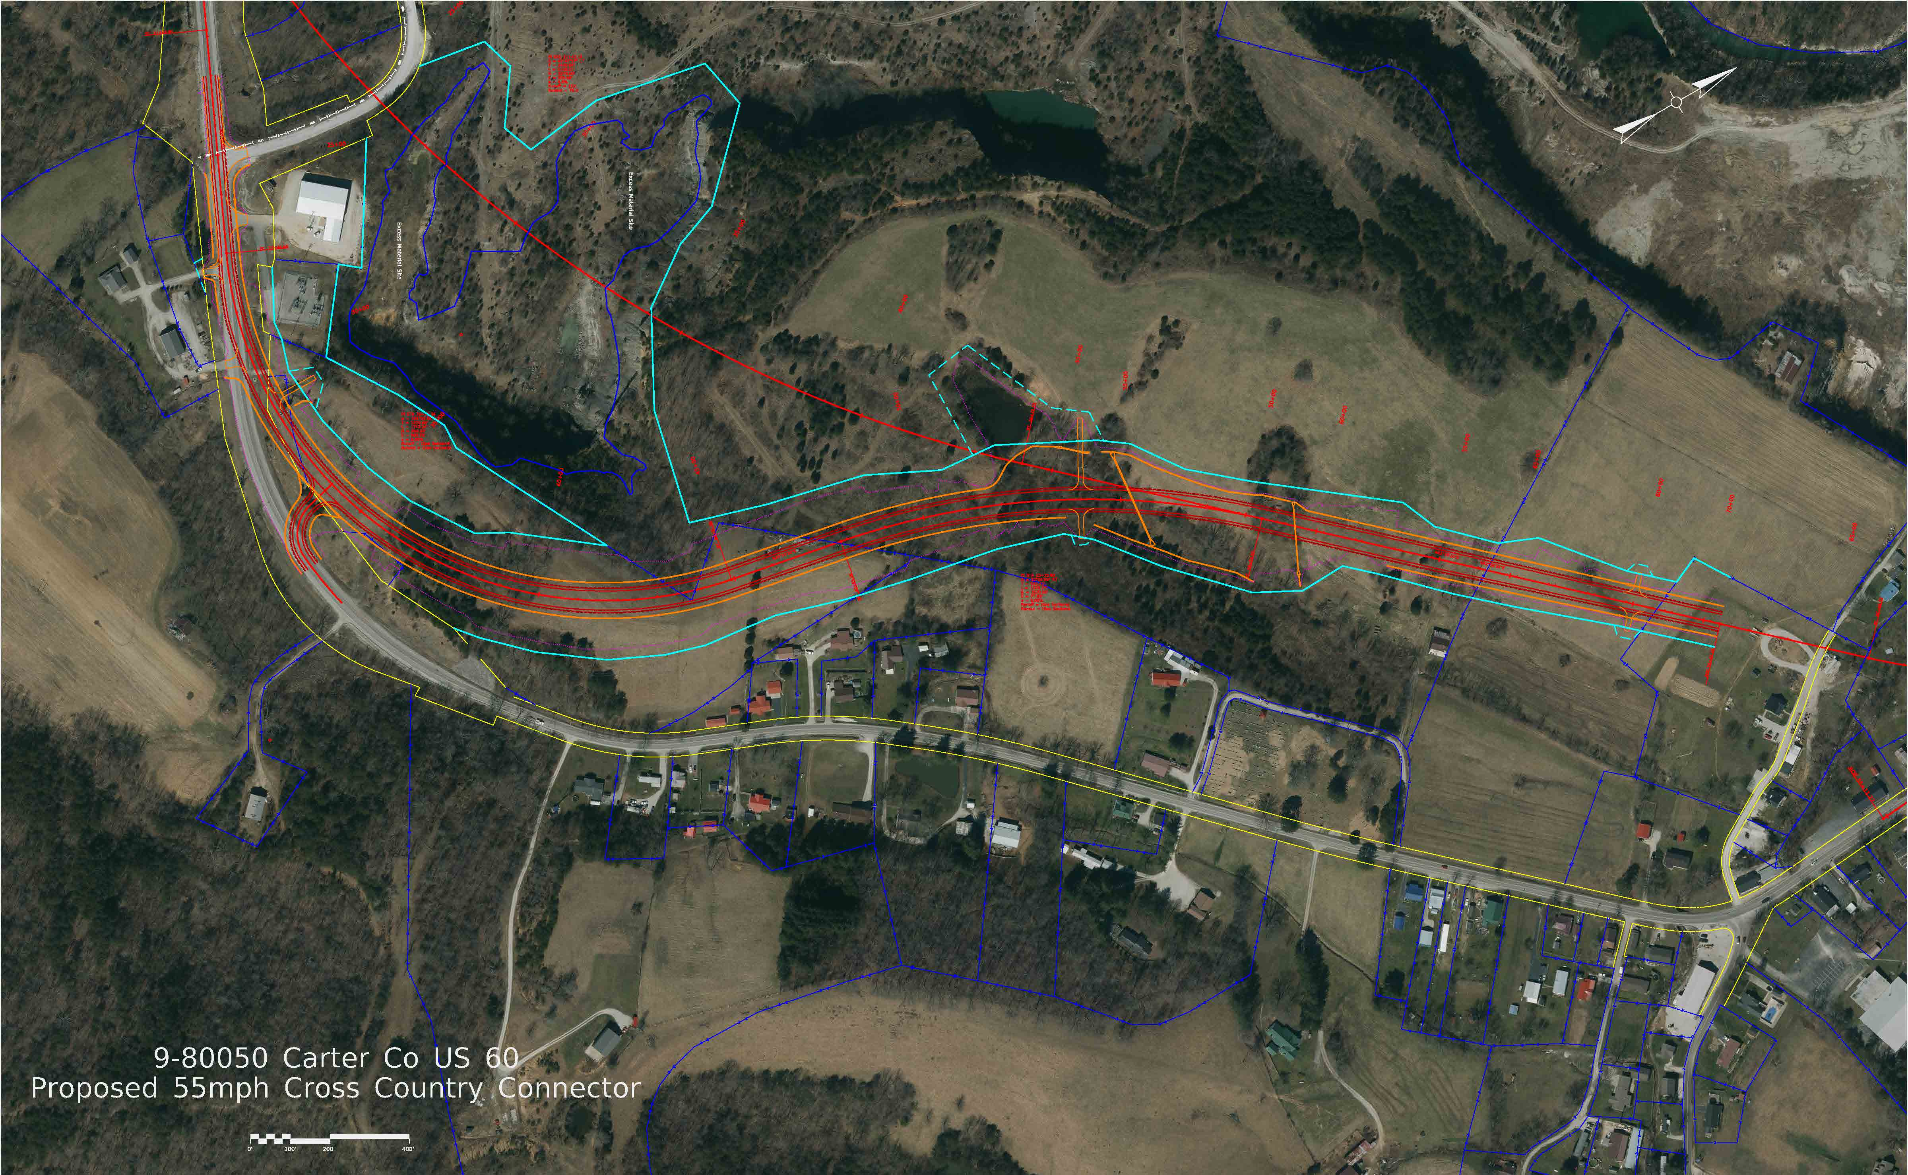
Alternative 2: 55mph Cross-Country Connector 2-Lane Rural
Total Construction, Right of Way, and Utility Cost: $29,587,000
Relocations: 3 (2 Residential and 1 Commercial)
Right of Way Acreage: 44.2 Acres
Notes:
Begins east of the quarry near the transformer station, 2-lane with truck climbing lanes over the hill. Grades are about the same as the existing road. Avoids crossing the gorge area with the road, but it will still be used for excess excavation. Joins up with the cross-country alignment just west of Cecil Ave., and follows the same to and through the interchange. Review total cost, relocations, and R/W acreage.

Slide 12
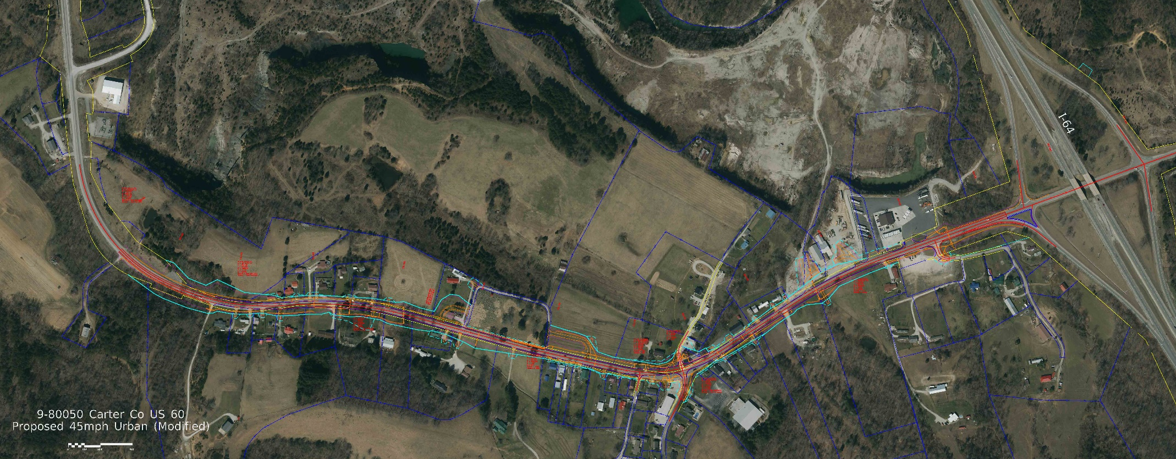
Alternative 3: 45mph On-Corridor 3-Lane Urban Curb and Gutter
Total Construction, Right of Way, and Utility Cost: $23,353,000
Relocations: 15 (12 Residential and 3 Commercial)
Right of Way Acreage: 7.5 Acres
Notes:
3-lane urban curb and gutter from the recent roadway widening reconstruction up to the interchange. Interchange would only be milling and repaving. Review total cost, relocations, and R/W acreage.

Slide 13
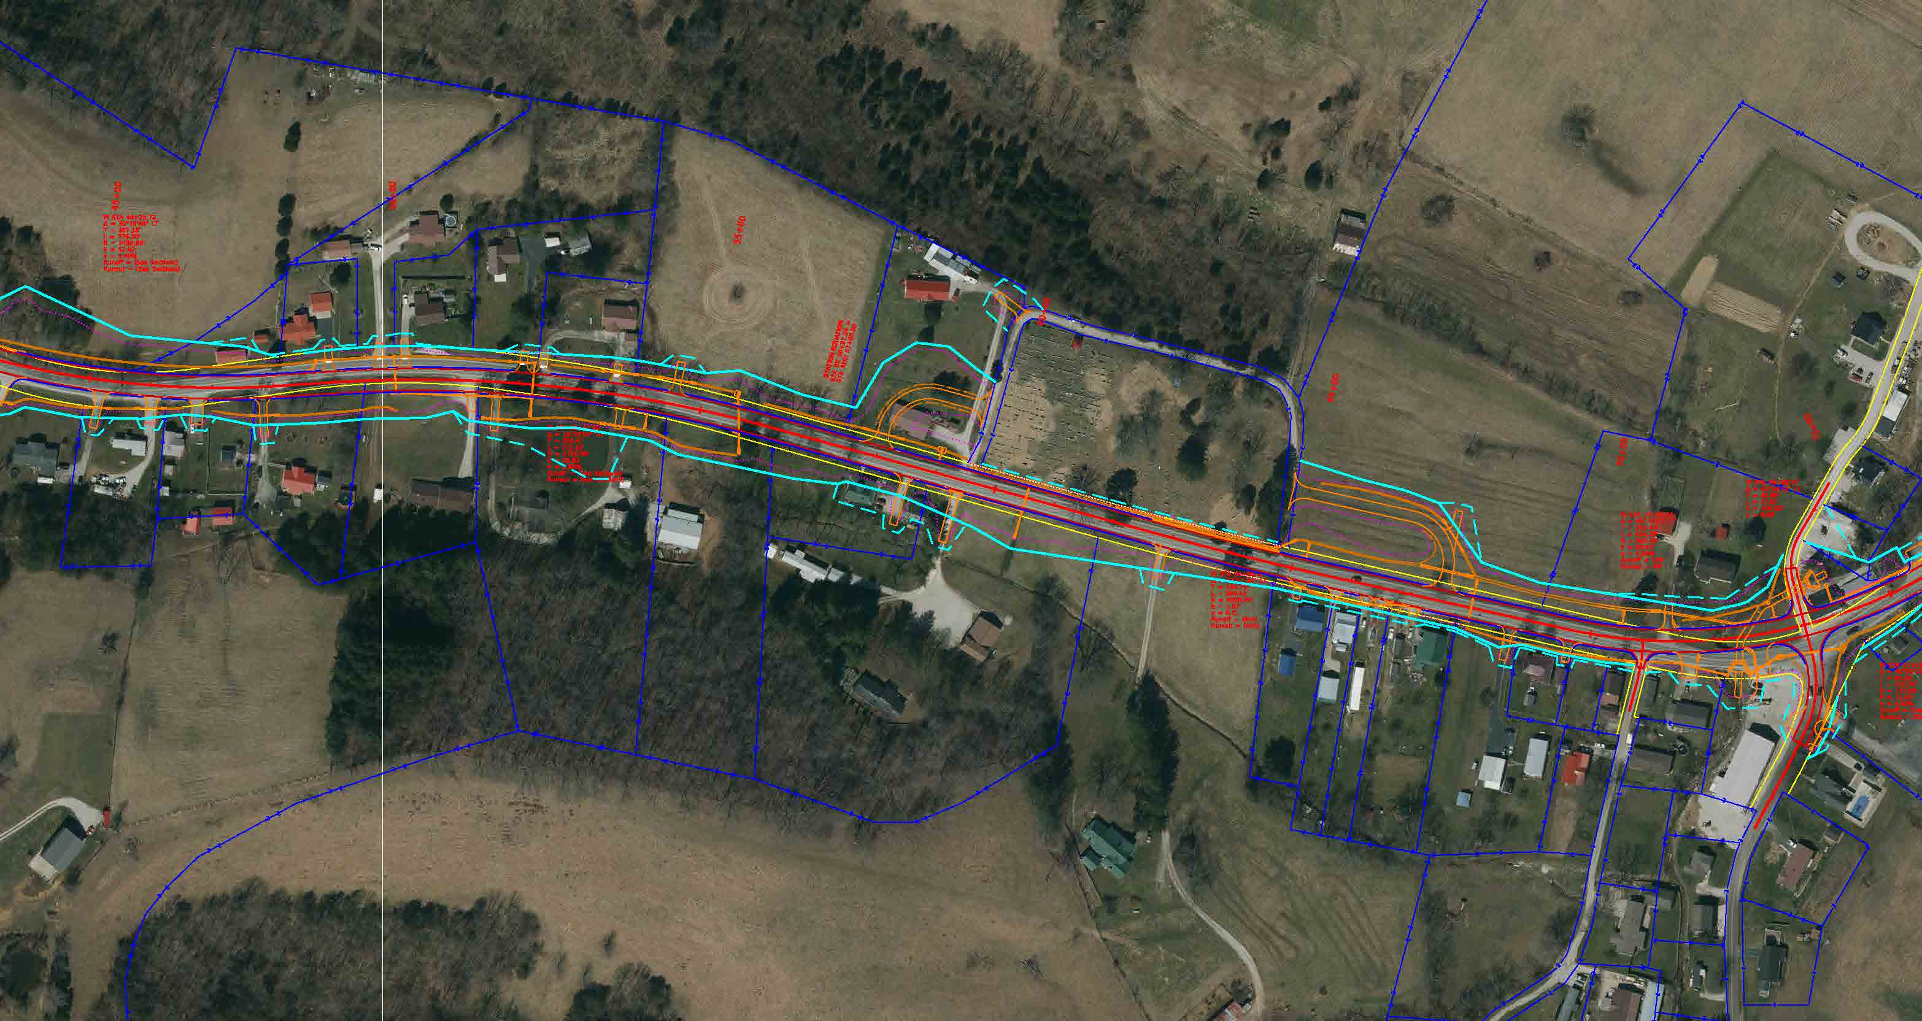
Alternative 3: 45mph On-Corridor 3-Lane Urban Curb and Gutter
Notes:
Flattens the vertical hilltop crest and the horizontal S-curve. Uses a retaining wall to keep off the cemetery. Entrances there must be relocated away from the wall for sight distance around it. Flattens the horizontal curve at KY 182.

Slide 14
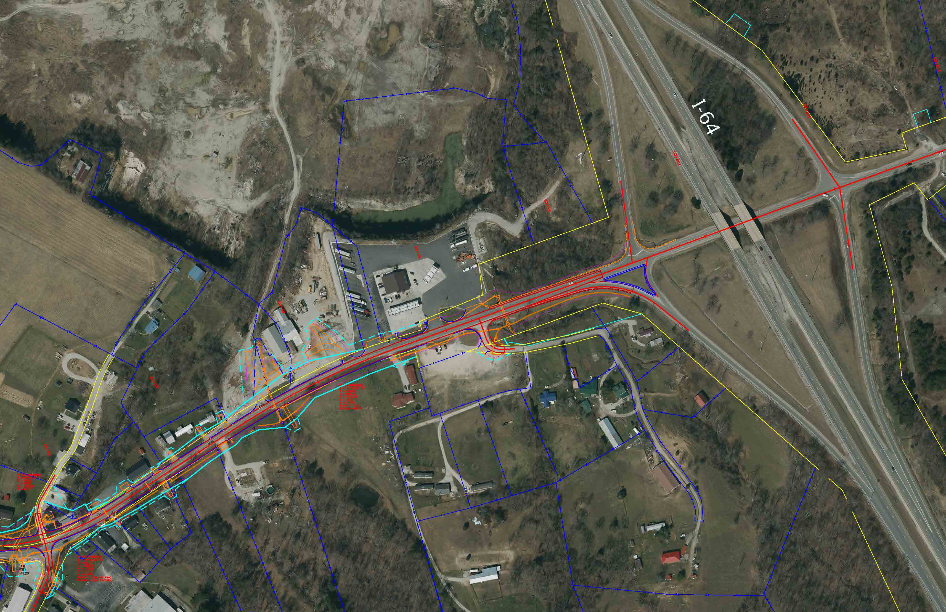
Alternative 3: 45mph On-Corridor 3-Lane Urban Curb and Gutter
Notes:
Modifies the church fellowship hall parking to reduce backing out into the roadway. Flattens the rolling grade in front of the machine shop. Keeps the 3-lanes up to the interchange. Only milling and repaving through the interchange.

Slide 15
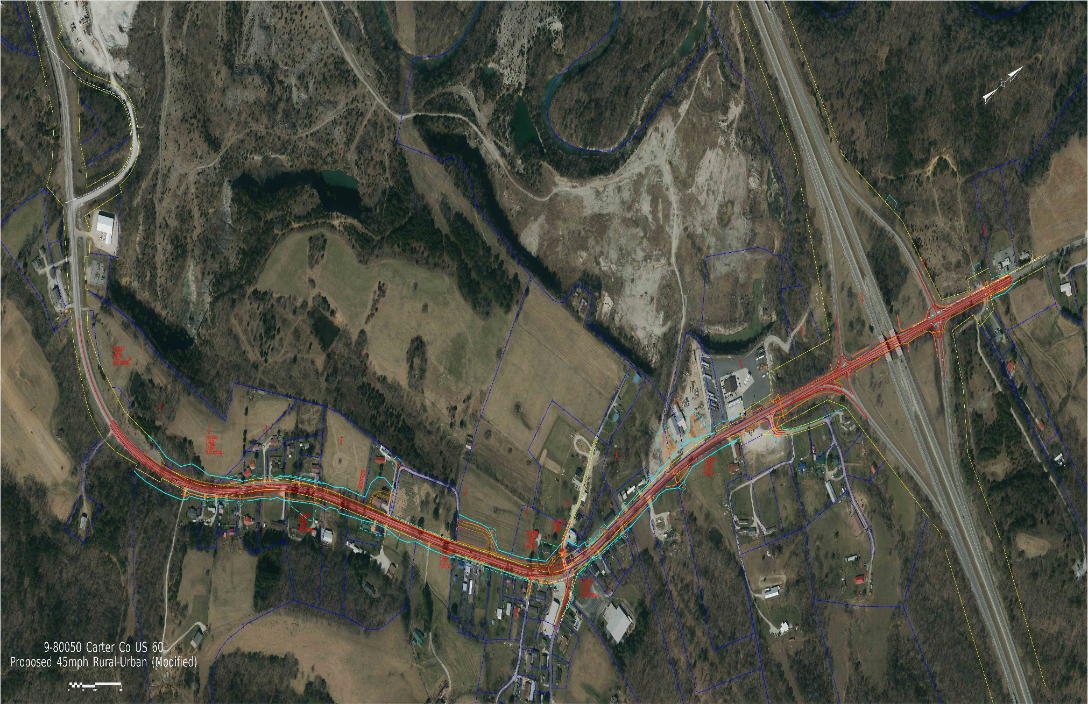
Alternative 4: 45mph On-Corridor 2-Lane Rural to 3-Lane Urban Curb and Gutter
Total Construction, Right of Way, and Utility Cost: $24,864,000
Relocations: 15 (12 Residential and 3 Commercial)
Right of Way Acreage: 6.6 Acres
Notes:
2-lane rural from the recent roadway widening reconstruction up to KY 182. Then would switch to 3-lane curb and gutter, following the previous alignment and grade. Would switch back to 2-lane rural, and reconstruct the road through the interchange (without altering the grade). Review total cost, relocations, and R/W acreage.

Slide 16
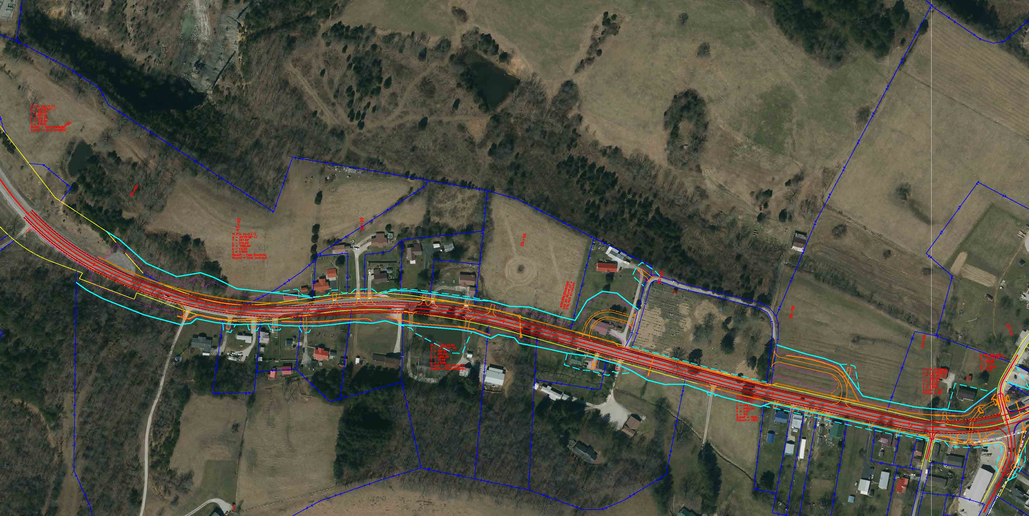
Alternative 4: 45mph On-Corridor 2-Lane Rural to 3-Lane Urban Curb and Gutter
Notes:
As in the previous alternative, the hilltop crest and horizontal S-curve will be flattened. Again a retaining wall will be constructed in front of the cemetery and the entrances relocated. Flattens the curve at KY 182.

Slide 17
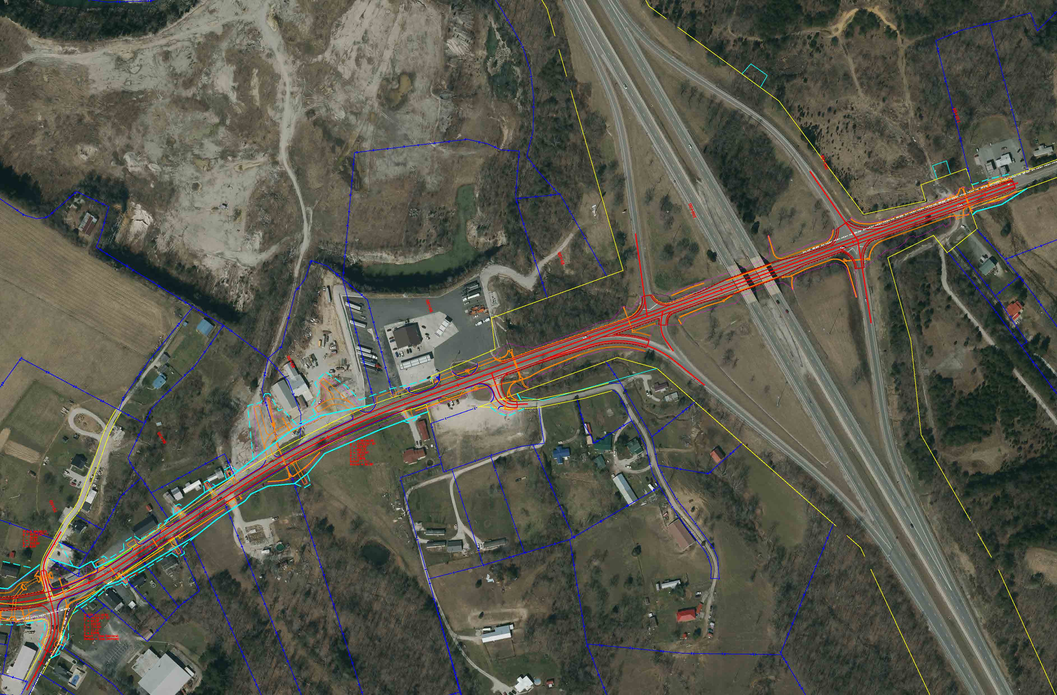
Alternative 4: 45mph On-Corridor 2-Lane Rural to 3-Lane Urban Curb and Gutter
Notes:
Modifies the church fellowship hall parking to reduce backing out into the roadway. Flattens the rolling grade in front of the machine shop. Keeps the 3-lane curb and gutter up to the interchange then switches to 2-lane rural and reconstructs the road through the interchange.

Slide 18
Current Six-Year Highway Plan
Right of Way
FY 2025 - $1,320000
Utilities
FY 2026 - $1,760,000
Construction
FY 2027 - $8,780,000
Notes:
Here are the funding and year from the current 6-year plan. The plan will be re-authorized in the legislative session next year. Funding amounts and years may be changed at that time.

Slide 19
Future Steps *
December 2023
Public Meeting
Early 2024
Final Alignment Chosen
Late 2024 to 2025
Right of Way Process Begins
Late 2025 to 2026
Utility Relocation Begins
Late 2026 to 2027
Construction Begins
* Pending Funding Availability
Notes:
If adequate funding is provided and years are not changed in the next legislative session, this is the tentative schedule for the project.

Slide 20
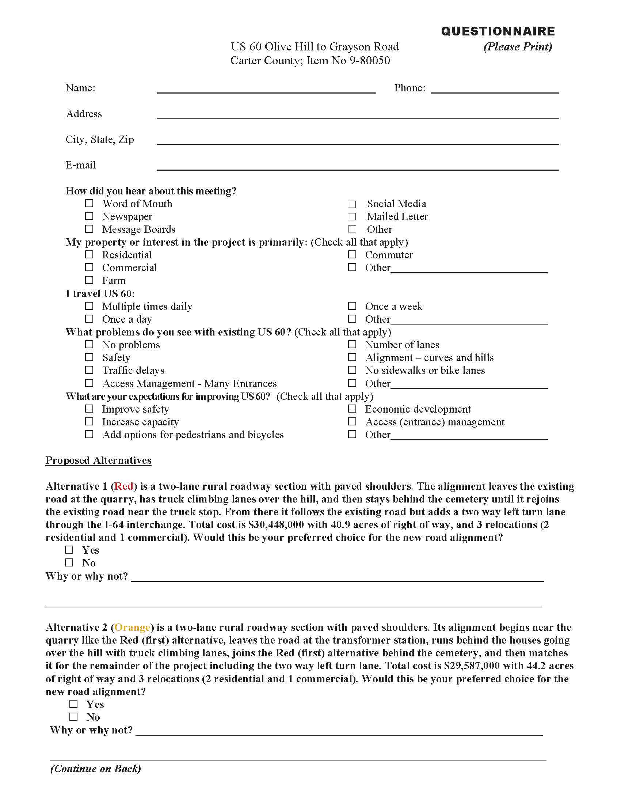
Meeting Forms
Notes:
Take a brochure and questionnaire, and fill out and drop off before you leave. If desired, they may be taken home to be filled out and mailed back. Use the address provided and make sure they are returned by January 7th.

Slide 21
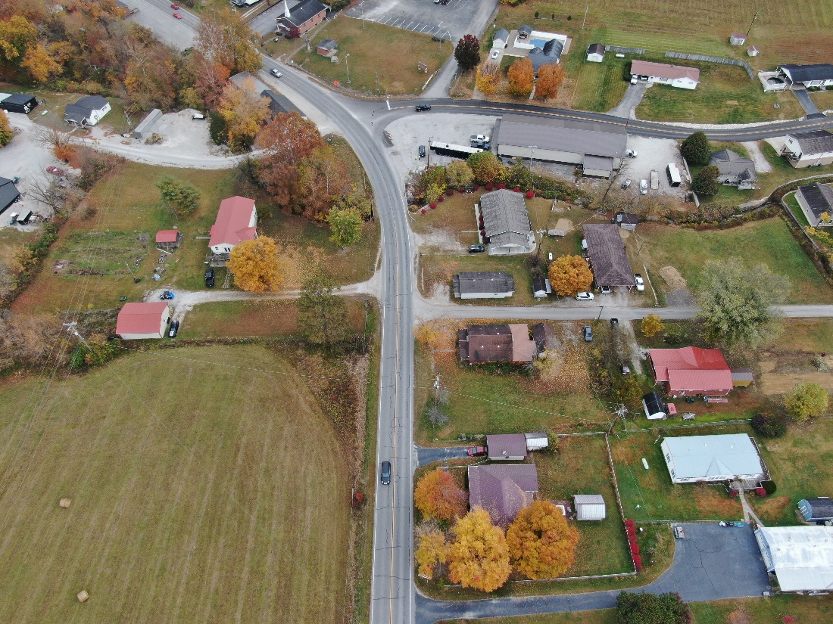
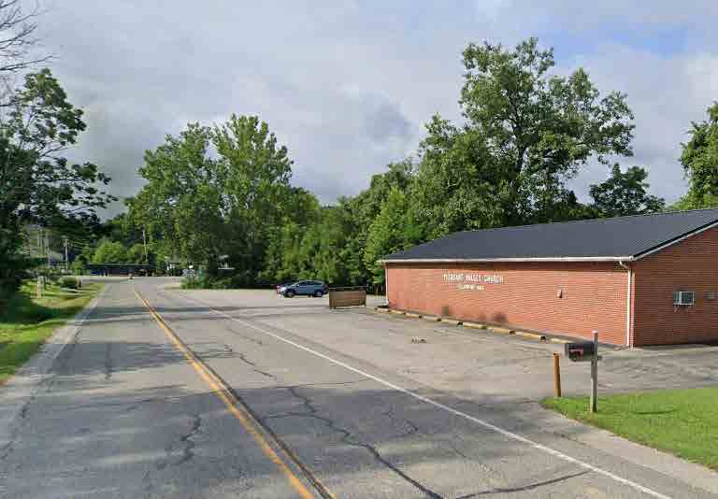
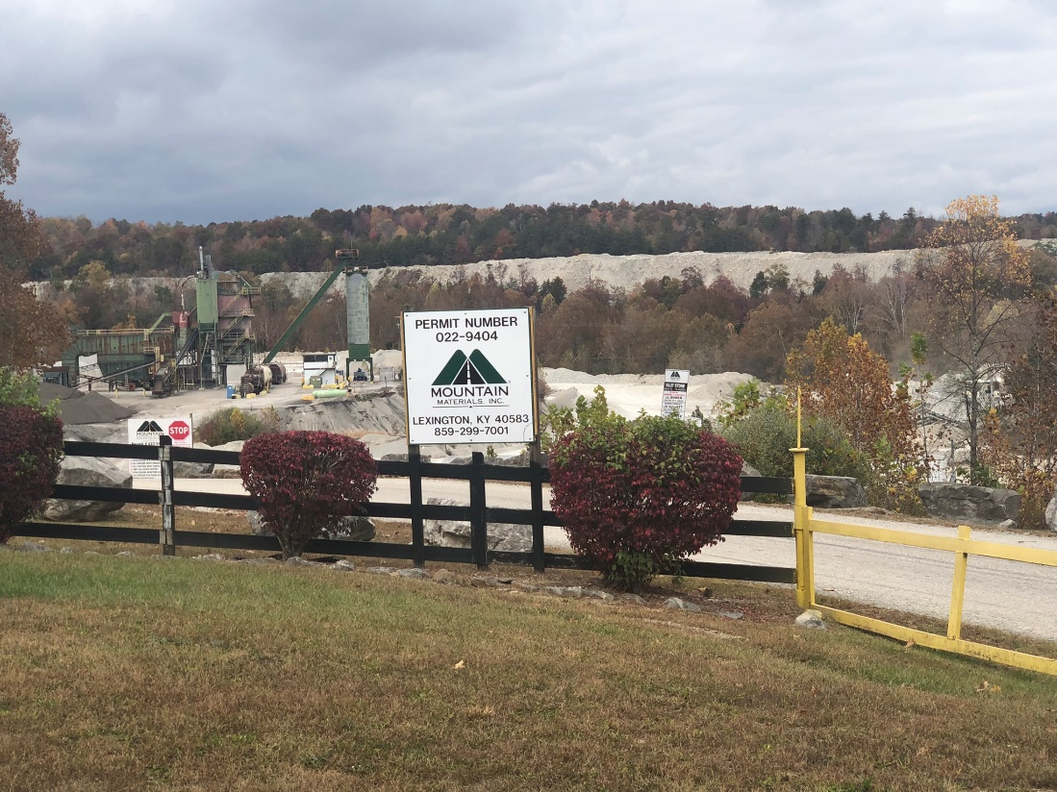
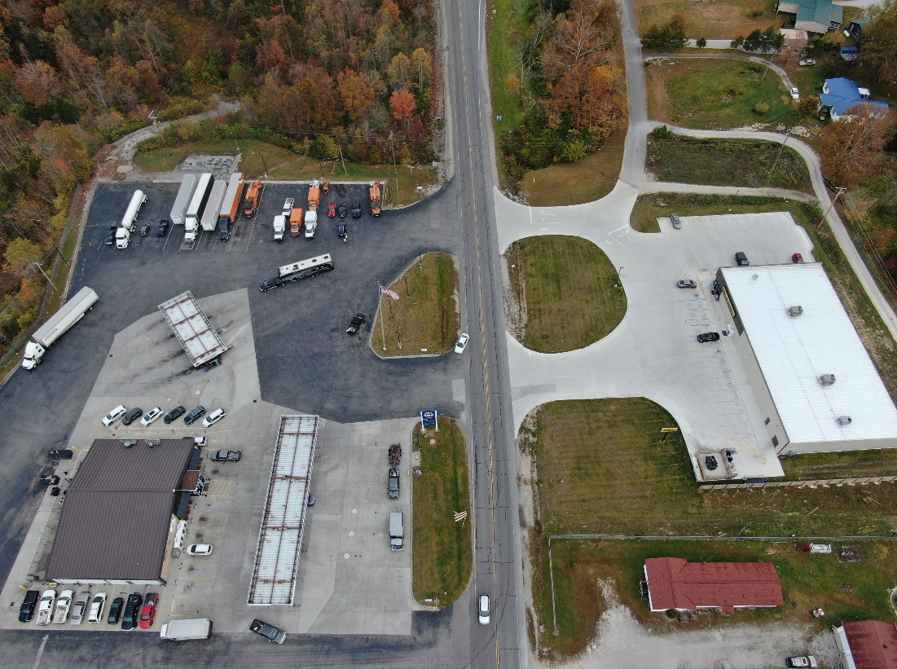
Thank You
Notes:
Thanks for attending. State and consultant staff will remain available for individual questions for the remainder of the meeting.

