Slide 1
Finals, Change Orders and other stuff that pops into my head

Slide 2
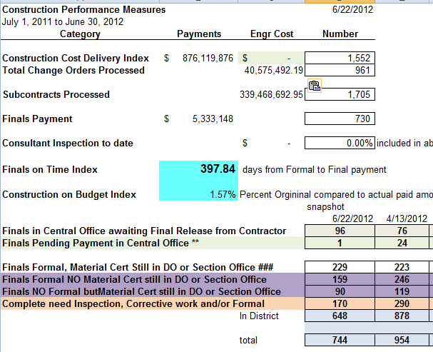

Slide 3
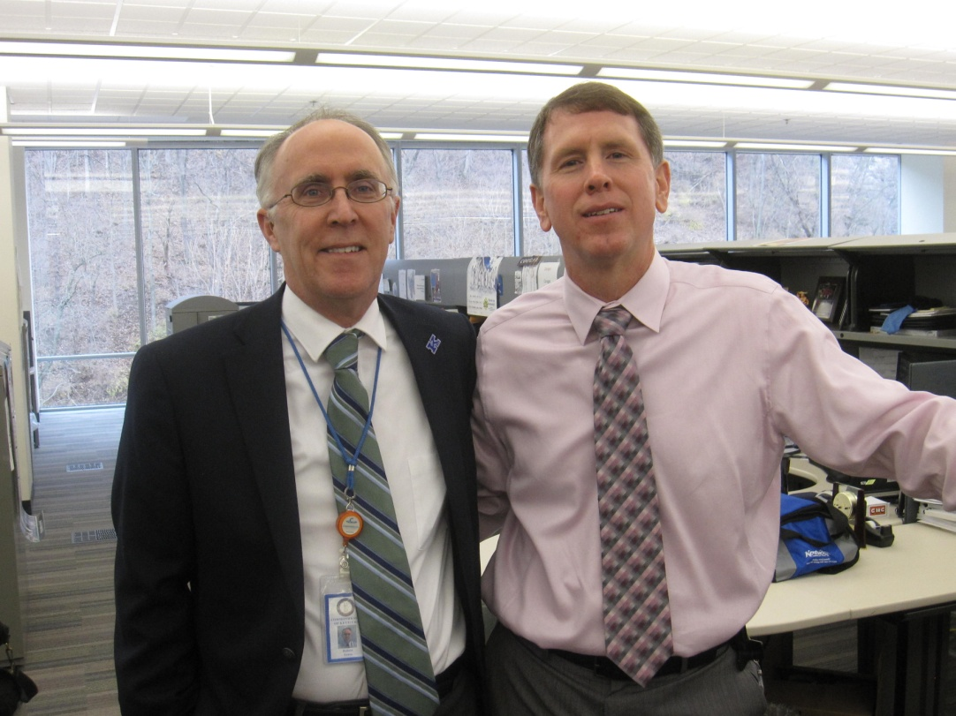
Final submitted in Timely Manner
It can be done!

Slide 4
Time from Formal Acceptance to Final Payment
Variables include:
Time to check final
If documentation maintained as Contract progresses
Complexity of Project
Time for Material Certification
Time for Contractor to sign Final Release
Time returned (2 week payment cycle)
Funds not available to pay final (Engineering Cost overrun)
Contractor Claim

Slide 5
Time from Formal Acceptance to Final Payment
Reason for Timely Final Payments.
Contractor finished the work, we Formally Accepted their work, let’s pay them
FHWA continually sends out request for why Program (money) has been inactive
Capital Project funds expire at end of Fiscal Year (June 30)
Because it is the right thing to do
Program Management cannot access an under run until Program closed out
Less e-mails asking why project not paid off
Specifications section 109.06 state after 180 days to submit final estimate to contractor, after which they have 60 days to agree or disagree.
Upon request contractor can request Demobilization payment after 180 calendars of formal acceptance less $1000. This is hassle!

Slide 6
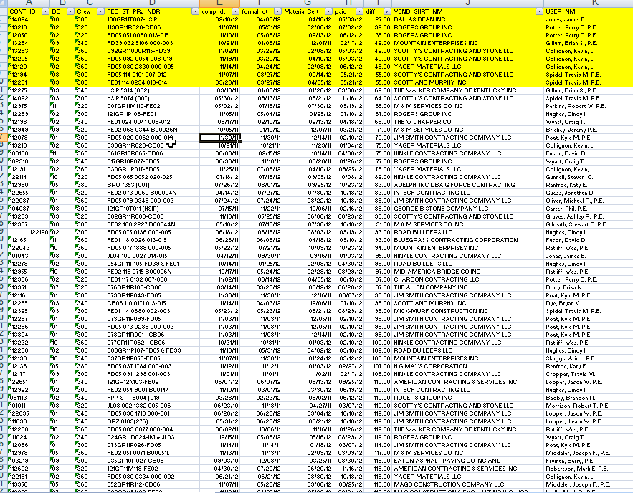
Time from Formal Acceptance to Final Payment
Benchmark should be 120 days. We can do it!! 9 out of 12 have done it at least one last year! 63 out of 732 contracts total.

Slide 7
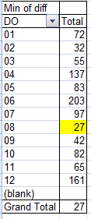
Time from Formal Acceptance to Final Payment
Benchmark should be 120 days. We can do it!! 9 out of 12 have done it at least one last year! 63 out of 732 contracts total.

Slide 8
And the best in Class are:

Slide 9
Best in Class 1/1/12 to 12/31/12 KYTC Division of Construction
Final Paid off in Timely Manner
District 08 ContID 11-4024
Project Engineer: James Jones
District Checker: Donald Burgin
Materials Section: Matthew Neikirk
TEBM- Bill Chaney
CDE- Bruce Neely & Rodney Little
Contractor Dallas Dean, Inc
Finals On Time Index 27 days. _____________________
Steven D. Criswell, Former Director

Slide 10
Honorable Mention 1/1/12 to 12/31/12 KYTC Division of Construction
Final Paid off in Timely Manner
District 02 ContID 11-3210
Project Engineer: Perry Potter/Nick Stallings
District Checker: Bruce Hardesty
Materials Section: David Jones
TEBM- Jason Ward
CDE- Kevin McClearn
Contractor Rogers Group, Inc
Finals On Time Index 32 days. _____________________
Steven D. Criswell, Former Director

Slide 11
Honorable Mention 1/1/12 to 12/31/12 KYTC Division of Construction
Final Paid off in Timely Manner
District 02 ContID 11-2050
Project Engineer: Perry Potter/Nick Stallings
District Checker: Bruce Hardesty
Materials Section: David Jones
TEBM- Jason Ward
CDE- Kevin McClearn
Contractor Rogers Group, Inc
Finals On Time Index 35 days. _____________________
Steven D. Criswell, Former Director

Slide 12
First 2012 paid off
Cindy Hughes Section Office D-2
Bruce Hardesty District Office D-2
David Jones Materials Section D-2
Kevin McClearn, CDE D-2
PCN 12-2120 to
Road Builders, Inc.
September 19, 2012

Slide 13
Honorable Mention 1/1/12 to 12/31/12 KYTC Division of Construction
Final Submitted to Central Office in a timely manner
District 3
Section Engineers: Travis Spidel, Bryan Dye, Ashley Graves
District Checker: Dana Johnson
TEBM- Tim Sharp & Daryl Price
CDE - Greg Meredith
Finals on Time Index (FOTI) 256 days
____________
Steven D. Criswell, Former Director

Slide 14
Honorable Mention 1/1/12 to 12/31/12 KYTC Division of Construction
Final Submitted to Central Office “finally”
District 7
Section Engineers: Tony McGaga, Shawn Russell, Charolote Faeth, Jonanath Taylor/Brandon Campbell, Fazi Sherkat
District Checker: George Taylor
DME – Sylar Hopper
TEBM- Matt Simpson & E. Steve Farmer
CDE - James E. Ballinger
Largest Number of Finals Paid- ~140
____________
Steven D. Criswell, Former Director

Slide 15
Best of Class 1/1/12 to 12/31/12 KYTC Division of Construction
Final Submitted to Central Office in a timely manner
District 2
Section Engineers: Cindy Hughes, Craig Wyatt, Nick Stalling & Kevin Collignon
District Checker: Bruce Hardesty
TEBM- Jason Ward & Brad Houch
CDE - Kevin McClearn
Finals on Time Index (FOTI) 155days
____________
Steven D. Criswell, Former Director

Slide 16
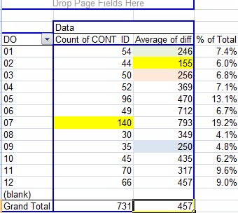
Time from Formal Acceptance to Final Payment

Slide 17
Change Order in DRAFT status not modified since 12/31/12??? Are they still valid, if so get them finished and ready for review!!!
Start a change order, get ready for review and send it on it way!!!

Slide 18
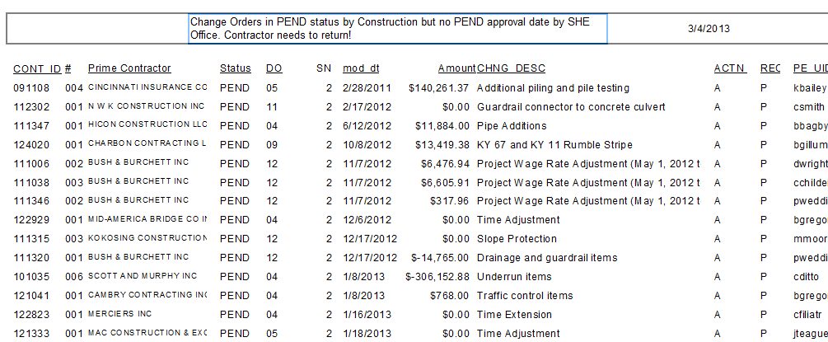
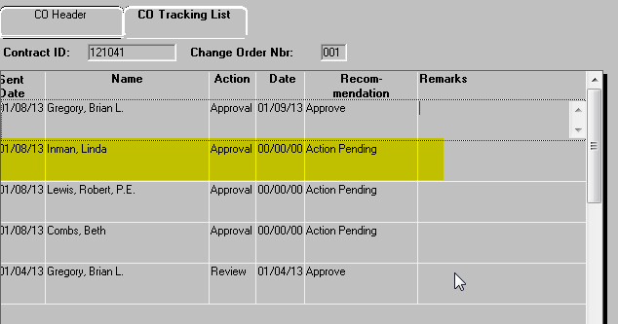

Slide 19
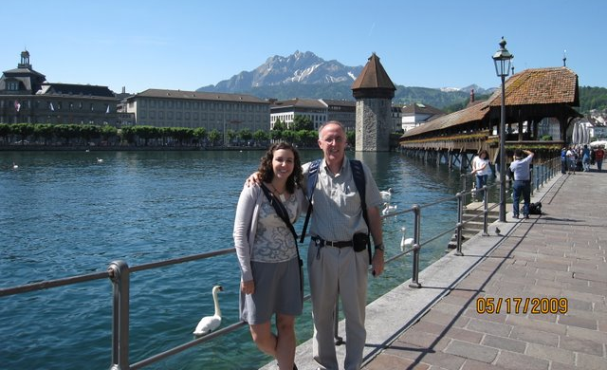
Robert C. Lewis, PE
Executive Advisor
200 Mero Street
TCOB 6th Floor West SHE Office
Frankfort, KY 40622
E-mail Bob.lewis@ky.gov
Cell 502-229-4809
Office 502-564-3730 ext 3029

